Slide 1

Constructing seamless MODIS LST maps for Australia from swath data
C. Bossung; K. Mallick; M. Schlerf
CCI LST User Workshop
24-26 June 2020

Slide 2
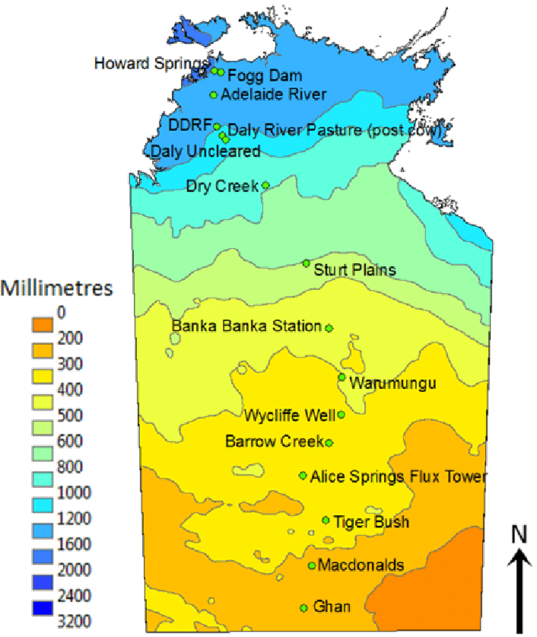
Original user case idea
Integration of CCI+ LST in a SEB model for simultaneous estimation of evaporation, transpiration and water stress, and validation across an aridity gradient and multiple biomes.
Evaluation of SEB model in the context of multi-sensor CCI+ LST data uncertainty and spatio-temporal stability.
Comparing multi-sensor CCI+ LST with Insitu LST
Source: Rogers, C. & Beringer, J. (2017), Biogeosciences, 14, 597-615, 10.5194/bg-14-597-2017.

Slide 3
Outline
Project overview
Challenges for the creation of the daily mosaics
Processing-Step 1: Re-ordering/structuring the data files
Processing-Step 2: Generating of daily pan-Australian mosaics
Pan – Australian mosaics: first impressions
Conclusions

Slide 4
Challenges: creation of daily pan – Australian mosaics
File structure on server: for each day all datasets in one folder
Separation btw. MODIS - Aqua / Terra; btw. MODIS and others (ATSR and Sentinel-3 SLSTR)
Distinguish btw. day and night observation; calculating overpass times in UTC
Unclear geo-location in the filename
Strategy: Mosaic all images of each sensor to a respective daily day- and night-time pan-Australian LST mosaic to extract the test sites.
At the end 4 pan-Australian mosaics for each day

Slide 5
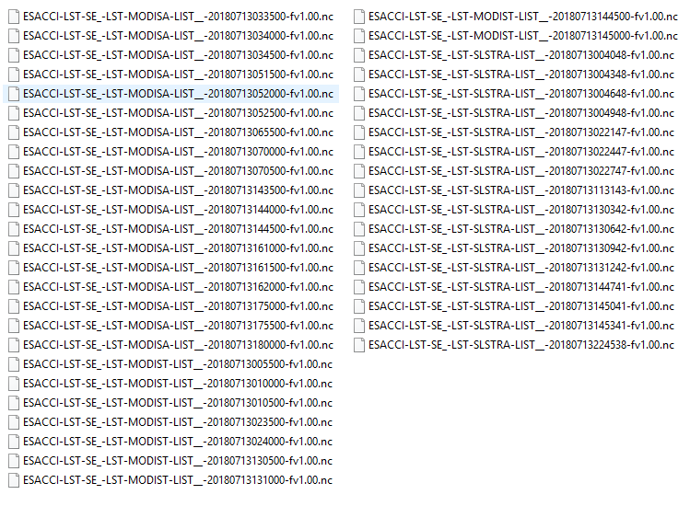
Processing-step 1.1: Re-ordering /structuring the data
Example of the file structure:
For each day all files are in one folder
Filenames does not indicate the geolocation to search directly for the sampling sites.

Slide 6
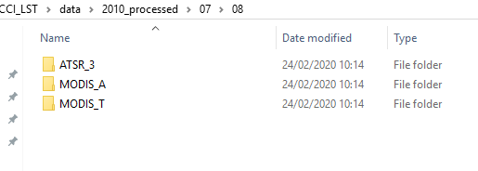
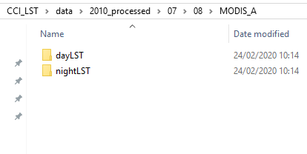
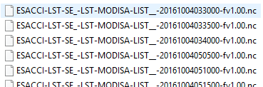
Processing-step 1.2: Sensor separation
Data transfer
Data downloaded for each day; consisting of MODIS – A / T and ATSR and SLSTRA (first 2016-10-29)
Filenames consisting name of satellite, platform, date and time (UTC)
Sensor
Date
Time

Slide 7
Processing-step 1.2: Sensor separation
Sorting/structuring
Structure needed: Sorting for each sensor and day / night observation
Sensor separation relatively easy with splitting the filename and moving the file into a separate folder
Sensor
Date
Time

Slide 8
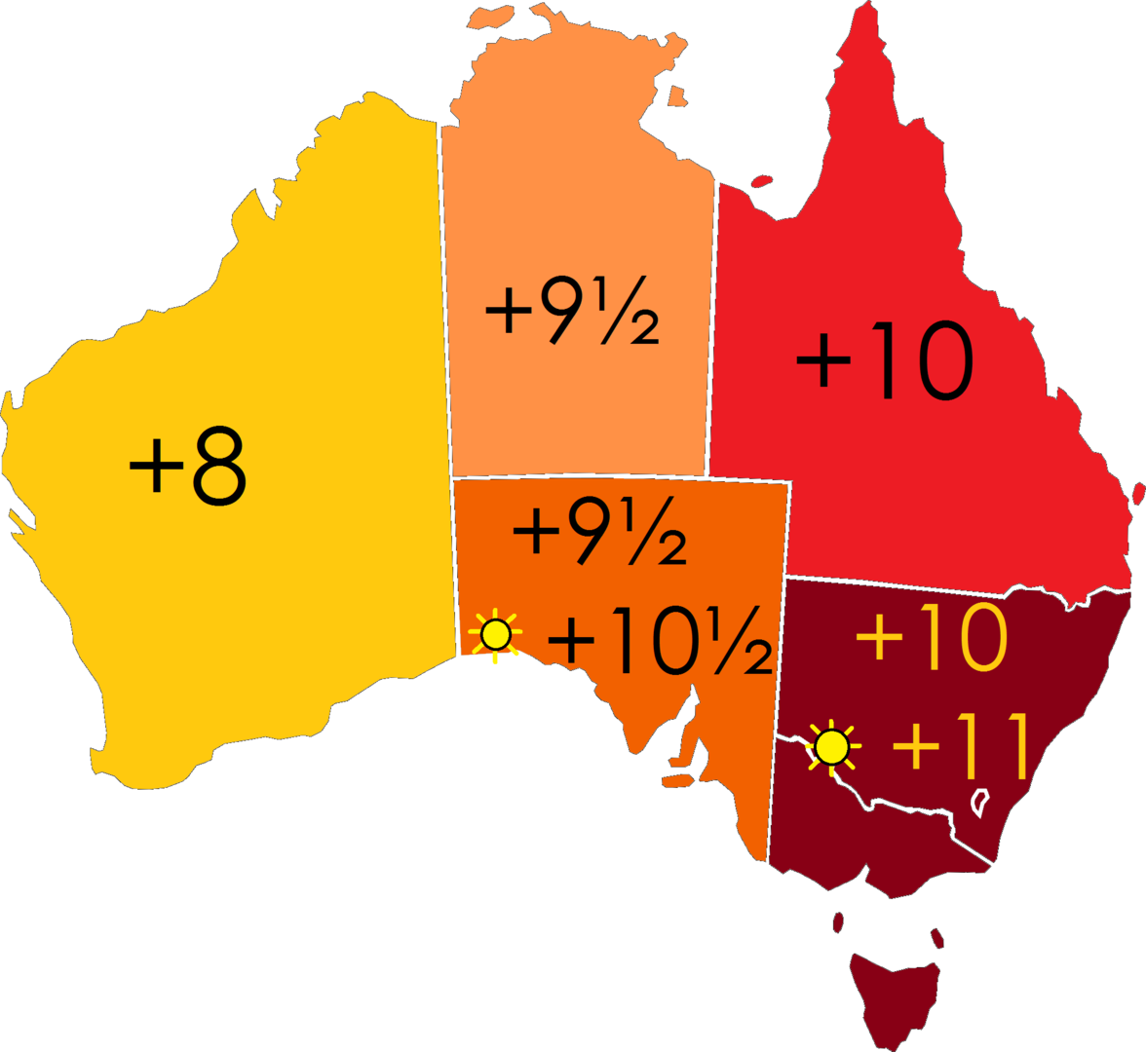
Processing-step 1.3: Calculating overpass in UTC; Day-night separation
Main problem: day / night separation; Filenames contain start time of the granule in UTC
Filenames in UTC, time in Australia:
  UTC : xhours, MODIS equatorial crossing time: Terra: 10:30, Aqua: 13:30 (local time)
  Australia time range:
    Terra (Day): 23:30 – 02:30 UTC
    Aqua (Day): 02:30 – 05:30 UTC
    Terra (Night): 11:30 – 14:30 UTC
    Aqua (Night): 14:30 – 17:30 UTC
Strategy: Calculate the potential overpass time for day / night observations in Australia in UTC time and search for this time range in the filenames
Source: https://en.wikipedia.org/wiki/Time_in_Australia#/media/File:Australia-states-timezones.png

Slide 9
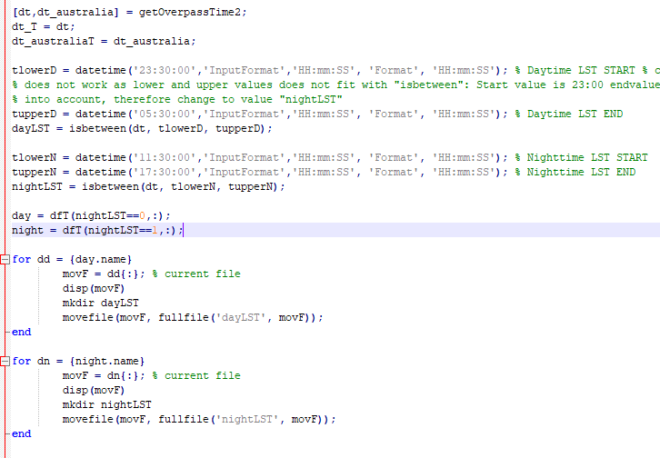
Processing-step 1.3: Calculating overpass in UTC; Day-night separation
Calculate Australian local time range:
Search for the files MODIS A / T in the day time-range and night time-range within the filenames (UTC)
Notes:
UTC + 8 hours W to UTC + 10/11 hours E; Matlab function: getOverpassTime2.m

Slide 10
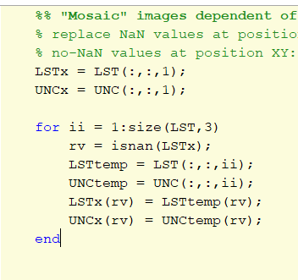
Processing-step 2: generating daily pan-Australian mosaics
All files (MODIS A/T) have the same geographic extent.
Each day consists of four observations MODIS-Aqua / Terra and day / night
Method: Replace NaN values of the first LST file with LST values of the other datasets in the respective folder (Aqua day / night; Terra day / night)
- With each iteration the search for NaN values is updated
Notes:
Easier to extract the test sides, as we were not able to figure out the extent of each raw file.

Slide 11
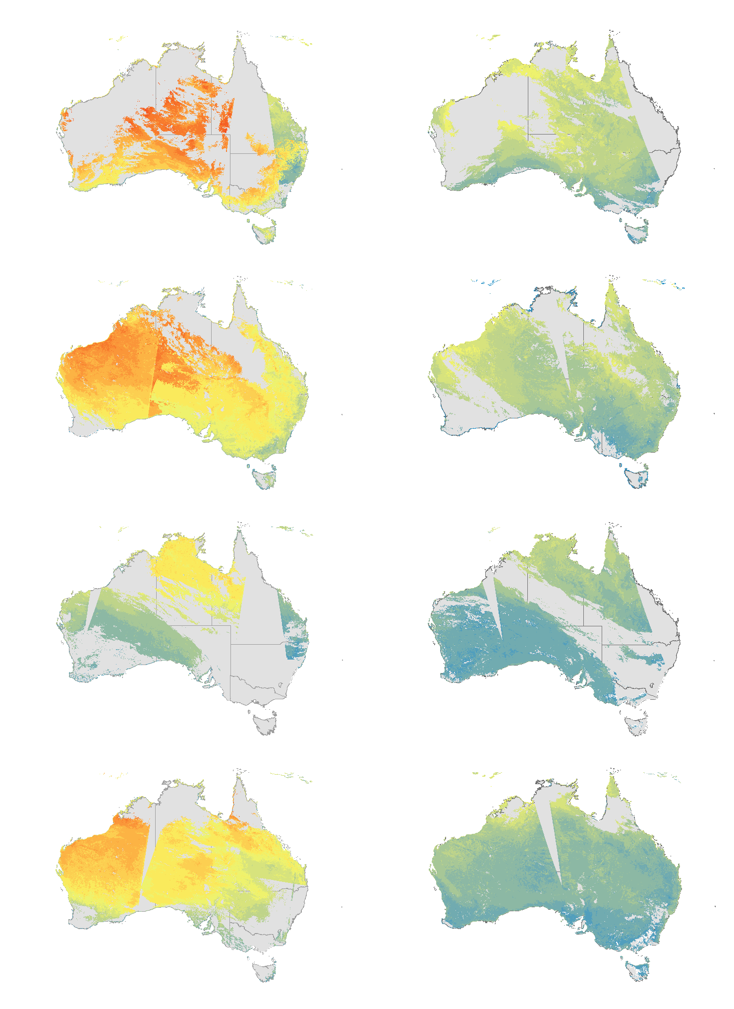
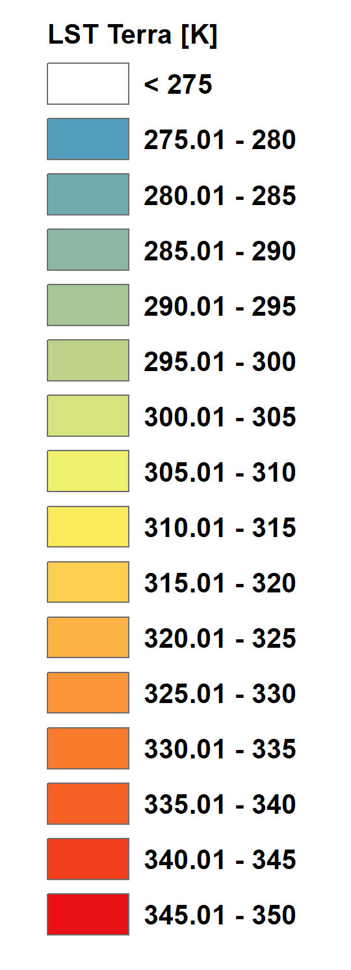
Examples: MODIS Terra LST
Day
Night
Jan 07, 2016
Apr 04, 2016
Jul 10, 2016
Oct 04, 2016

Slide 12
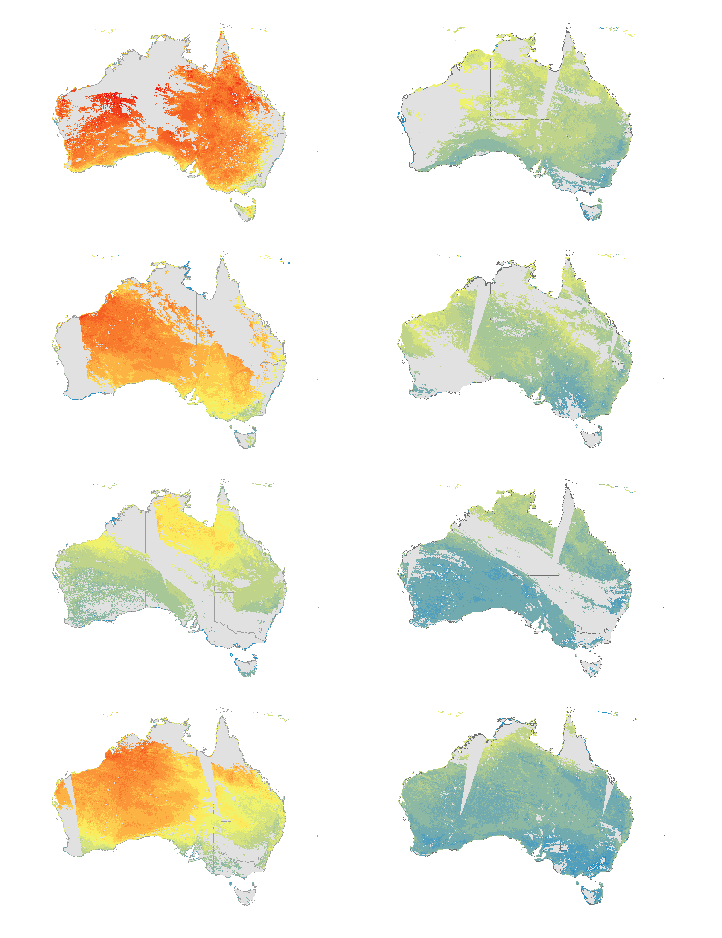
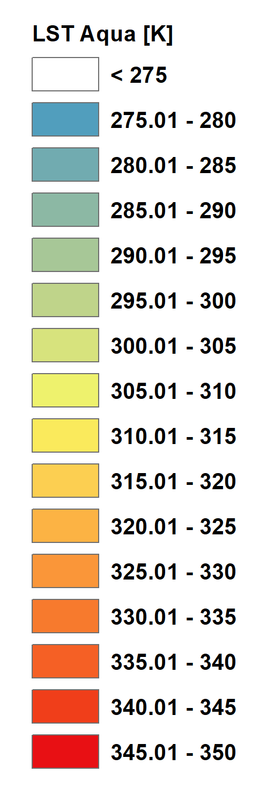
Examples: MODIS Aqua LST
Day
Night
Jan 07, 2016
Apr 04, 2016
Jul 10, 2016
Oct 04, 2016

Slide 13
Conclusions and Follow up work
Seamless mosaics of MODIS Terra and Aqua day and night LST for Australia were produced for the period of 1 Jan 2001 – 31 Dec 2016.
The mosaics
Serve as input to further SEB modelling and stress index calculations
Allow to analyze LST and ET patterns along aridity gradients
Post lockdown:
Subsetting at least two sites in the north and the south Australia; Insert LST data into a non-parametric surface energy balance model

