Slide 1
Sensitivity of diurnal cycle of LST to the soil moisture detected from combined LST, SM, precipitation observations
Y. Zhao, F. Cheruy LMD/IPSL
LST_cci User Workshop 2020
24-26 June 2020

Slide 2
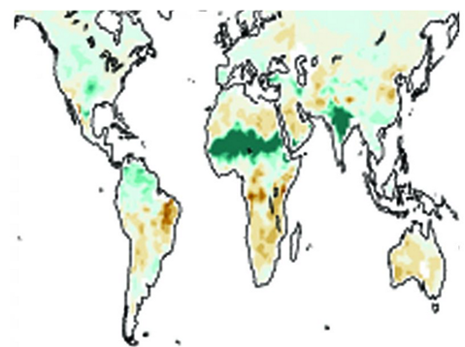


Can we use combined LST, SM, PRECIP data to detect the contribution of soil thermal inertia which is strongly dependent on soil moisture to daily variations in nighttime minimum temperature?

Slide 3
Combined instantaneous LST, superficial soil moisture and precipitation are used to identify dry spells and explore the sensitivity of the LST to the superficial soil moisture.
 | Resolution | Region | Period
LST CCI SEVIRI MSG L3 data (MSG_SEVIRI_L3U) | 0.05 ° spatial Hourly temporal | 81.125 ° W-E 81.125 ° N-S | 2008-2010
ESA CCI Surface Soil Moisture COMBINED Product (fv04.5) | 0.25 ° spatial Daily temporal | Global | 1979-2018
Tropical Rainfall Measuring Mission (TRMM) V7 | 0.25 ° spatial 3-hourly temporal | 81.125 ° W-E 50 ° N-S | 2008-2010

Slide 4
Identify dry spells to isolate the effect of SM on LST Find the dry day when the mean daily rainfall is below 0.5mm at 0.25° resolution. At least 10 consecutive dry days for one dry spell. Select dry spell days to calculate the linear regression coefficient between LST (daily maximum, minimum and magnitude) and SM The day without the missing value for 24 hours LST. The day without the missing value for daily SM. The day is in the dry spell period.

Slide 5
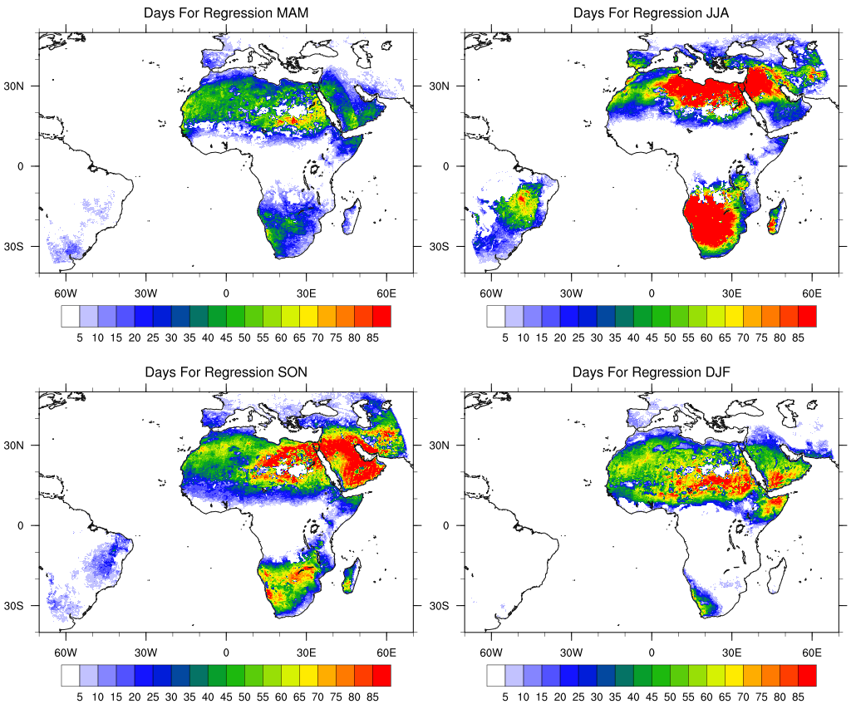
Selected dry spell days of 4 Seasons in 3 years for linear regression coefficient

Slide 6
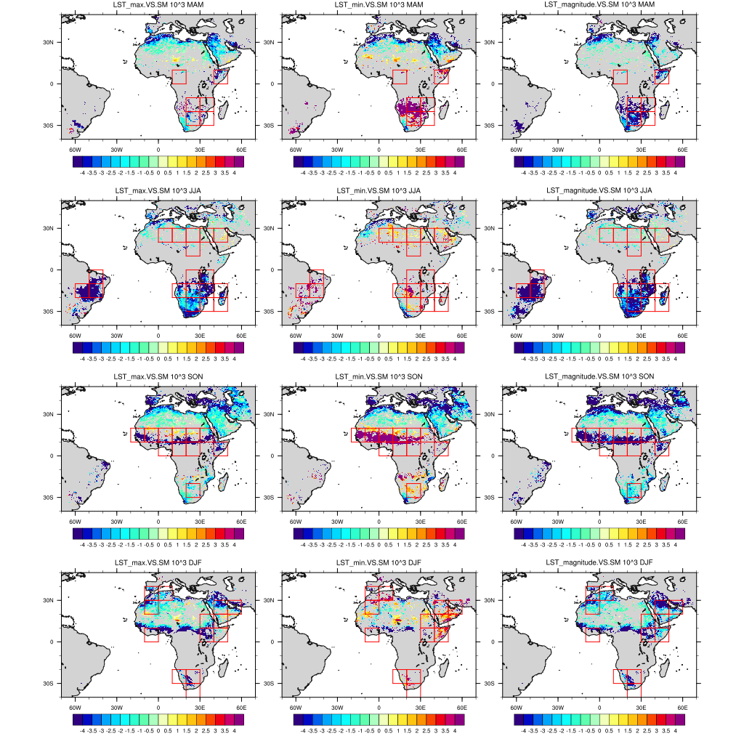
The linear regression coefficient between LST_max and SM (left), LST_min and SM (middle), and, LST magnitude and SM(right), with the probability larger than 60%.

Slide 7
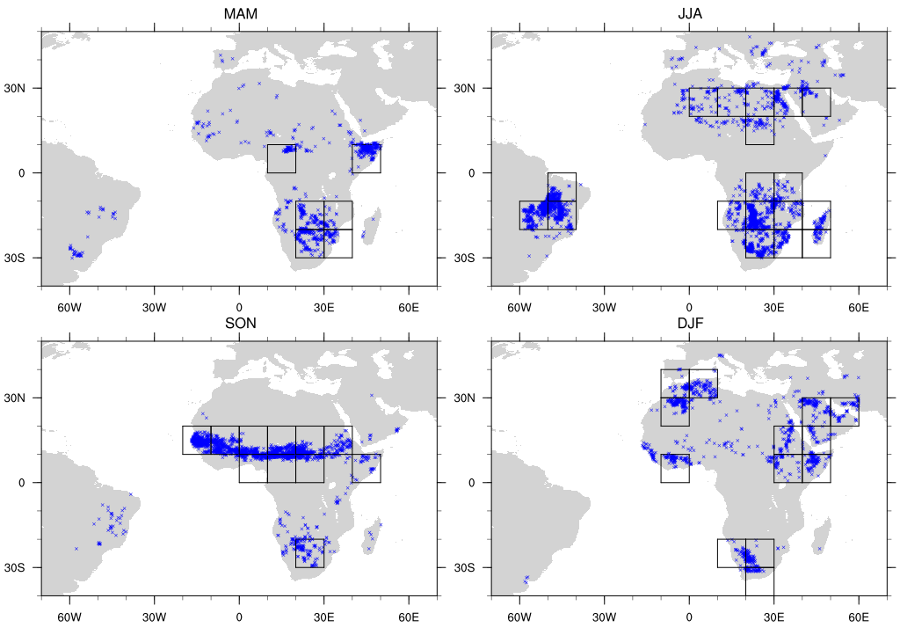
Target grid: LST_max.VS.SM negative LST_min.VS.SM positive LST_magnitude.VS.SM negative The probability of linear regression coefficient larger than 90%.
For each target grid, we calculate the SM anomaly based on all selected dry spell days in one season.
Regions with at least 30 target grids with significant statistics are identified.
For each region, all the target grids and all negative (or positive) SM anomaly days are averaged.

Slide 8
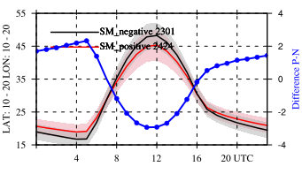
SON
Evaporative cooling effect
JJA
F. Cheruy et al. 2017
Soil moisture/thermal inertia effect

Slide 9
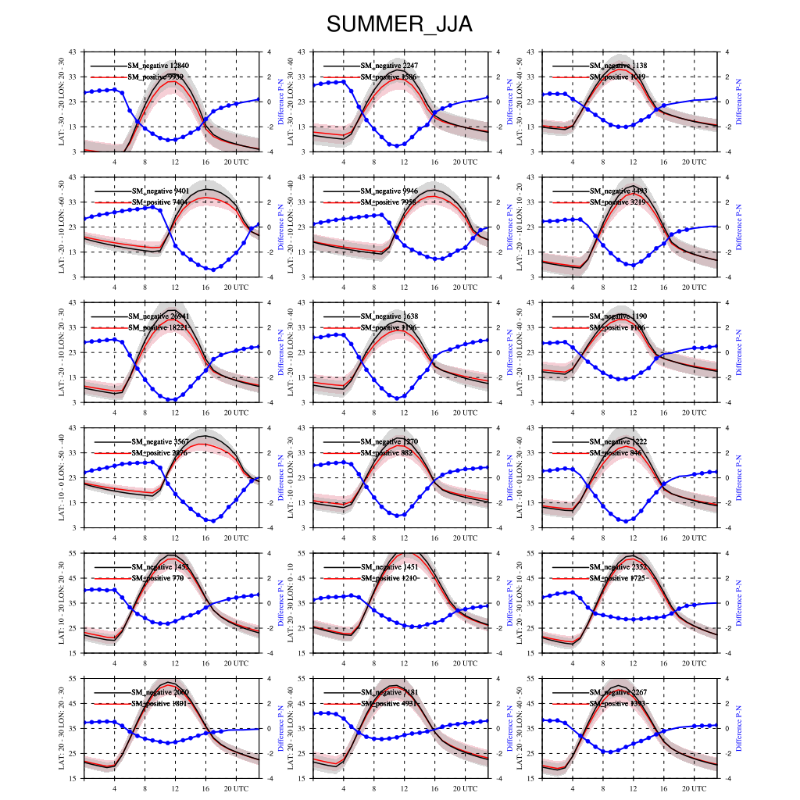
JJA

Slide 10
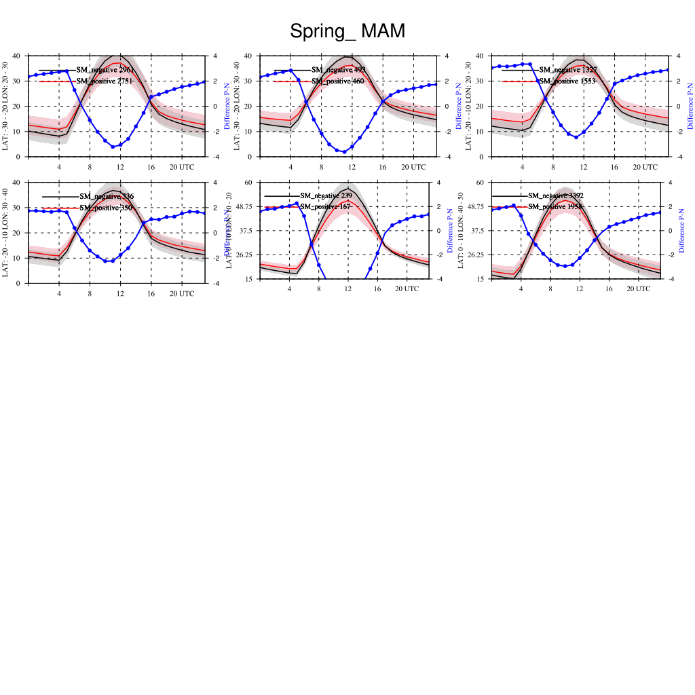
MAM
Evaporative cooling effect
Soil moisture/thermal inertia effect

Slide 11
Summary When superficial soil moisture increases, nocturnal effect and daytime cooling effect are detected over some semiarid regions with a good confidence. The linear regression coefficient between LST_max and SM is negative (cooling effect of evaporation, and high thermal inertia) The linear regression coefficient between LST_min and SM is positive (damping effect of the thermal inertia)

Slide 12
Next…… -> Not a lot of observation data can be used over Sahel during JJA. -> A noteworthy negative nocturnal feedback between soil moisture and temperature in so-called “hot-spot” regions of land-atmosphere coupling was detected during JJA (F. Cheruy et al. 2017), but the similar feedback in observation was detected during SON. -> Use a longer period LST to verify the results. -> Take into account the land cover class.

