Slide 1

Recent progress on the global ET product with the thermal energy balance method
Xuelong Chen

Slide 2
1. Thermal remote sensing energy balance ET model
2. ET model improvments over forest
3. A daily global land ET data
4. Error source for the global ET data
5. Summary

Slide 3

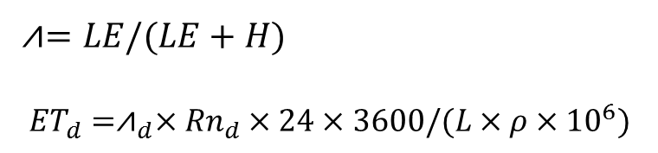

1. Thermal remote sensing ET method
$Rn=\left(1−α\right) SWD+ LWD−ε {LST}^{4}$
$H= u_{∗}ρC_{p}\left(θ_{0}−θ_{a}\right){\left[ \ln\left(\frac{z−d}{z_{0h}}\right)−Ψ_{h}\left(\frac{z−d}{L}\right)+Ψ_{h}\left(\frac{z_{0h}}{L}\right)\right]}^{−1}$
$G_{0}= R_{n}\left(f_{c }Γ_{c}+\left(1−f_{c})Γ_{s}\right)\right)$
LE = $R_{n }$- $G_{0 }$-H
Energy balance
⩘$=LE/(LE+H)$
$${ET}_{d}={\text{⩘}}_{d}×{Rn}_{d}×24×3600/(L×ρ×{10}^{6})$$
Daily evap.
(assume ${\text{⩘}}_{d}\text{=}\text{⩘}$)

Slide 4
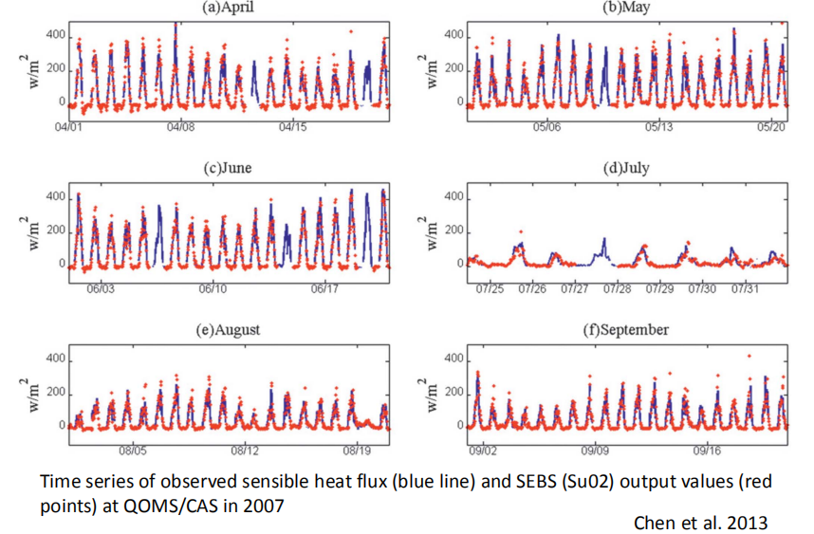
Evaluation over arid region

Slide 5
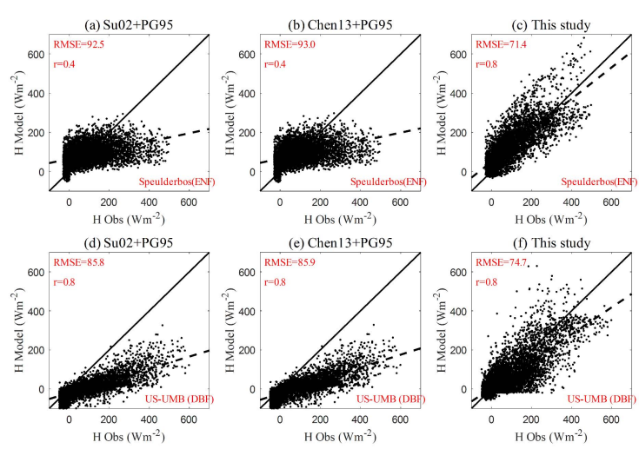
2. ET model improvments over forest
needle-leaf forest
broad-leaf forest

Slide 6
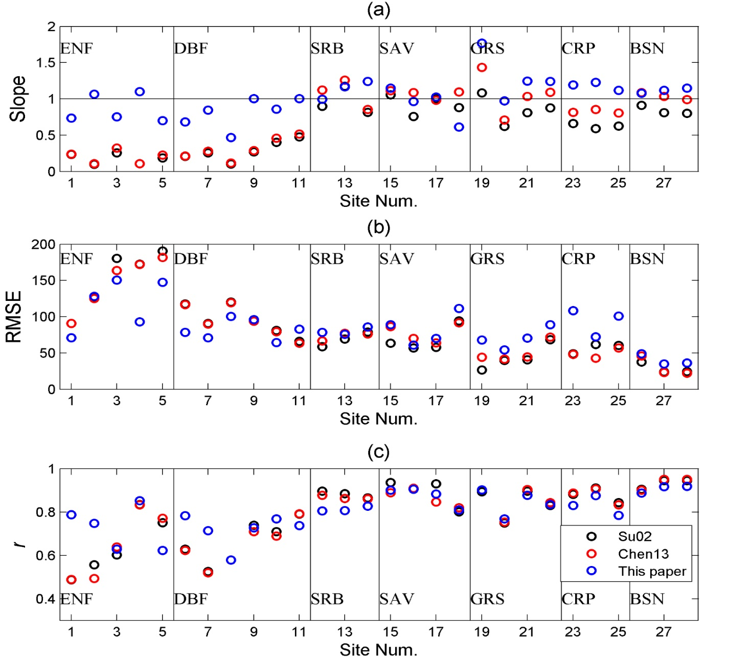
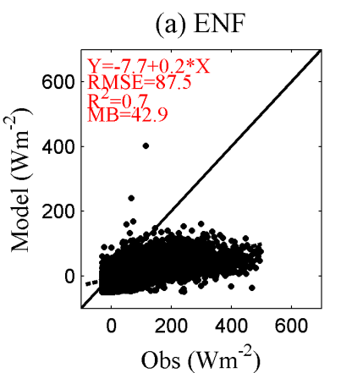
Linear fitting results from sensible heat simulations against obs. at 28 flux sites
ENF-evergreen needle leaf forest
DBF-deciduous broadleaf forest
SRB-shrub land
SAV-savanna
GRS-grassland
CRP-cropland
BSN-barren/sparsely vegetated
Linear fitting slope, RMSE, r derived from observation and model simulations. Each circle represents results of one flux tower.
Chen et al. 2019 JGR
Notes:
New model is better than its old version (Su02 and Chen13). The old version lowestimated sensible heat and overestimated latent heat and ET. New model solved the problem of high ET estimation.

Slide 7
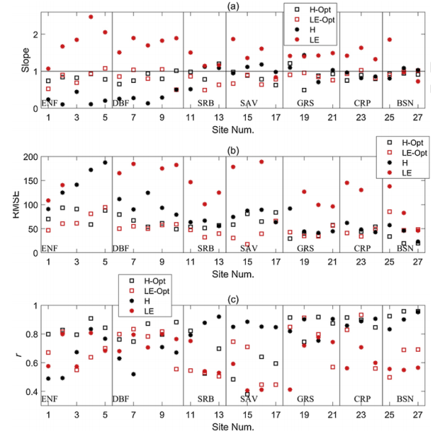
Chen et al. 2019,AFM

Slide 8
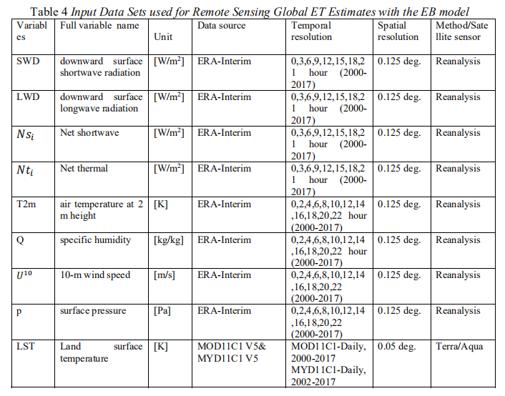
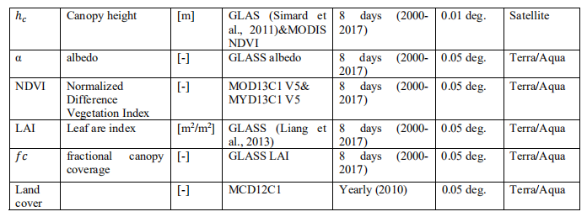
3. A daily global land ET data

Slide 9
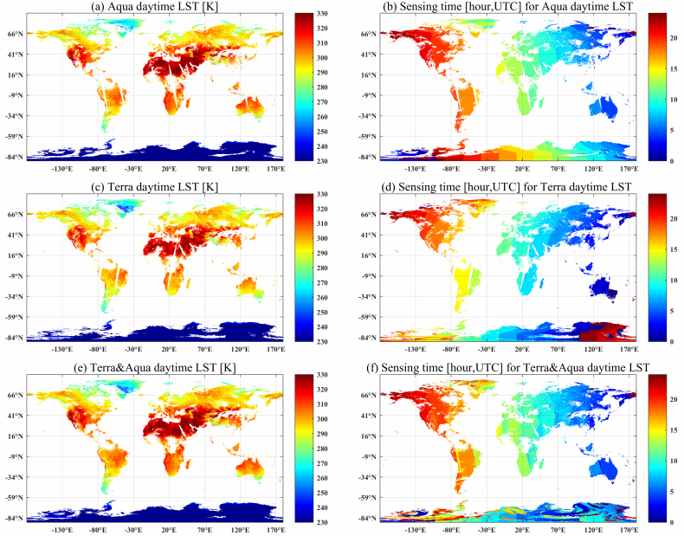

Slide 10
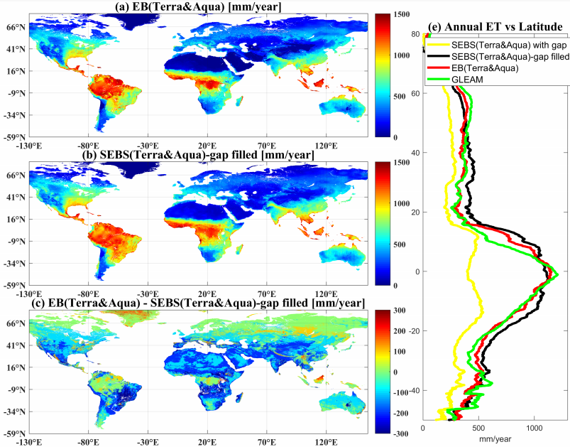

Slide 11
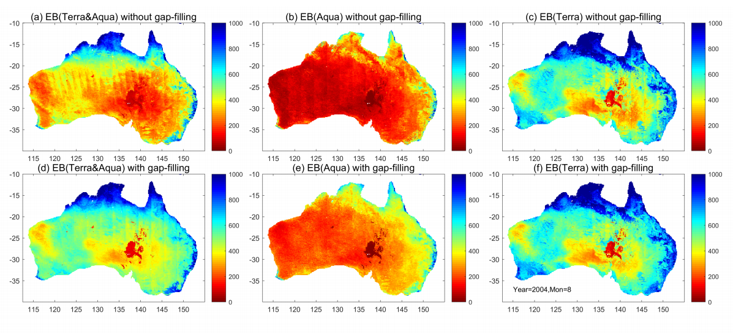
Benefits of the EF gap-filling

Slide 12
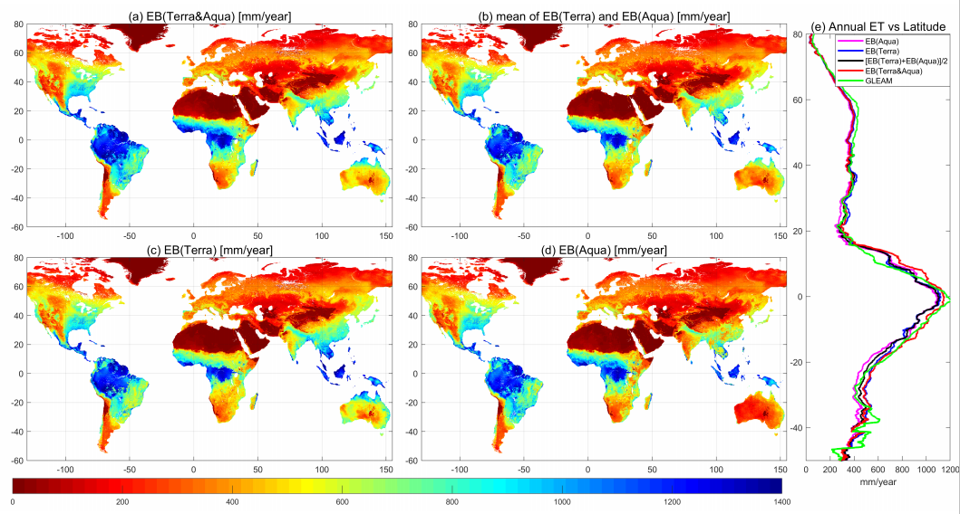

Slide 13
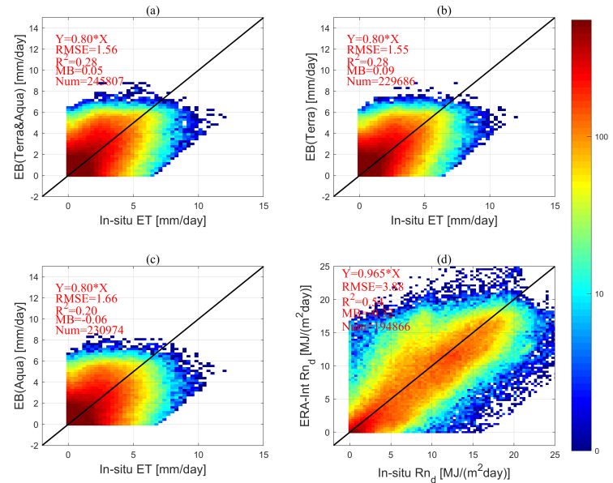

Slide 14
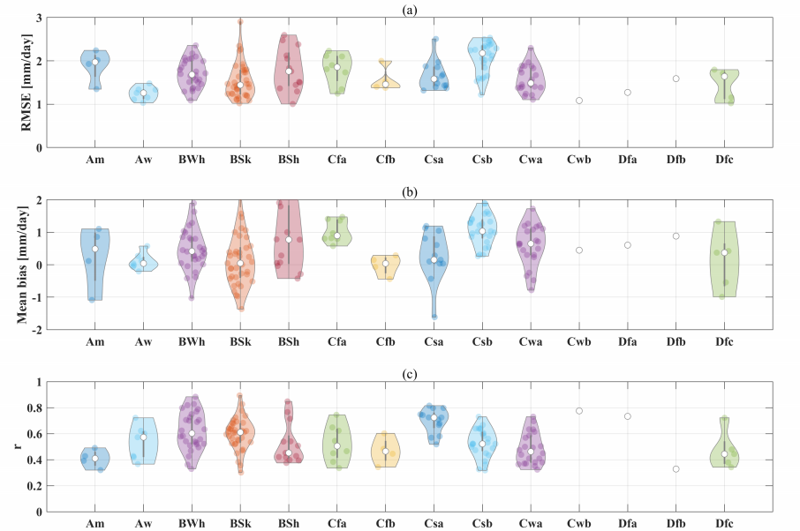
Koeppen–Geiger climate Classification

Slide 15
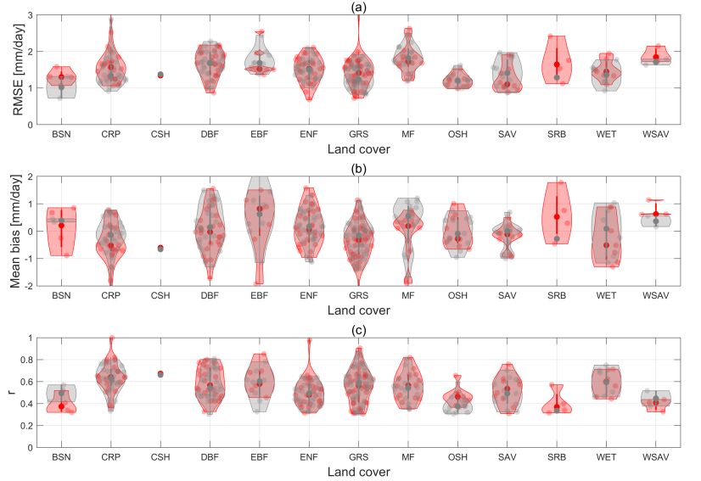

Slide 16
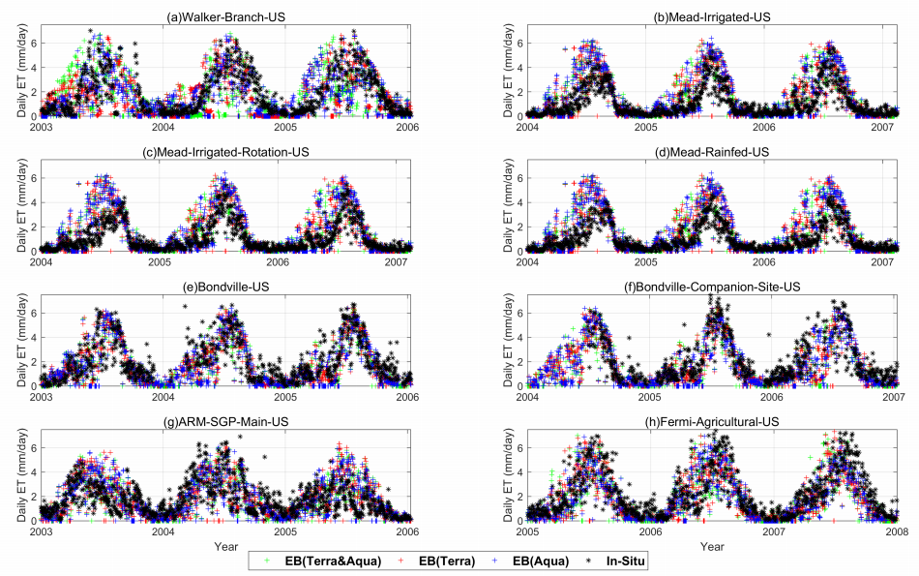

Slide 17
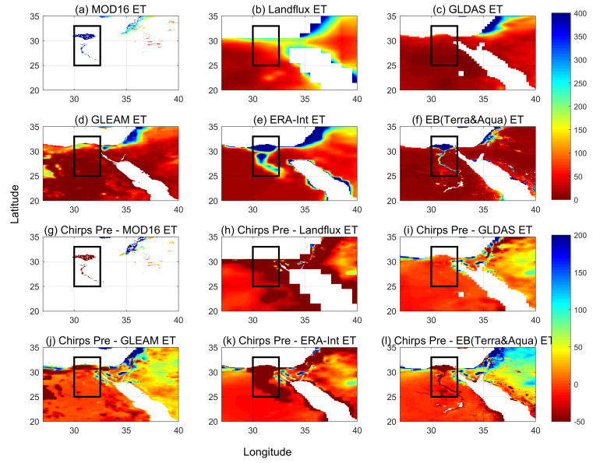

Slide 18
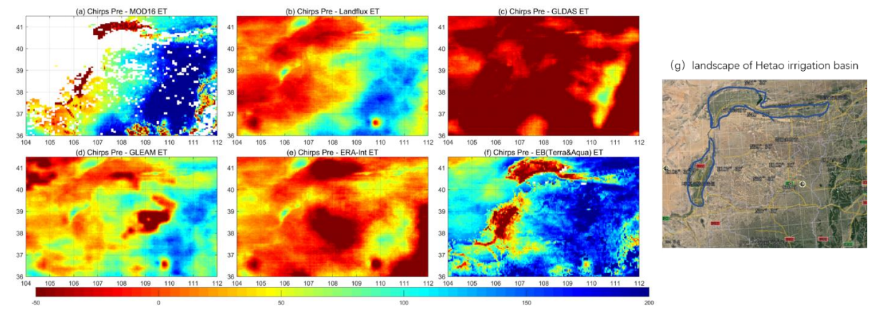

Slide 19
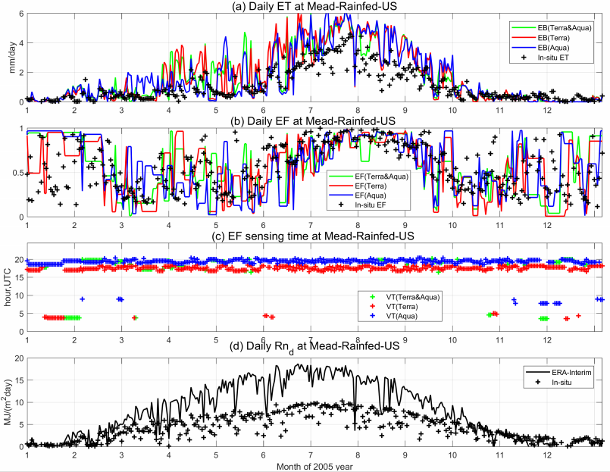
4. Error source for the global ET data

Slide 20
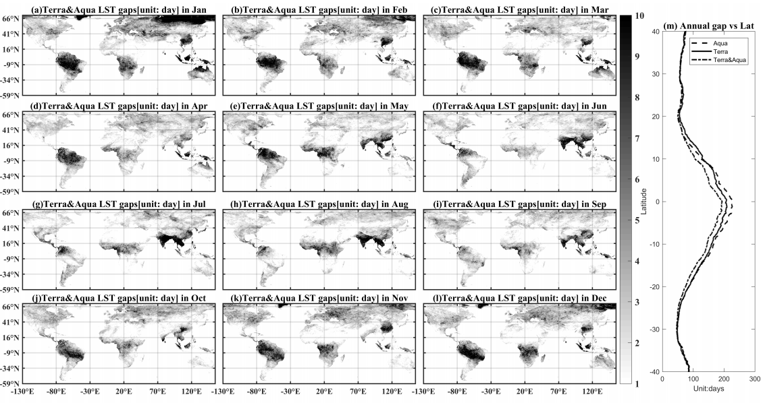

Slide 21
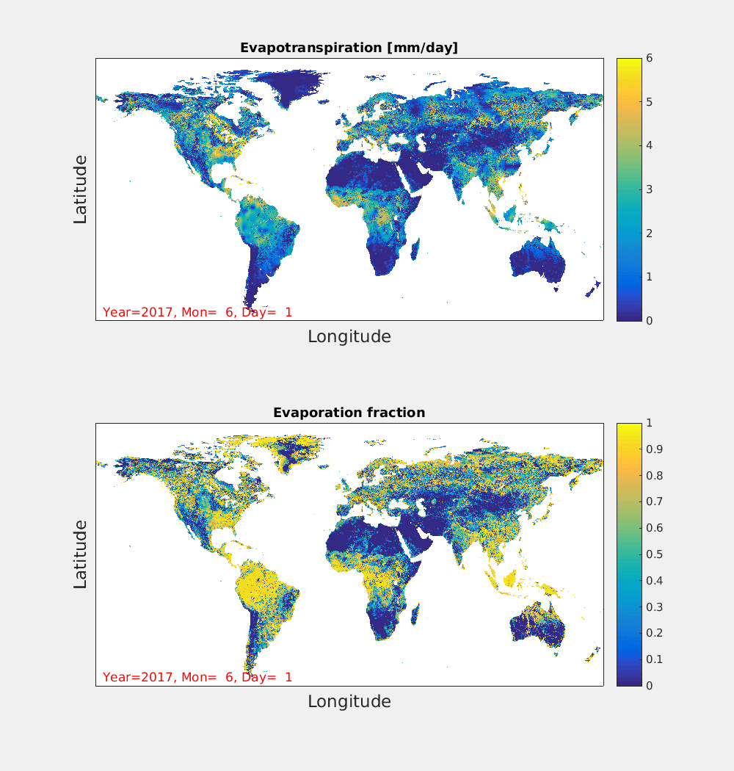

Slide 22
Summary
An energy balance (EB) model has been improved.
The thermal EB model can estimate daily ET for all weather conditions with gap-filling methods.
EB ET data has a higher potential for agriculture water resource management than most of the global ET product.
The error source for the ET could be radiation or LST gaps.
Xuelong Chen, Zhongbo Su, Yaoming Ma, Isabel Trigo, Pierre Gentine, Remote Sensing of Global Daily Evapotranspiration based on Surface Energy Balance Method and Reanalysis data, JGR (under review)
The ET data is available at : http://en.tpedatabase.cn/portal/MetaDataInfo.jsp?MetaDataId=249454

Slide 23
