Slide 1
Findings from the LST_cci User Requirements Assessment
Freya Aldred & Lizzie Good
Met Office Hadley Centre

Slide 2
Background
The CCI projects have a very clear path to product development.
A User Requirements Document (URD) is drafted early in the project.
The aim of this document is to provide requirements for the development of the products in the CCI project.
The URD is used to inform the Product Requirements Document (PRD), which are the basis of all the CCI products.
In LST_cci, the URD was drafted in Autumn 2018 and released to the public in early 2019. It can be found here:
http://cci.esa.int/sites/default/files/LST-CCI-D1.1-URD%20-%20i1r1%20-%20User%20Requirement%20Document.pdf
(or navigate http://cci.esa.int/lst -> Resources, data and documents)

Slide 3
Approach to Requirements Gathering

Slide 4
Approach
Based on the approach used for GlobTemperature (Bulgin & Merchant, 2016)
Review of existing requirements, e.g. GlobTemperature, literature, GCOS
Short paper survey issued at the Joint Land Workshop (IPMA, 2018)
22 responses
Longer online survey
76 responses from all over the world
Structured interviews with LST_cci Climate Research Group (CRG)
8 interviews

Slide 5
Climate Research Group (CRG)
Each CCI project has a Climate Research Group (CRG)
The groups consists of users from different application areas
In LST_cci, this group has been a core part of the requirements gathering process. Most of the group are funded through the project to conduct user case studies (UCS).
UCS aims: to use the LST_cci data products, provide valuable feedback to the LST_cci project team on data quality, issues, etc, and publish the study in the peer-reviewed literature.
There is an ongoing dialogue between the CRG and the LST_cci Project team, which has already allowed data issues to be identified and corrected.

Slide 6
LST_cci CRG
Met Office Hadley Centre – UCS: Global and Regional Trends
Danish Meteorological Institute – UCS: Greenland Ice Sheet Modelling
Ruhr University Bochum – UCS: Surface Urban Heat Islands
Max Planck Institute for Biogeochemistry – UCS: LST and Carbon Fluxes
MeteoRomania – UCS: Urban Heat Islands from satellites & other data
Luxembourg Institute of Science and Technology – UCS: LST and Surface Energy Balance Modelling
MetOffice Hadley Centre – CCI Climate Modelling User Group representative (LST and 2m-air temperature as an indicator of vegetation stress)
MeteoSwiss – Drought monitoring, intercomparison of CCI and Meteosat LSTs
The six LST_cci UCS partners will be presenting work during this workshop

Slide 7
LST_cci User Requirements
Requirements derived for LST_cci have the following unique identification:
LST-URD-<type>-<number>-<source>
<source> is the source of the requirement:
‘L’: Joint Land Workshop held in Lisbon
‘O’: Online questionnaire
‘I’: Interviews with members of the CRG
LST-URD indicates that the requirement or advice note has originated from this LST_cci User Requirements Document (URD)
<type> is the type of requirement:
“REQ”: A requirement that must be addressed. When questions are asked in terms of a threshold, breakthrough or objective requirement, the threshold requirement is used here.
“OPT”: An optional requirement that should be met where possible. This aligns with the breakthrough requirement definition.
“ADV”: An advisory requirement that should be considered where feasible. Used where requirements cannot be analysed quantitatively, for example interviews.
<number> is a two digit counter
Example: full traceability for requirement
ID | Requirement | Notes
Data Format and Accessibility
LST-URD-REQ-01-O | Provide LST products in NetCDF format | 90% of respondents were able to use NetCDF data

Slide 8
Definitions
Requirement Level | Definition
Threshold | The limit, beyond which, the data is of no use for the given application
Breakthrough | The level at which significant improvement in the given application would be achieved
Objective | The level beyond which, no further improvement would be of value for the given application
‘REQ’
‘OPT’
Term | Definition
Accuracy | The degree of conformity of the measurement to the accepted ‘true’ value. This is theoretical, as the true value cannot be known due to measurement error.
Precision | The closeness of agreement between independent measurements of a quantity under the same conditions.
Stability | The consistency of LST measurements from a given satellite product over time (including a product comprised of multiple satellite instruments)

Slide 9
Online Survey Results

Slide 10

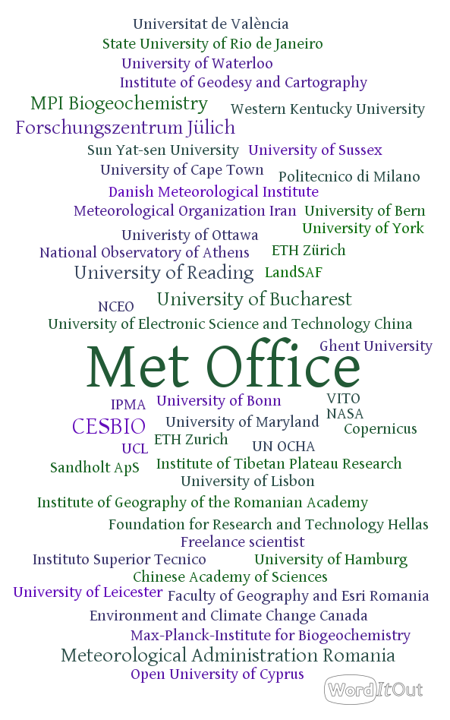

Online Questionnaire
Open from 17 Jul - 17 Sept 2018
77 responses

Slide 11
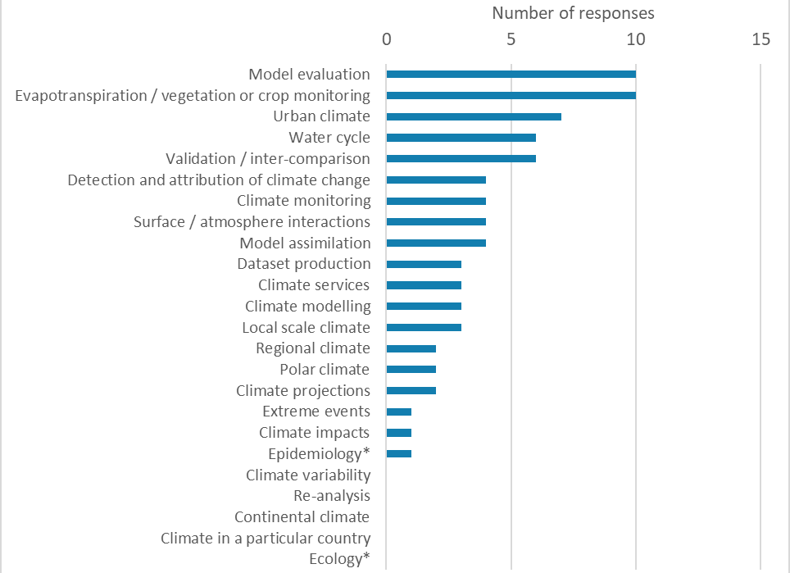
Primary Application Area
Please select the primary climate application from the list for which you use or intend to use LST data. This is the application we would like you to have in mind when you answer the rest of the survey.

Slide 12
Current Data Use
Majority of respondents are
Current users
Using MODIS data (many from GlobTemperature)
Using L2 (orbit) or L3C (spatio-temporal averages on regular grid)
Many respondents are using the data with land cover data
Quite a few respondents using the data with soil moisture or SST
Considerable interest in using other ECV products with LST

Slide 13
Concerns in Using LST Data
Concerns about using LST (in order of priority)
Spatial resolution is too low for my application
Retrieved LST’s may be contaminated with cloud, and therefore contain large errors
It is not clear to me exactly what satellite LST represents / I cannot relate satellite LST with other surface temperature data that I am using
Temporal resolution is too low for my application
There is a lack of appropriate or accurate uncertainty information
Dataset time series are not long enough
Satellite derived LST measurements are currently expected to be within 1-3 K of the ‘true’ LST, this is too large for my application
InfraRed datasets only include cloud-free LST’s and therefore my analysis of these data may be clear-sky biased
InfraRed datasets only include cloud-free LST’s and are therefore spatially incomplete
Stability is unknown / too poor for my application

Slide 14
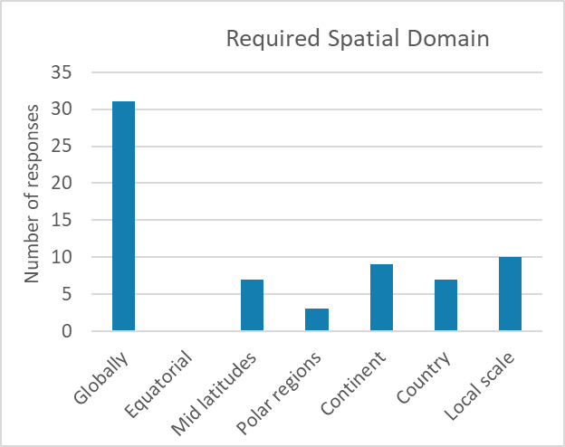
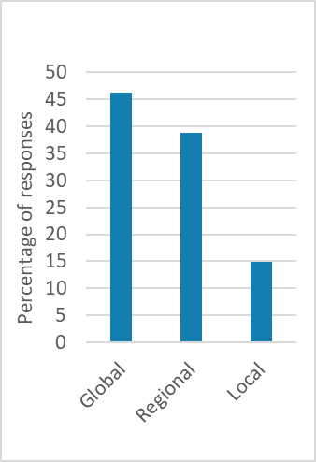
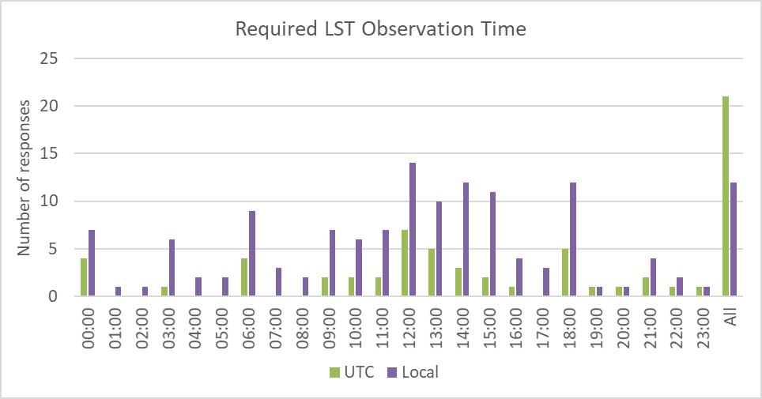
Spatial Scale and Required Times
n responses
% responses
Majority of users want global scale data, but a large number also require regional scale data
Requirement for observations at all hours.
Clear need for observations around solar noon.

Slide 15
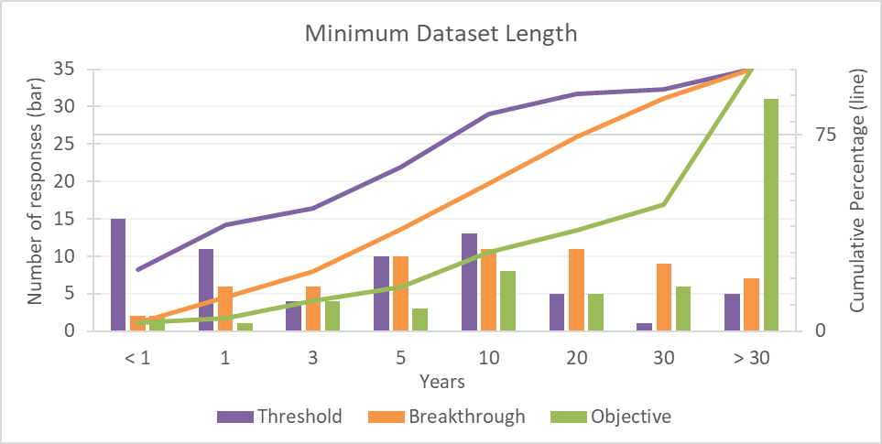
Example: Dataset Length
Threshold = 10 years
Breakthrough = 20 years
Objective = >30 years

Slide 16
All Specifications
Specification | Threshold | Breakthrough | Objective
Data set length | 10 years | 20 years | >30 years
Spatial Resolution | 1 km | <1 km | <1 km
Temporal resolution | 6 hours | 1 hours | < 1 hour
Accuracy | 1 K | 0.5 K | 0.3 K
Precision | 1 K | 0.5 K | 0.3 K
Stability | 0.3 K/decade | 0.2 K/decade | 0.1 K/decade
Clear preference for high-quality data over spatially-complete fields
Those working on global scales prioritise high temporal resolution and data set length
Those working at local scales prioritise high spatial resolution over high temporal resolution, and high temporal/spatial resolution over data set length

Slide 17
Data Format and Metadata
Clear requirements to provide L2 and L3c data.
Provide data in standard CCI format (NetCDF)
QC flags (priority order):
Day / night
Summary cloud
Summary confidence
Land
Aerosol
Water body
Snow/ice
Requirement for quality information (e.g. best quality, bad data, worst quality, low quality, etc) at both the pixel and file level

Slide 18
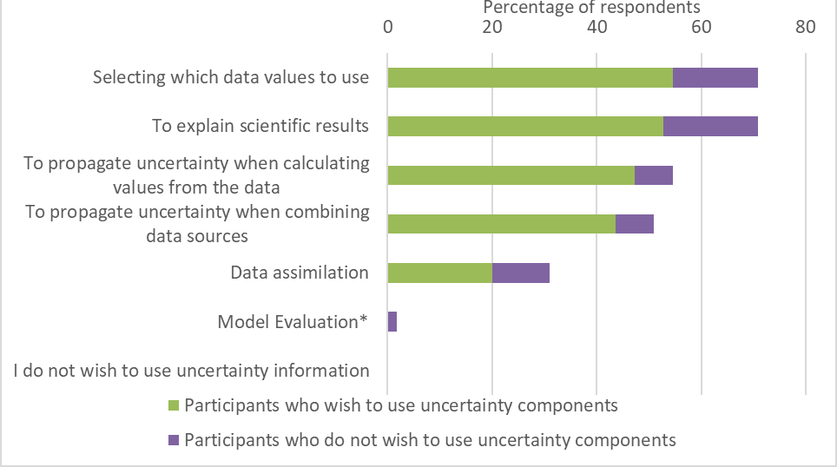
Error and Uncertainty
Survey suggested that many users – but not all - are using uncertainty information.
Most respondents wanted uncertainty components (uncertainties partitioned by correlation properties). Most of these would make use of the total uncertainty alongside other components
Requirement for clear documentation on uncertainties, including descriptions of the data, how to use them and worked examples.
Intended use of uncertainty data separated by the requirement for total uncertainty budget only, and the provision of uncertainty components

Slide 19
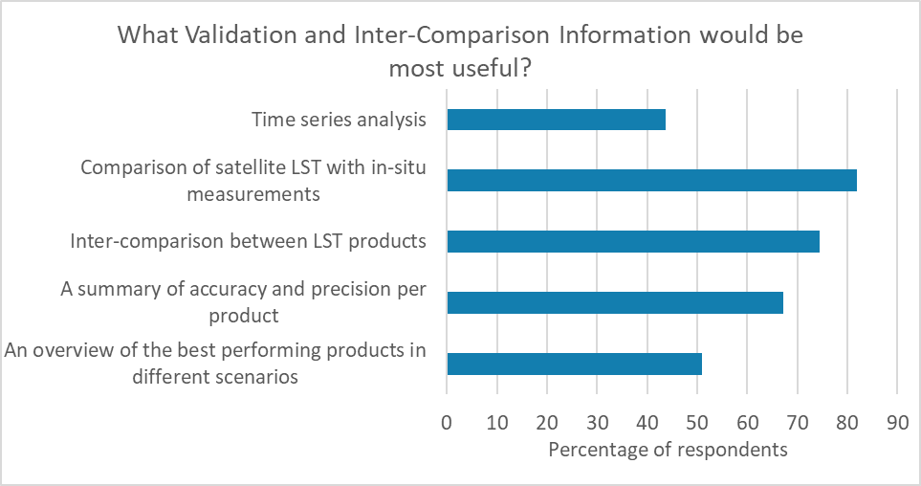
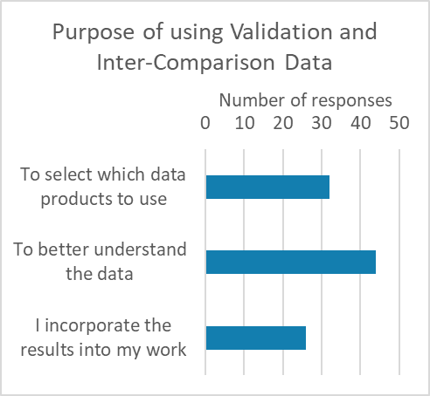
Validation and Intercomparison
Vast majority of respondents make use of validation and inter-comparison results provided with data sets.
Requirement for information on how to use the data and sometimes more information (e.g. difficulty in interpreting L3 data with temporal averaging and local overpass time is not present).

Slide 20
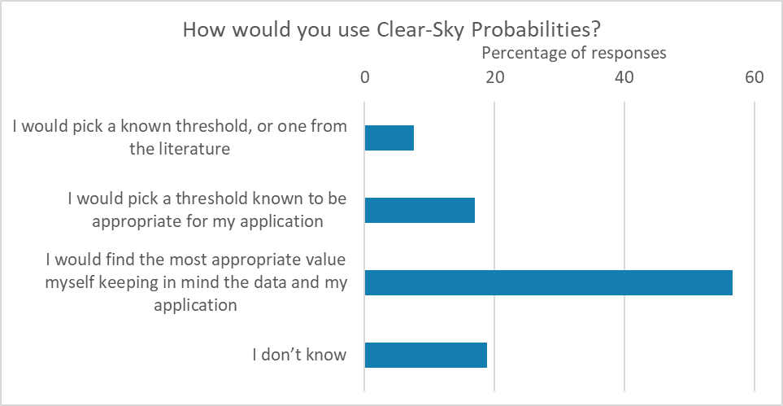
Clouds
Requirement for both binary cloud mask and probabilistic information
Descriptions and worked examples required to use clear-sky probabilities
80%, 90% and 95% were the most popular probabilistic thresholds suggested in the survey.

Slide 21
Reflections
Online survey a good way to review user requirements
High numbers, global reach
Quantitative way to define user requirements with clear traceability
Some users might not know exactly what they require, e.g. accuracy, but the ensemble of answers is likely to give a good indication.
Users require short-ish surveys, ideally <15 mins, ~30 mins is probably too long (LST_cci survey was about this length).
A online survey is quite restrictive in some ways, therefore it is useful to combine survey results with other approaches to requirements gathering, such as discussions with users.

Slide 22
Breakout Questions
What requirements did we miss in our requirements gathering exercise? (Most are covered in this presentation, but also see complete list of requirements at the end of this presentation)
What spatial resolution is required for different applications? How useful is a 0.01 deg global product, given the huge data volumes involved?
Are you using the beta LST_cci data sets? If so, do you have any feedback? If a previous user of GlobTemperature data, are you finding it easy to adapt to the different CCI format?
CCI does not provide an operational service and the climate data records (CDRs) are typically fixed-length data sets. If LST_cci data can be made available in more ‘real time’, what timeliness of data would you ideally require?
Is there any requirement for component LSTs in gridded data sets? For example, providing the average LSTs for each primary surface type (e.g. grassland, deciduous forest, etc) within each grid cell?

Slide 23
LST_cci Requirements
(Included here for reference)

Slide 24
Data Format and Accessibility Requirements
ID | Requirement | Notes
Data Format and Accessibility
LST-URD-REQ-01-O | Provide LST products in NetCDF format | 90% of respondents were able to use NetCDF data
LST-URD-ADV-01-O | CCI standard format is recommended for LST_cci products | 52 participants currently use CCI products, 32 use these in conjunction with LST data
LST-URD-ADV-02-OI | Disseminate clear information on what LST data represents, potential applications and how the data may be used | Aim to improve understanding of what LST data represents
LST-URD-ADV-03-I | Provide documentation detailing assumptions made during the retrieval process or product construction, including detailed information on any techniques used for merging | Aim to make it as easy as possible to understand the data
LST-URD-ADV-04-LI | Ensure long term, easy access to data | GlobTemperature portal suggested as a good model
LST-URD-ADV-05-O | Provide a summary of the availability and characteristics of different LST products
LST-URD-ADV-06-LI | Consistency should be maintained between different LST products within LST_cci | Users often require data from multiple sensors
LST-URD-ADV-07-OI | Consistency between LST_cci and other CCI products should be maintained | 32 participants use CCI ECV products in conjunction with LST data
LST-URD-ADV-08-OI | Provide information on how comparable LST_cci products are with other CCI datasets, for example, spatial and temporal averaging, uncertainties, changes likely to impact LST (e.g. vegetation fractional cover)

Slide 25
Product Types
Product Types
LST-URD-REQ-02-O | Provide LST from IR LEO satellites | 68% of respondents are interested in these data
LST-URD-REQ-03-O | Provide LST from IR GEO satellites | 66% of respondents are interested in these data
LST-URD-REQ-04-O | Provide products which merge LST from multiple IR LEO satellite datasets to create a long running, near-global CDR | 54% of respondents are interested in these data
LST-URD-REQ-05-LO | Provide products produced by merging LEO and GEO datasets | 90% (Lisbon) / 63% (Online) of participants were interested in merged products
LST-URD-REQ-06-O | Provide LST data products at level 2 | 47% of respondents selected Level 2 data
LST-URD-REQ-07-O | Provide LST data products at level 3C | 55% of respondents selected Level 3C data
LST-URD-REQ-08-O | Data from MODIS instruments should be given high priority | 75% of respondents currently use MODIS LST data for climate applications
LST-URD-ADV-09-LI | Provide multi-decadal, homogenised datasets, free from non-climatic discontinuities | Long term, consistent datasets are required for climate science. Links to LST-URD-REQ-13-O and LST-URD-OPT-13-0
LST-URD-ADV-10-OI | Provision of MW LST products | 43% of respondents were interested in MW products
LST-URD-ADV-11-LOI | Provision of all-sky LST datasets | Some members of the CRG are gap-filling IR LST data sets already; a standard option would be useful 38% of respondents to the online survey are interested in a merged IR and MW product
LST-URD-ADV-12-O | Provision of Meteosat data | Meteosat was the second most popular instrument out of respondents currently use LST data for climate applications
LST-URD-ADV-13-O | Provision of Landsat data | Landsat was the third most popular instrument out of respondents who currently use LST data for climate applications
LST-URD-ADV-14-O | Provision of AVHRR data | To extent data record length

Slide 26
Specification
Data Specification
LST-URD-REQ-09-O | Provide global coverage of LST data | 47% of respondents require global data
LST-URD-REQ-10-O | Provide observations at all hours of the day | 52% of respondents requested observations at all hours of the day
LST-URD-REQ-11-O | Provide minimum dataset length of 10 years | Satisfies 82% of respondents at the threshold level
LST-URD-OPT-11-O | Provide minimum dataset length of 30 years | Satisfies 87% of respondents at the breakthrough level
LST-URD-REQ-12-O | Provide datasets with a spatial resolution of 1 km | Satisfies 83% of respondents at the threshold level
LST-URD-OPT-12-O | Provide datasets with a spatial resolution finer than 1 km | Satisfies 100% of respondents at the breakthrough level
LST-URD-REQ-13-O | Provide data with temporal resolution of 6 hours | Satisfies 75% of respondents at the threshold level
LST-URD-OPT-13-O | Provide data with a temporal resolution of 1 hour | Satisfies 94% of respondents at the breakthrough level
LST-URD-ADV-15-OI | Provision of LST observations close to solar noon / early afternoon should be prioritised | 31% of respondents who did not request observations at all times of day selected 12 noon: this option received the highest number of selections

Slide 27
Priorities
Data Quality Priorities
LST-URD-REQ-14-O | Provision of data with accuracy of 1 K | Satisfies 84% of respondents at the threshold level
LST-URD-OPT-14-O | Provision of data with accuracy of 0.5 K | Satisfies 87% of respondents at the breakthrough level
LST-URD-REQ-15-O | Provision of data with precision of 1 K | Satisfies 80% of respondents at the threshold level
LST-URD-OPT-15-O | Provision of data with precision of 0.5 K | Satisfies 85% of respondents at the breakthrough level
LST-URD-REQ-16-O | Provision of data with stability of 0.3 K | Satisfies 85% of respondents at the threshold level
LST-URD-OPT-16-O | Provision of data with stability of 0.2 K | Satisfies 88% of respondents at the breakthrough level
LST-URD-ADV-16-I | Improve accuracy of LST retrievals for urban and arid biomes | Current LST products often perform poorly for these land cover types
Data Specification Priorities
LST-URD-REQ-17-L | Product accuracy should be prioritised over long term stability and global spatially complete fields | 62% of participants agreed with this statement
LST-URD-REQ-18-O | High data quality should be prioritised over spatially complete fields | 67% of participants agreed with this statement
LST-URD-ADV-17-O | Datasets intended for global studies should prioritise high temporal resolution and long datasets | Of those requiring data globally: 56% prioritised high temporal resolution over spatial 63% prioritised long datasets over high resolution
LST-URD-ADV-18-O | Datasets intended for local studies should prioritise high spatial resolution | Of those requiring data for local studies: 75% prioritised high spatial resolution over temporal 88% prioritised high resolution over long datasets
LST-URD-ADV-19-O | Datasets intended for global studies should prioritise using a consistent approach to cloud clearing and provide a pre-screened dataset | Of those requiring data globally: 58% preferred a consistent approach to cloud clearing 56% preferred pre-screened data
LST-URD-ADV-20-O | Datasets intended for regional or local studies should prioritise using the best cloud clearing algorithm for each sensor, and allow the user to apply the cloud mask themselves | Of those requiring data for regional or local studies: 62% preferred a best for each sensor approach 61% preferred to apply a cloud mask themselves
LST-URD-ADV-21-LOI | Improvements in LST spatial resolution should be prioritised

Slide 28
QC, Error and Uncertainty
Quality Control
LST-URD-REQ-19-L | Provide LST data with quality flags | 64% of participants would use quality flags
LST-URD-REQ-20-O | Provide the following QC flags (in order of preference): Day / night Summary cloud Summary confidence Land Aerosol | Participants were asked to order the importance of these QC flags
LST-URD-REQ-21-O | Provide the following QC flags in addition to the above: Water body Snow / ice | 75% of participants requested a water body flag 66% of participants requested a snow / ice flag
LST-URD-REQ-22-O | Provide LST data with QC level data on a pixel level | 93% of participants requested these data
LST-URD-REQ-23-O | Provide LST data with QC level data on a file level | 69% of participants requested these data
Error and Uncertainty
LST-URD-REQ-24-LO | Provide per pixel total uncertainty values | 73% requested this data
LST-URD-REQ-25-O | Provide uncertainty data partitioned into components according to correlation properties | 72% of respondents required more than just a total uncertainty Interviewees also expressed interest in these data 27% of Lisbon survey respondents requested this information
LST-URD-REQ-26-O | Uncertainty information should be provided with clear documentation including descriptions of how to use the data and worked examples | 93% of participants requested descriptions of how to use uncertainty data 64% of participants requested worked examples
LST-URD-ADV-22-I | Provide detailed information on how uncertainties are calculated
LST-URD-ADV-23-OI | Provide information on what the uncertainties represent and why they are useful
LST-URD-ADV-24-O | Provide information about spatial and temporal structure of the uncertainty components | Comment left by a participant
LST-URD-ADV-25-LOI | Include cloud effects in uncertainty data

Slide 29
Validation/Inter-comparison and Clouds
Validation and Inter-comparison
LST-URD-REQ-27-OI | Provide comparisons of satellite LST data with in-situ measurements as part of the validation and inter-comparison results | 82% of respondents requested this information
LST-URD-REQ-28-O | Provide inter-comparisons between LST products as part of the validation and inter-comparison results | 75% of respondents requested this information
LST-URD-REQ-29-LO | Provide a summary of accuracy and precision per product as part of the validation and inter-comparison results | 67% of respondents requested this information 59% of respondents to Lisbon questionnaire Q.9 also requested this information
LST-URD-REQ-30-O | Provide an overview of the best performing products in different scenarios as part of the validation and inter-comparison results | 51% of respondents requested this information
LST-URD-ADV-26-O | Provide results from time series analysis | 44% of respondents require this information
LST-URD-ADV-27-O | Consider including validation of uncertainty components | Comment left by participant
LST-URD-ADV-28-O | Consider including validation of clear-sky probabilities | Comment left by participant
LST-URD-ADV-29-O | Where possible provide advice on how validation and inter-comparison results can benefit users, and how the results can be incorporated into their work
Clouds
LST-URD-REQ-31-O | Provide a binary cloud mask | 52% of participants requested both binary cloud mask and clear-sky probability
LST-URD-REQ-32-O | Provide clear-sky probabilities | 52% of participants requested both binary cloud mask and clear-sky probability
LST-URD-REQ-33-O | Where clear-sky probabilities are provided, include descriptions of how to use these data and worked examples | 89% requested descriptions 57% requested worked examples
LST-URD-ADV-30-I | Provide a description of what is represented by clear-sky probabilities and how they are calculated
LST-URD-ADV-31-O | Provide a recommended starting value to be used by users for cloud clearing, ideally for a set of different applications | Comment left by participant
LST-URD-ADV-32-LI | Investigate and provide information to users concerning clear-sky bias in IR LST data
LST-URD-ADV-33-LOI | Reduce errors due to cloud contamination in IR LST data sets | 73% were concerned about cloud contamination errors (Lisbon) Cloud contamination errors were the second highest concern in the online survey

