Slide 1
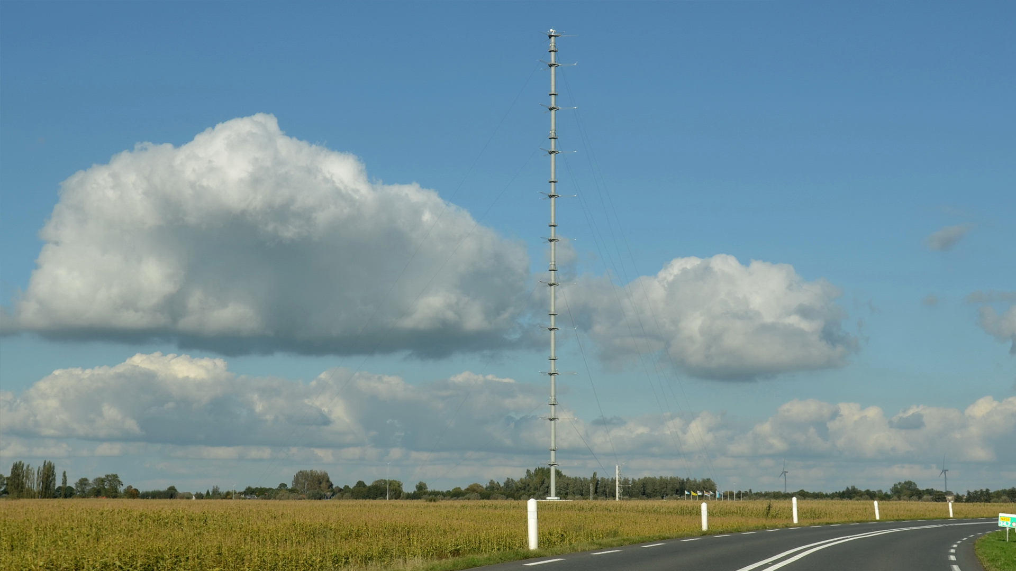
Validation of the All-Sky Land Surface Temperature product based on MSG/SEVIRI observations
João P. A. Martins (IPMA / LSA SAF)
with
Emanuel Dutra, Sofia Ermida, Isabel Trigo
Picture from Cabauw, The Netherlands (from https://ruisdael-observatory.nl/becoming-an-expert-in-your-field/)

Slide 2
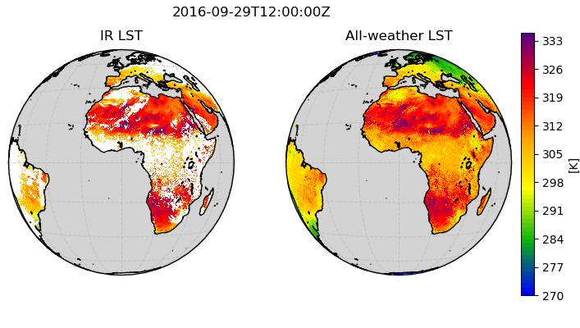
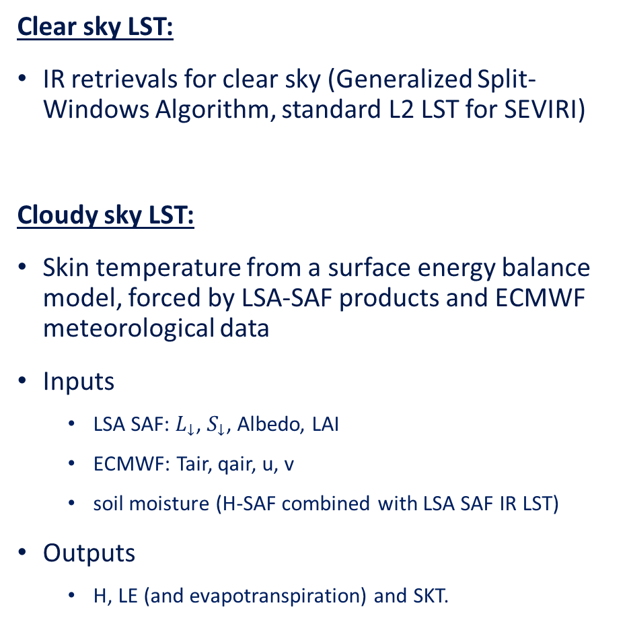
The LSA SAF All-sky Land Surface Temperature
Clear sky LST:
IR retrievals for clear sky (Generalized Split-Windows Algorithm, standard L2 LST for SEVIRI)
Cloudy sky LST:
Skin temperature from a surface energy balance model, forced by LSA-SAF products and ECMWF meteorological data
Inputs
  LSA SAF: $L_{↓}$, $S_{↓}$, Albedo, LAI
  ECMWF: Tair, qair, u, v
  soil moisture (H-SAF combined with LSA SAF IR LST)
Outputs
  H, LE (and evapotranspiration) and SKT.

Slide 3
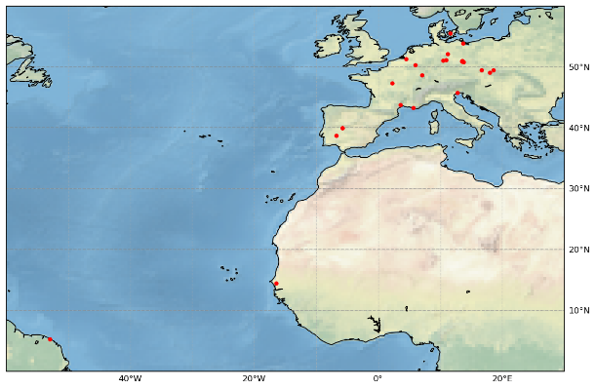
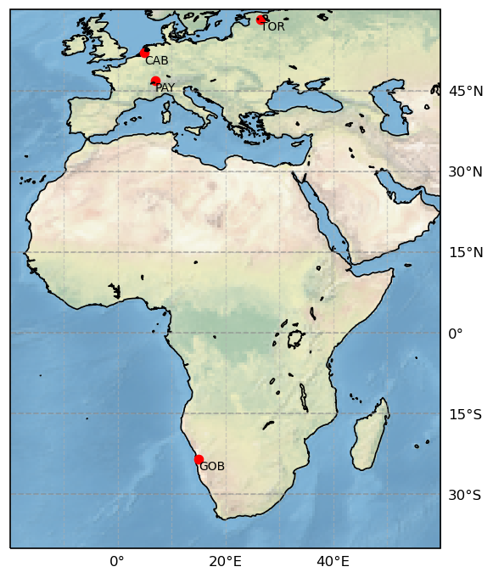
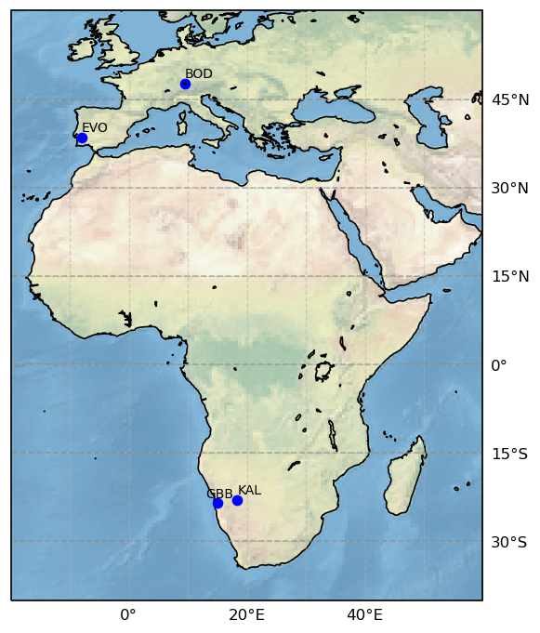
Validation procedure
Comparisons to in situ from Feb 2018 – Dec 2018
Comparison to skin temperature from ERA5-Land (9km, every hour)
For every station:
  Station data representativity at the pixel level (selection of the most suitable pixel over a 5x5 window around the station)
  Summary statistics (robust)
For one station per land cover
  Time series
  Monthly stats
  Mean diurnal cycle
EFDC (26)
BSRN (4)
In situ stations – total of 33 (+ Lake Constance, BOD)
Bare soil – 2
Crops – 10
Deciduous Forest – 6
Evergreen Forest – 10
Grassland – 3
Mixed Vegetation – 2
KIT (3+1)

Slide 4
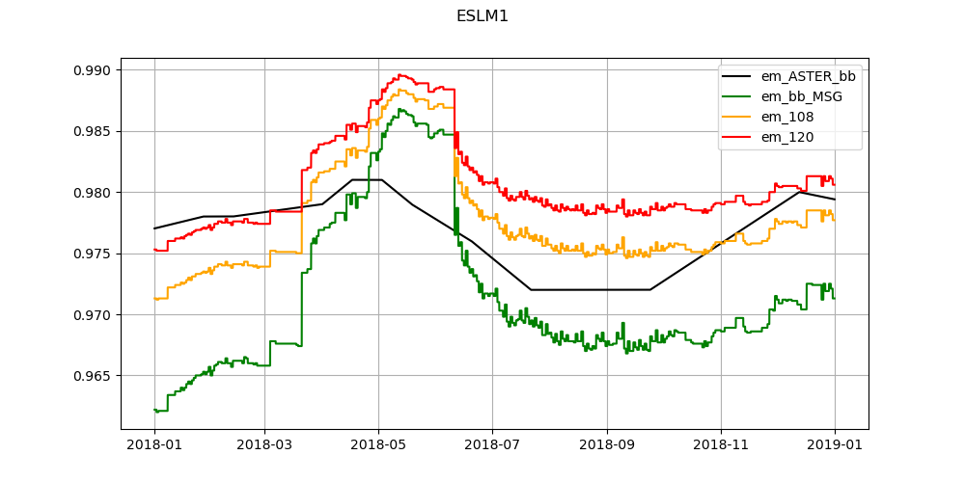
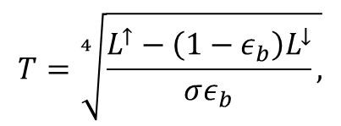

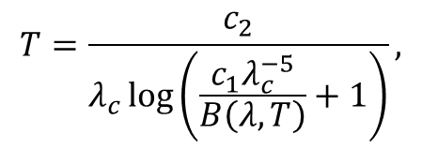
In situ LST determination
In situ LST is calculated using up upward and downward pointing radiometers
For narrowband sensors (KIT), inverse Planck function is used to determine LST:
For broadband sensors (BSRN, EFDC), Stefan-Boltzman Law is used:
Broadband emissivity (BBE) was determined using the Malakar et al 2018 parameterization. BBE is a function of channel emissivity, derived from high resolution imagery in Google Earth Engine (Ermida et al, 2020):
  ASTER emissivity – fixed values
  LandSat NDVI – dynamic values (vegetation correction)
$$L^{↑}=ε\left(λ\right)B\left(λ,T\right)+\left(1−ε\left(λ\right)\right)L^{↓}\left(λ\right)$$
$$T=\frac{c_{2}}{λ_{c}\log\left(\frac{c_{1}λ_{c}^{−5}}{B\left(λ,T\right)}+1\right)},$$
$$T=\sqrt[4]{\frac{L^{↑}−\left(1−ε_{b}\right)L^{↓}}{σε_{b}},}$$

Slide 5
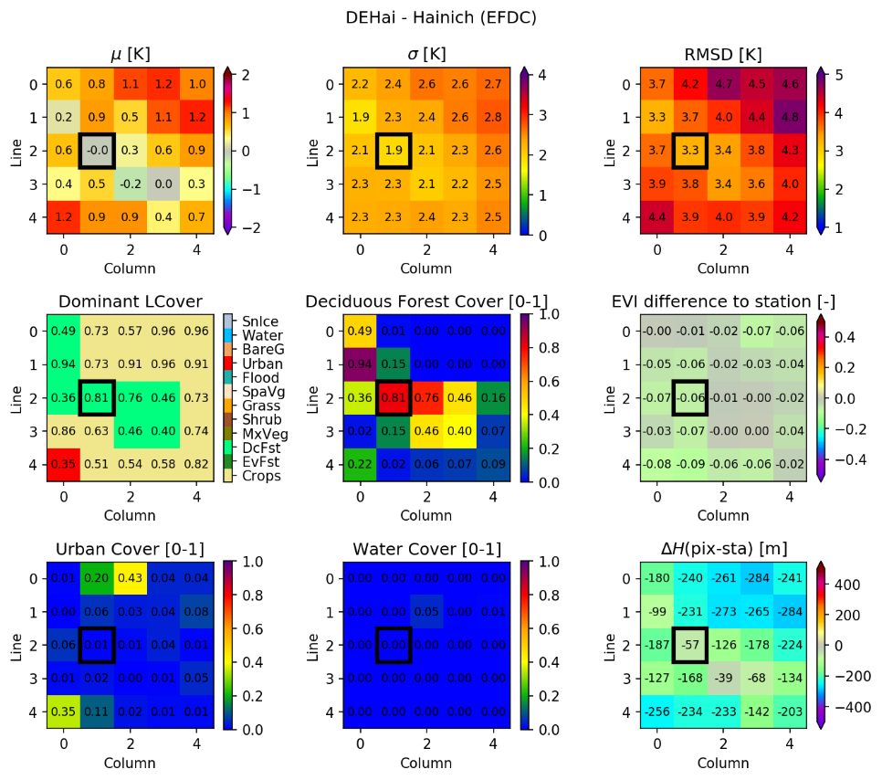
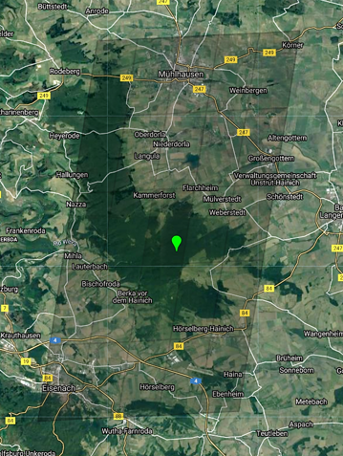
Most representative pixel selection procedure
Top row:
  median difference,
  median absolute deviation
  RMSD
Medium row:
  Dominant land cover of each pixel and respective coverage
  Pixel percentage of the dominant land cover (at station FOV level ~30 m buffer)
  Difference in Enhanced Vegetation Index (EVI) to the station FOV
Bottom row:
  Pixel percentage of Urban areas
  Pixel percentage of water bodies
  Height difference between pixel and station
Right Side:
  SEVIRI pixels overlaid over Google Earth visual imagery. Station location is marked with the green pin

Slide 6
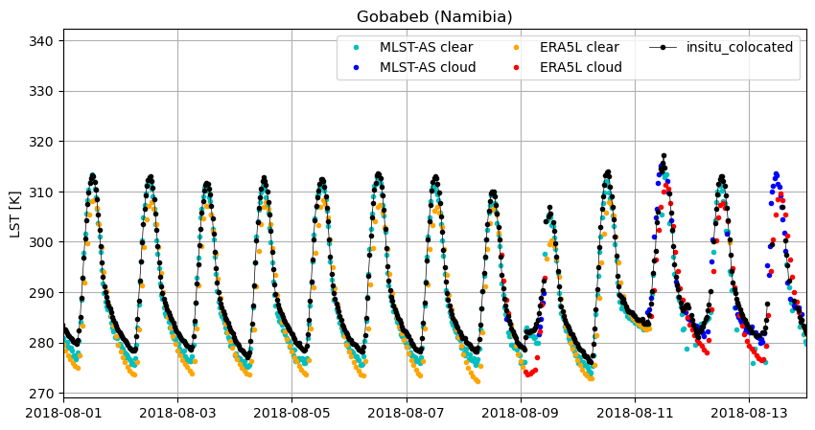
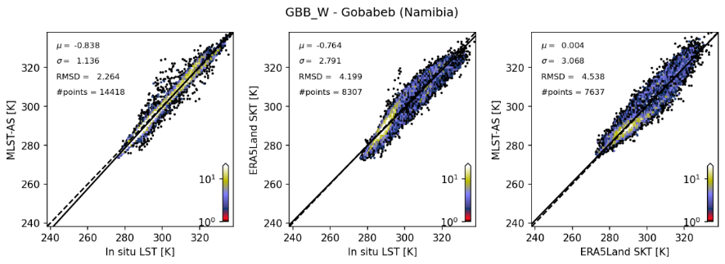
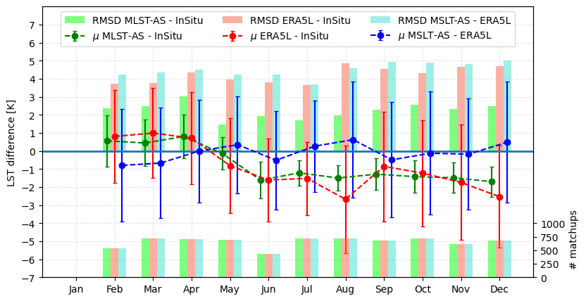
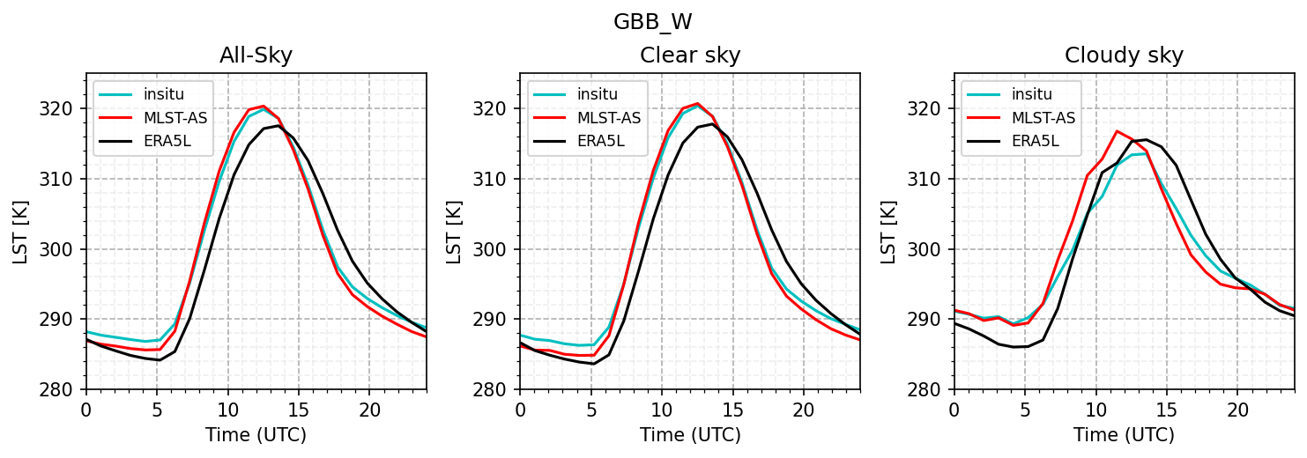
Validation – GBB (bare)

Slide 7
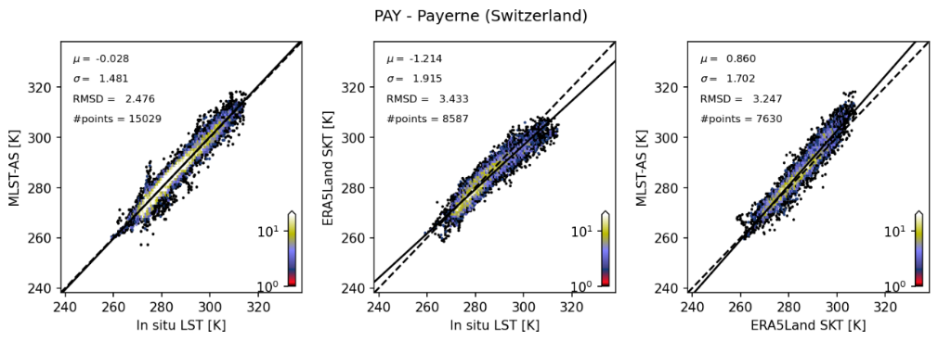
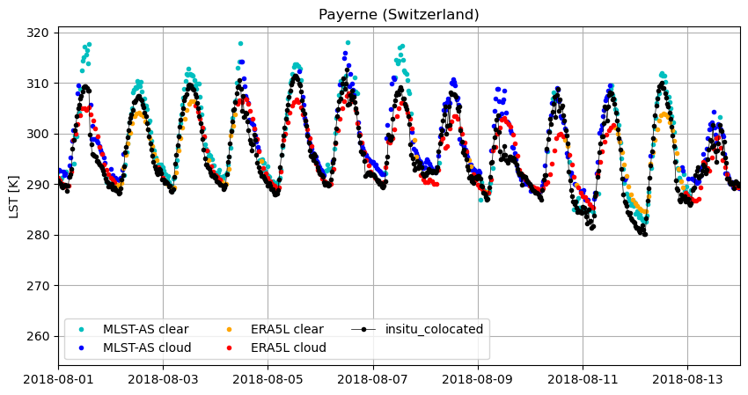
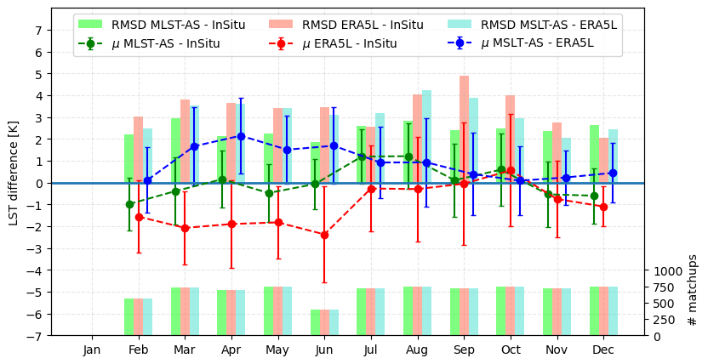
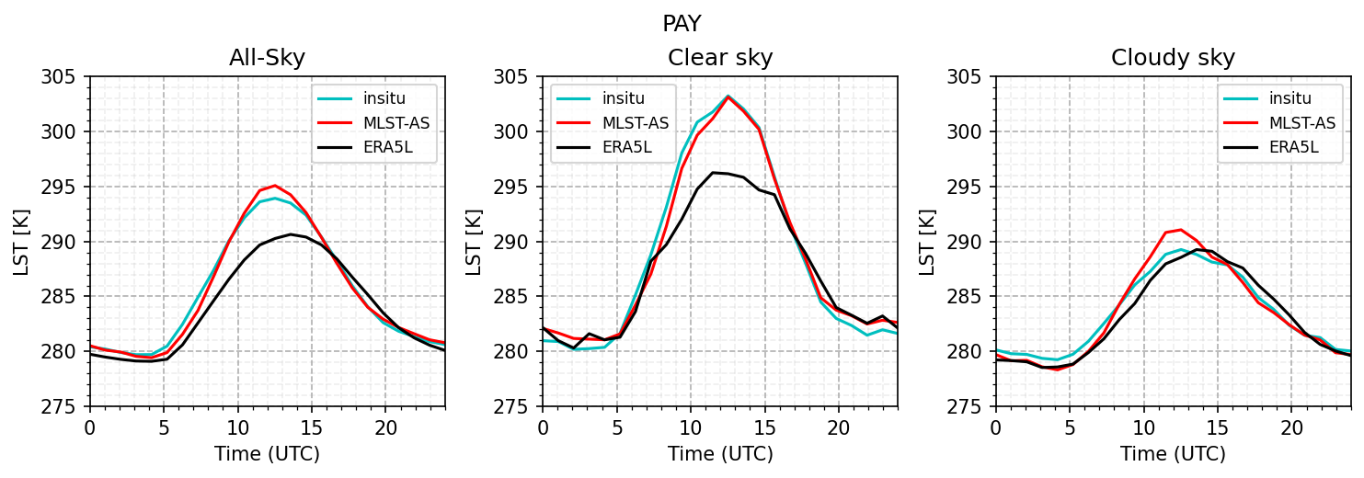
Validation – PAY (crops)

Slide 8
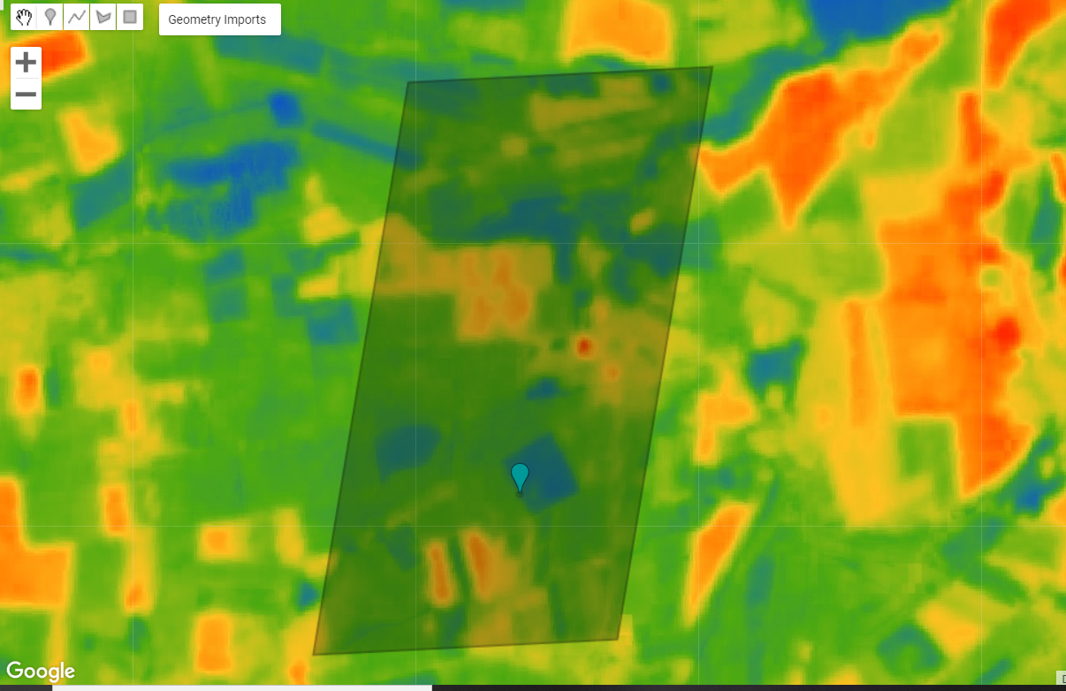
Validation – DEGeb (crops)
Some crops station are problematic... Should we even use these for LST validation?
Landsat 8 LST (Ermida et al, 2020)
2018-07-14T10:08:17
Station LST (30 m buffer): 301.4 K
Pixel LST: 304.4 K
Irrigation? Harvesting?

Slide 9
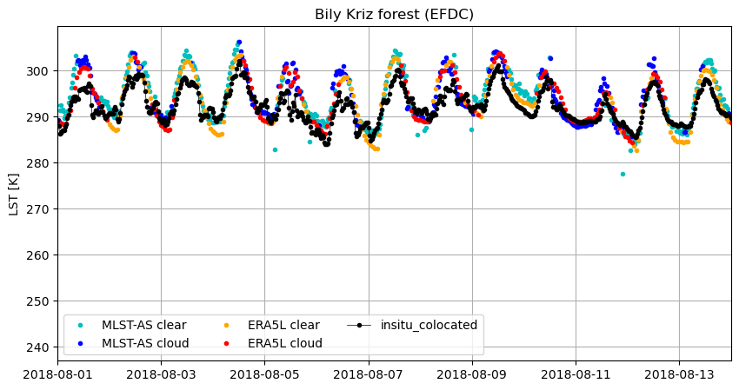
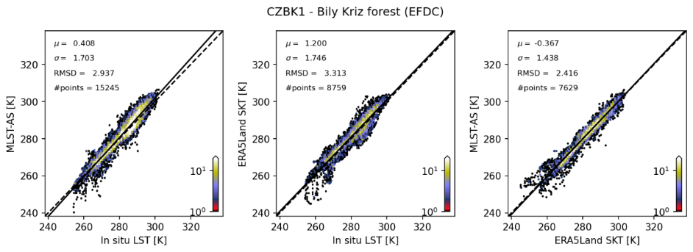
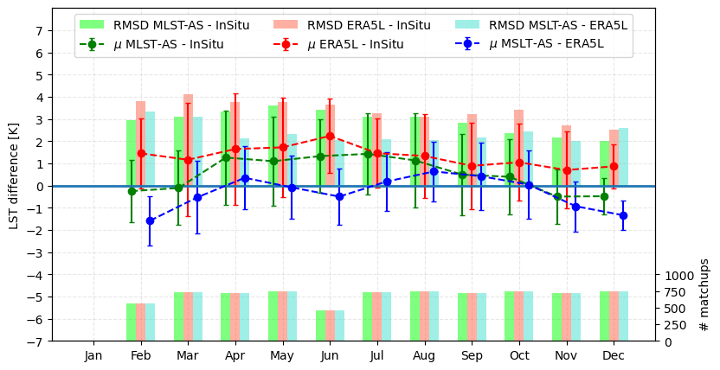
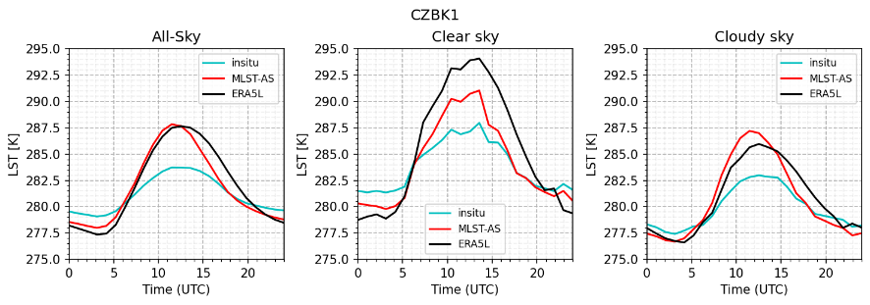
Validation – CZBK1 (evergreen forest)

Slide 10
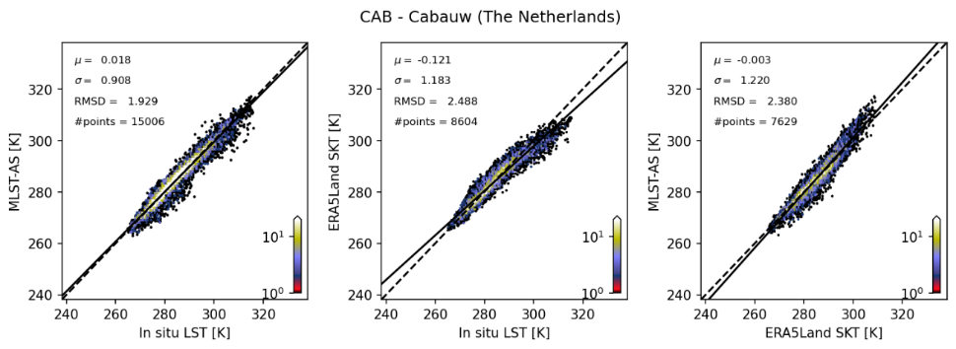
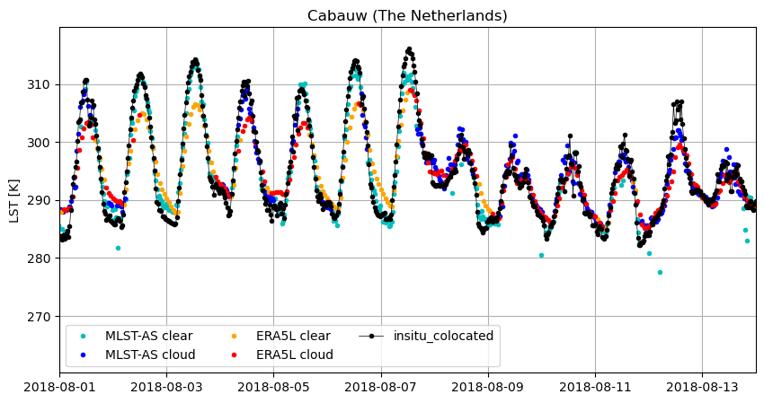
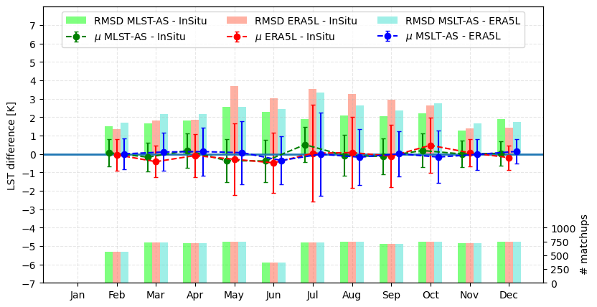
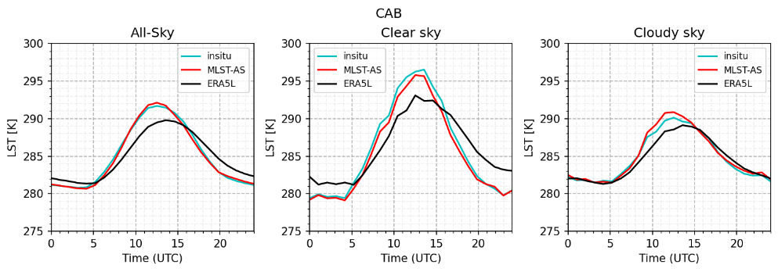
Validation – CAB (grassland)

Slide 11
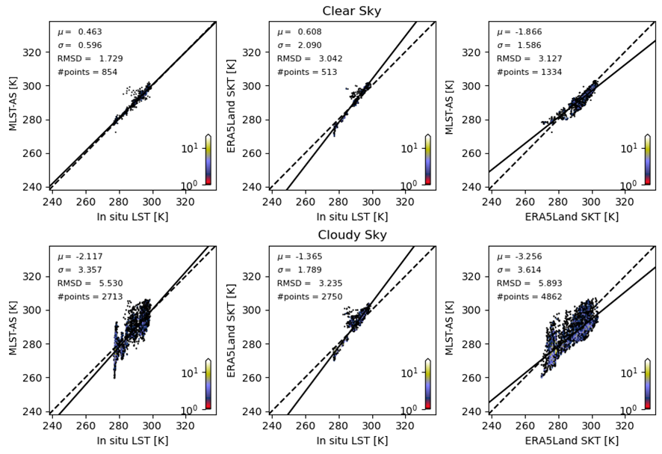
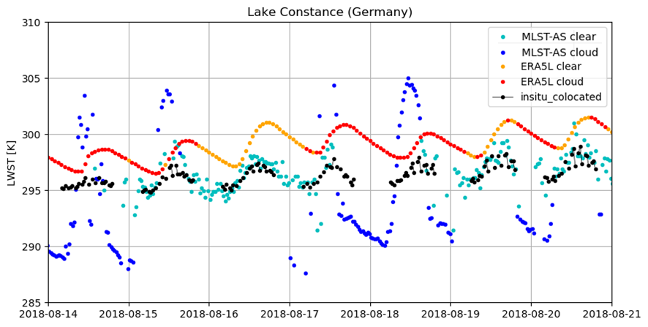
Validation – BOD (inland water)
EB model values are unrealistic for inland water

Slide 12
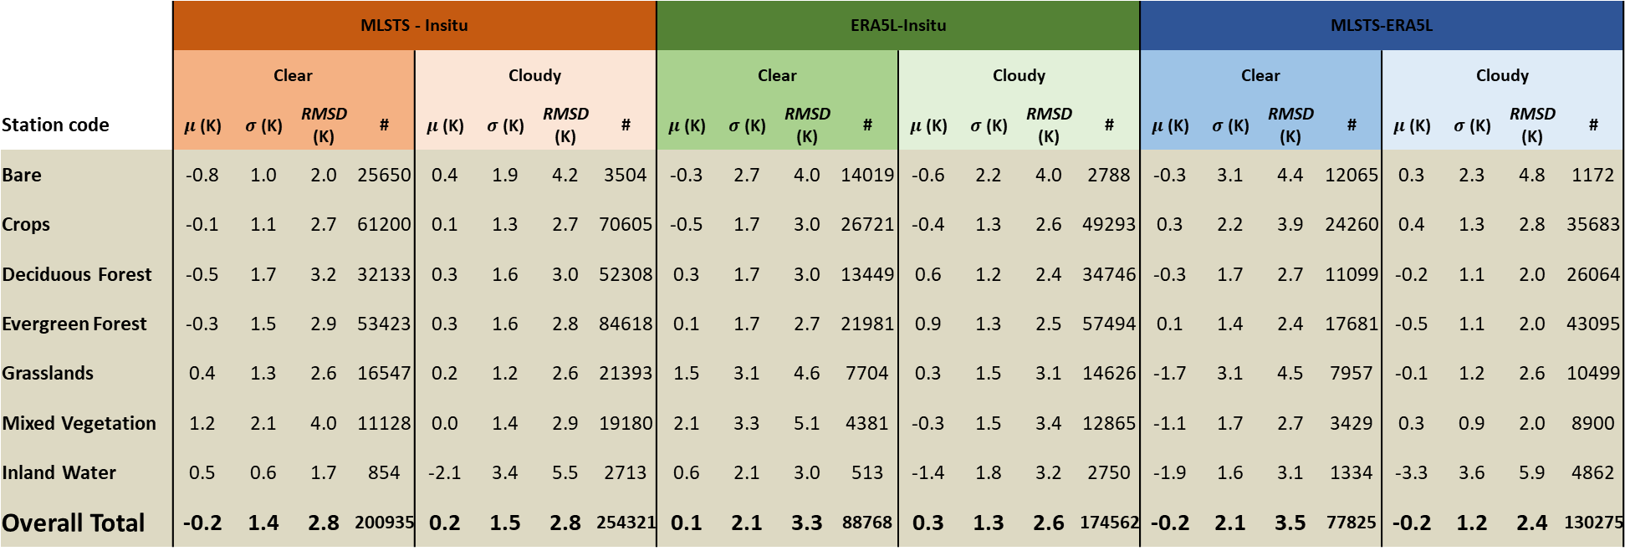
Validation – Summary statistics
 | MLSTS - Insitu |  |  |  |  |  |  |  | ERA5L-Insitu |  |  |  |  |  |  |  | MLSTS-ERA5L
 | Clear |  |  |  | Cloudy |  |  |  | Clear |  |  |  | Cloudy |  |  |  | Clear |  |  |  | Cloudy
Station code | $μ$ (K) | $σ$ (K) | RMSD (K) | # | $μ$ (K) | $σ$ (K) | RMSD (K) | # | $μ$ (K) | $σ$ (K) | RMSD (K) | # | $μ$ (K) | $σ$ (K) | RMSD (K) | # | $μ$ (K) | $σ$ (K) | RMSD (K) | # | $μ$ (K) | $σ$ (K) | RMSD (K) | #
Bare | -0.8 | 1.0 | 2.0 | 25650 | 0.4 | 1.9 | 4.2 | 3504 | -0.3 | 2.7 | 4.0 | 14019 | -0.6 | 2.2 | 4.0 | 2788 | -0.3 | 3.1 | 4.4 | 12065 | 0.3 | 2.3 | 4.8 | 1172
Crops | -0.1 | 1.1 | 2.7 | 61200 | 0.1 | 1.3 | 2.7 | 70605 | -0.5 | 1.7 | 3.0 | 26721 | -0.4 | 1.3 | 2.6 | 49293 | 0.3 | 2.2 | 3.9 | 24260 | 0.4 | 1.3 | 2.8 | 35683
Deciduous Forest | -0.5 | 1.7 | 3.2 | 32133 | 0.3 | 1.6 | 3.0 | 52308 | 0.3 | 1.7 | 3.0 | 13449 | 0.6 | 1.2 | 2.4 | 34746 | -0.3 | 1.7 | 2.7 | 11099 | -0.2 | 1.1 | 2.0 | 26064
Evergreen Forest | -0.3 | 1.5 | 2.9 | 53423 | 0.3 | 1.6 | 2.8 | 84618 | 0.1 | 1.7 | 2.7 | 21981 | 0.9 | 1.3 | 2.5 | 57494 | 0.1 | 1.4 | 2.4 | 17681 | -0.5 | 1.1 | 2.0 | 43095
Grasslands | 0.4 | 1.3 | 2.6 | 16547 | 0.2 | 1.2 | 2.6 | 21393 | 1.5 | 3.1 | 4.6 | 7704 | 0.3 | 1.5 | 3.1 | 14626 | -1.7 | 3.1 | 4.5 | 7957 | -0.1 | 1.2 | 2.6 | 10499
Mixed Vegetation | 1.2 | 2.1 | 4.0 | 11128 | 0.0 | 1.4 | 2.9 | 19180 | 2.1 | 3.3 | 5.1 | 4381 | -0.3 | 1.5 | 3.4 | 12865 | -1.1 | 1.7 | 2.7 | 3429 | 0.3 | 0.9 | 2.0 | 8900
Inland Water | 0.5 | 0.6 | 1.7 | 854 | -2.1 | 3.4 | 5.5 | 2713 | 0.6 | 2.1 | 3.0 | 513 | -1.4 | 1.8 | 3.2 | 2750 | -1.9 | 1.6 | 3.1 | 1334 | -3.3 | 3.6 | 5.9 | 4862
Overall Total | -0.2 | 1.4 | 2.8 | 200935 | 0.2 | 1.5 | 2.8 | 254321 | 0.1 | 2.1 | 3.3 | 88768 | 0.3 | 1.3 | 2.6 | 174562 | -0.2 | 2.1 | 3.5 | 77825 | -0.2 | 1.2 | 2.4 | 130275
~Similar performance

Slide 13
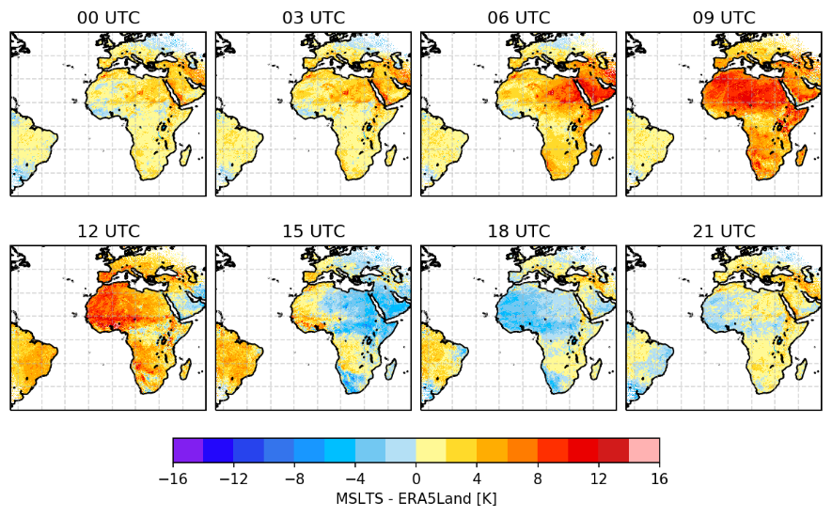
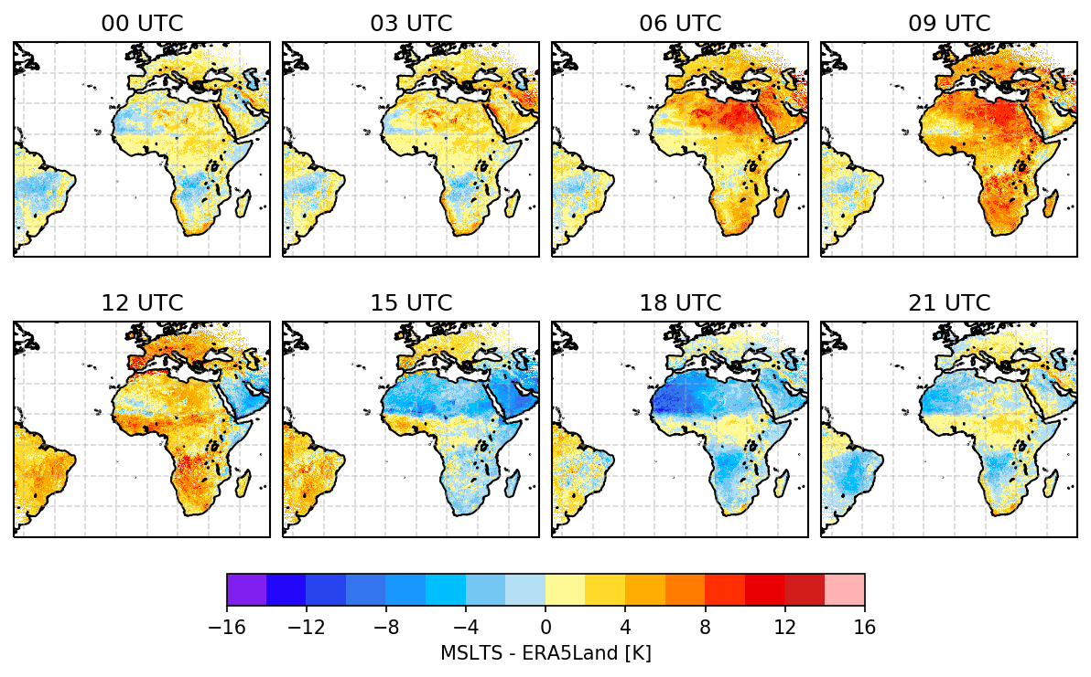
Comparison to ERA5-Land
  Comparison to independent LST dataset: ERA5-Land (res: ~9 km, data every 1h). Forced by data downscaled from ERA5 (41r2); more advanced H-TESSEL model cycle (45r1)
  For each 3-hourly MLST-AS timeslot (i.e. 0 UTC, 3 UTC, …), data are re-projected to the ERA5-Land regular Plate Carrée projection, with 0.1◦ spatial resolution, by averaging all valid data points within each grid-cell.
  Monthly averages of both datasets are then compared every 3h, for February and July.
Feb 2018
July 2018

Slide 14
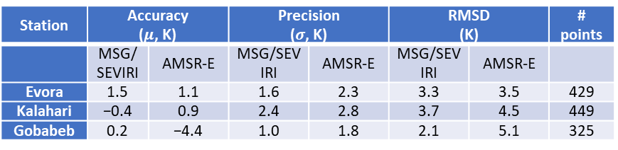
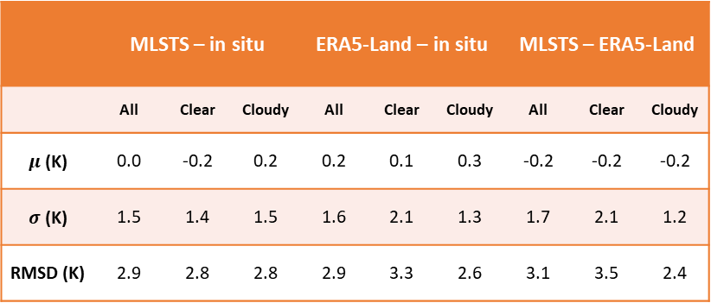
Concluding remarks
 | MLSTS – in situ |  |  | ERA5-Land – in situ |  |  | MLSTS – ERA5-Land
 | All | Clear | Cloudy | All | Clear | Cloudy | All | Clear | Cloudy
$μ$ (K) | 0.0 | -0.2 | 0.2 | 0.2 | 0.1 | 0.3 | -0.2 | -0.2 | -0.2
$σ$ (K) | 1.5 | 1.4 | 1.5 | 1.6 | 2.1 | 1.3 | 1.7 | 2.1 | 1.2
RMSD (K) | 2.9 | 2.8 | 2.8 | 2.9 | 3.3 | 2.6 | 3.1 | 3.5 | 2.4
  Careful selection of SEVIRI pixels used for validation, taking into account in situ measurements representativeness at the pixel level (may still be improved?)
  In situ emissivity estimated using ASTER and Landsat high resolution measurements (Ermida et al, 2020)
  ERA5-Land chosen as independent all-sky LST product
  Problems found
    Diurnal cycle differences between satellite and in situ
    Lake water temperature is not well represented
    Temporal inconsistencies between clear and cloudy cases in the time series
    station GBB (bare) shows that daily maximum temperature is overestimated by MLST-AS by about 5 K for cloudy situations, therefore failing the target accuracy for cloudy situations
  In general, the LST-005 product complies with requirements
Station | Accuracy ($μ$, K) |  | Precision ($σ$, K) |  | RMSD (K) |  | # points
 | MSG/SEVIRI | AMSR-E | MSG/SEVIRI | AMSR-E | MSG/SEVIRI | AMSR-E
Evora | 1.5 | 1.1 | 1.6 | 2.3 | 3.3 | 3.5 | 429
Kalahari | −0.4 | 0.9 | 2.4 | 2.8 | 3.7 | 4.5 | 449
Gobabeb | 0.2 | −4.4 | 1.0 | 1.8 | 2.1 | 5.1 | 325
From Martins et al, 2019
Product requirements
LST Product | Coverage | Resolution |  | Accuracy
 |  | Temporal | Spatial | Threshold | Target | Optimal
MLSTS (LSA-005) | MSG Disk | 30 min | MSG pixel resolution | 4 K (clear-sky); 8 K (cloudy) | 2 K (clear-sky); 4 K (cloudy) | 1 K

Slide 15
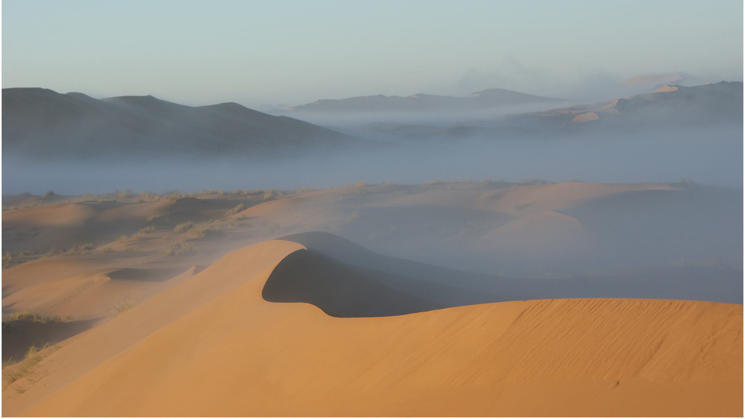
The end
Characteristic early‐morning fog of the Namib Desert, on the sand dunes of the central Namib sand sea, within a UNESCO World Heritage Site
Photo: Joh Henschel (taken from Mitchel et al, 2020)

Slide 17
Station ID | Location | Coordinates | Altitude (m) | Climate zone (Köppen) | Landcover Group / ESA CCI code | Period / Comments
GBB (KIT) | Gobabeb Namibia | 23.551 S, 15.051 E | 406 | Desert (arid), cold arid (BWk) | Bare soil (200) | Jan 2018 – Dec 2018 Surface emissivity: 0.944
GOB (BSRN) | Gobabeb Namibia | 23.561 S, 15.042 E | 407 | Desert (arid), cold arid (BWk) | Bare soil (200) | Feb 2018 – Dec 2018 Very homogeneous
BELon (EFDC) | Lonzee Belgium | 50.552 N, 4.746 E | 167 | Mild temperate, warm summer (Cfb) | Crops (10) | Jan 2018 – Mar 2018 Moderate urban coverage
DEGeb (EFDC) | Gebesee Germany | 51.100 N, 10.915 E | 158 | Mild temperate, warm summer (Cfb) | Crops (10) | Jan 2018 – Dec 2018 Moderate urban coverage
DEKli (EFDC) | Klingenberg Germany | 50.893 N, 13.522 E | 480 | Snowy/humid winter, warm summer (Dfb) | Crops (10) | Jan 2018 – Dec 2018 Mixed landscape; urban coverage
ESAbr (EFDC) | Albuera Spain | 38.702 N, 6.786 W | 280 | Mild temperate, dry hot summer (Csa) | Crops (30) | Jan 2018 – Dec 2018
ESLM1 (EFDC) | Majadas del Tietar North Spain | 39.942 N, 5.779 W | 265 | Mild temperate, dry hot summer (Csa) | Crops (10) | Jan 2018 – Dec 2018 Homogeneous
ESLM2 (EFDC) | Majadas del Tietar South Spain | 39.935 N, 5.776 W | 271 | Mild temperate, dry hot summer (Csa) | Crops (30) | Jan 2018 – Dec 2018 Homogeneous
EVO (KIT) | Evora Portugal | 38.540 N, 8.003 W | 225 | Mild temperate, dry hot summer (Csa) | Crops (10) | Jan 2018 – Dec 2018 Emissivity: 0.978
ITLsn (EFDC) | Lison Italy | 45.741 N, 12.750 E | 0 | Mild temperate, warm summer (Cfa) | Crops (10) | Jan 2018 – Dec 2018
PAY (BSRN) | Payerne Switzerland | 46.815 N, 6.944 E | 491 | Mild temperate, warm summer (Cfb) | Crops (10) | Jan 2018 – Dec 2018 Moderate urban coverage
SNNkr (EFDC) | Niakhar Senegal | 14.496 N, 16.454 W | 8 | Steppe (semi-arid), hot arid (BSh) | Crops (10) | Jul 2018 – Dec 2018 Homogeneous
CZStn (EFDC) | Stitna Czech Republic | 49.036 N, 17.970 E | 562 | Mild temperate, warm summer (Cfb) | Deciduous Forest (60) | Jan 2018 – Jul 2018 Moderate urban coverage
DEAkm (EFDC) | Anklam Germany | 53.866 N, 13.683 E | 0 | Mild temperate, warm summer (Cfb) | Deciduous Forest (60) | Apr 2018 – Dec 2018
DEHai (EFDC) | Hainich Germany | 51.079 N, 10.452 E | 459 | Mild temperate, warm summer (Cfb) | Deciduous Forest (60) | Jan 2018 – Dec 2018
DEHoH (EFDC) | Hohes Holz Germany | 52.085 N, 11.219 E | 211 | Mild temperate, warm summer (Cfb) | Deciduous Forest (60) | Jan 2018 – Dec 2018
DKSor (EFDC) | Soroe Denmark | 55.486 N, 11.645 E | 47 | Mild temperate, warm summer (Cfb) | Deciduous Forest (60) | Jan 2018 – Dec 2018 Includes a lake within SEVIRI FOV
FRHes (EFDC) | Hesse France | 48.674 N, 7.065 E | 311 | Mild temperate, warm summer (Cfb) | Deciduous Forest (60) | Jan 2018 – Dec 2018
BEBra (EFDC) | Brasschaat Belgium | 51.308 N, 4.520 E | 20 | Mild temperate, warm summer (Cfb) | Evergreen Forest (90) | Jan 2018 – Dec 2018 Mixed landscape; high urban density
BEVie (EFDC) | Vielsalm Belgium | 50.305 N, 5.998 E | 493 | Mild temperate, warm summer (Cfb) | Evergreen Forest (70) | Jan 2018 – Apr 2018
CZBK1 (EFDC) | Bily Kriz Forest Czech Republic | 49.502 N, 18.537 E | 881 | Mild temperate, warm summer (Cfb) | Evergreen Forest (70) | Jan 2018 – Dec 2018
CZRAJ (EFDC) | Rajec Czech Republic | 49.444 N, 16.697 E | 648 | Snowy/humid winter, warm summer (Dfb) | Evergreen Forest (70) | Jan 2018 – Dec 2018
DEHzd (EFDC) | Hetzdorf Germany | 50.964 N, 13.490 E | 397 | Mild temperate, cool summer (Cfc) | Evergreen Forest (70) | Apr 2018 – Dec 2018 Moderate urban coverage
DEObe (EFDC) | Oberbärenburg Germany | 50.787 N, 13.721 E | 747 | Snowy/humid winter, cool summer (Dfc) | Evergreen Forest (70) | Jan 2018 – Dec 2018
DETha (EFDC) | Tharandt Germany | 50.963 N, 13.565 E | 400 | Snowy/humid winter, cool summer (Dfc) | Evergreen Forest (70) | Jan 2018 – Dec 2018 Moderate urban coverage
FRFBn (EFDC) | Font-Blanche France | 43.241 N, 5.679 E | 435 | Mild temperate, dry warm summer (Csb) | Evergreen Forest (70) | Jan 2018 – Dec 2018 Valley
FRPue (EFDC) | Puechabon France | 43.741 N, 3.596 E | 271 | Mild temperate,dry warm summer (Csb) | Evergreen Forest (70) | Jan 2018 – Oct 2018 Valley
GFGuy (EFDC) | Guyaflux French Guiana | 5.2788 N, 52.925 W | 55 | Tropical Monsoon (Am) | Evergreen Forest (50) | Jan 2018 – Dec 2018 Homogeneous
CAB (BSRN) | Cabauw The Netherlands | 51.971 N, 4.927 E | 0 | Mild temperate, warm summer (Cfb) | Grassland (130) | Jan 2018 – Dec 2018 Very homogeneous
DEGri (EFDC) | Grillenburg Germany | 50.950 N, 13.513 E | 376 | Snowy/humid winter, cool summer (Dfc) | Grassland (130) | Jan 2018 – Dec 2018 Moderate urban cover; forest
KAL (KIT) | Farm Heimat Namibia | 22.933 S, 17.992 E | 1380 | Hot semi-arid (BSh) | Grassland (130) | Jan 2018 – Dec 2018
FRLGt (EFDC) | La Guette France | 47.323 N, 2.284 E | 153 | Mild temperate, warm summer (Cfb) | Mixed Vegetation (100) | Jan 2018 – Dec 2018 Mixed landscape; urban coverage
TOR (BSRN) | Toravere Estonia | 58.254 N, 26.462 E | 70 | Snowy/humid winter, cool summer (Dfc) | Mixed Vegetation (100) | Feb 2018 – Dec 2018 High SEVIRI view angle; large pixel
BOD | Lake Constance Switzerland / Germany | 47.605 N, 9.444 E | 396 | Cold, no dry season, warm summer (Dfb) | Water (210) | Jan 2018 – Dec 2018 Station mounted on a ferry. Sampling every 3 min.

Slide 18
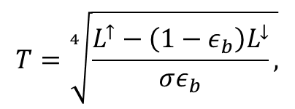
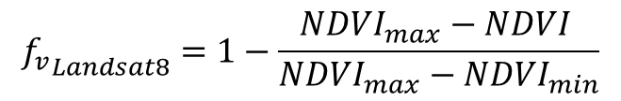
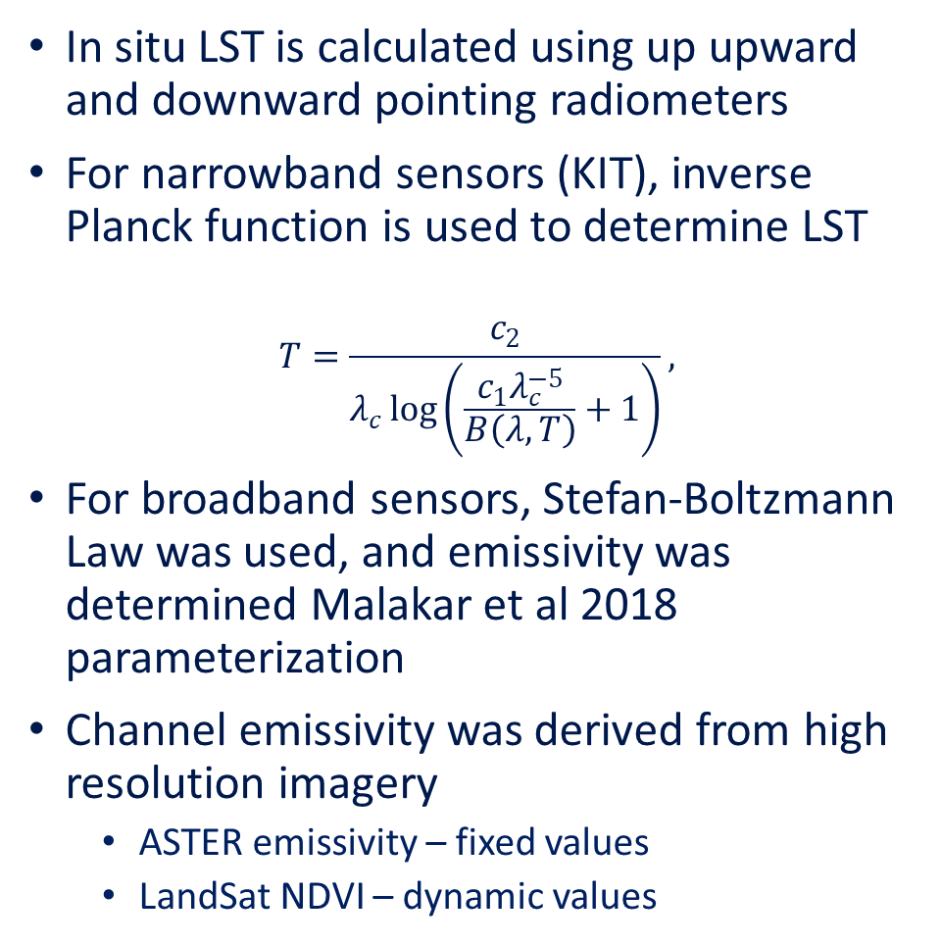
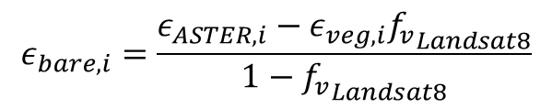

In situ LST determination
$$T=\sqrt[4]{\frac{L^{↑}−\left(1−ε_{b}\right)L^{↓}}{σε_{b}},}$$
In situ LST is calculated using up upward and downward pointing radiometers
For narrowband sensors (KIT), inverse Planck function is used to determine LST
$$T=\frac{c_{2}}{λ_{c}\log\left(\frac{c_{1}λ_{c}^{−5}}{B\left(λ,T\right)}+1\right)},$$
For broadband sensors, Stefan-Boltzmann Law was used, and emissivity was determined Malakar et al 2018 parameterization
Channel emissivity was derived from high resolution imagery
  ASTER emissivity – fixed values
  LandSat NDVI – dynamic values
$$ε_{b}=0.128+0.014ε_{10}+0.145ε_{11}+0.241ε_{12}+0.467ε_{13}+0.004ε_{14}$$
= 0.99
$$ε_{i}=f_{v}ε_{veg,i}+\left(1−f_{v}\right)ε_{bare,i,},$$
$$ε_{bare,i}=\frac{ε_{ASTER,i}−ε_{veg,i}{f_{v}}_{Landsat8}}{1−{f_{v}}_{Landsat8}}$$
$${f_{v}}_{Landsat8}=1−\frac{NDVI_{max}−NDVI }{NDVI_{max}−NDVI_{min}}$$

Slide 19
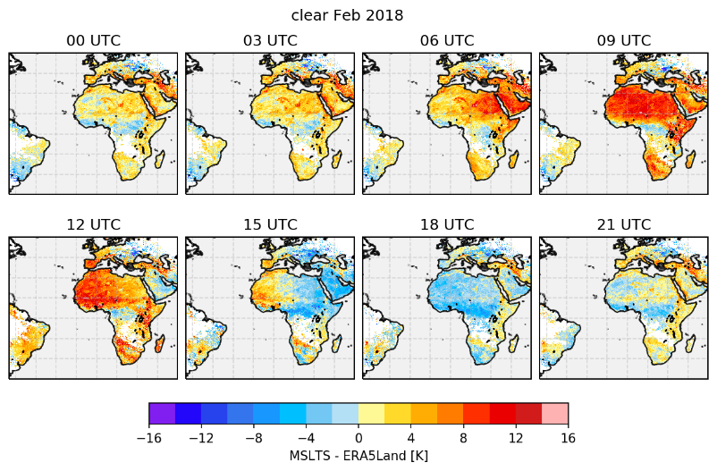
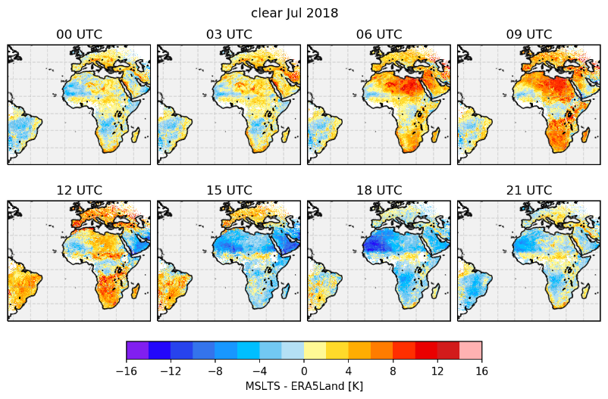
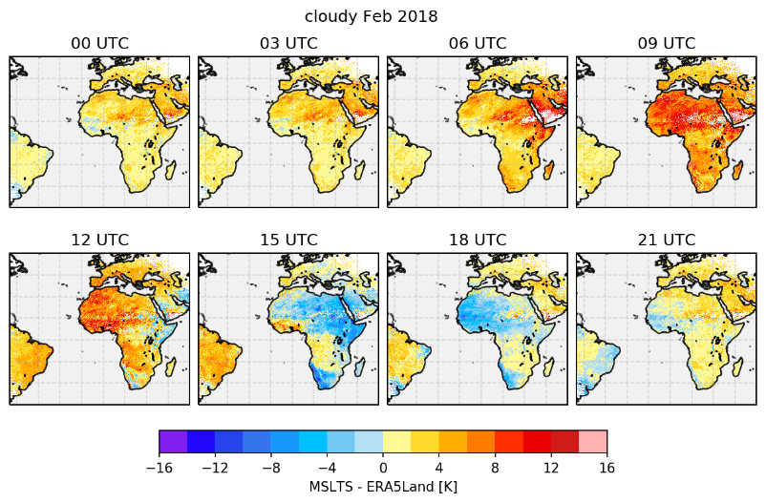
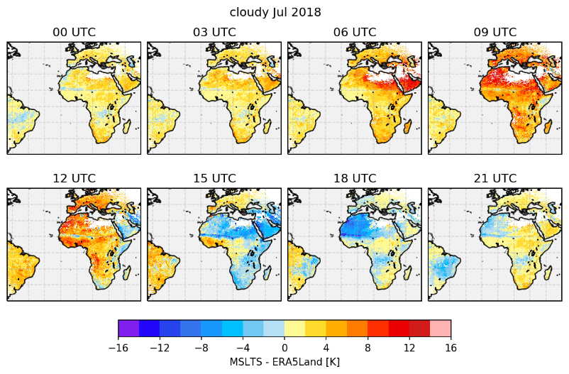
Comparison to ERA5-Land: clear vs. Cloudy sky
Clear
Cloudy

