Slide 1
ESA Climate Change Initiative (CCI)
LST_cci User Workshop, 24-26 June 2020
Simon Pinnock
ESA Climate Office
Directorate of Earth Observation Programmes
ECSAT, Harwell, UK
simon.pinnock@esa.int

Slide 2
ESA Climate Change Initiative (CCI)
Objective:
To realise the full potential of the long-term global EO archives that ESA, together with its Member States, has established over the last 40 years…
... as a significant and timely contribution to the Essential Climate Variable (ECV*) databases required by the
United Nations Framework Convention on Climate Change (UNFCCC)
* An ECV is a physical, chemical, or biological variable or a group of linked variables that critically contributes to the characterization of Earth’s climate.
S. Bojinski et al., BAMS 2014, doi.org/10.1175/BAMS-D-13-00047.1
Notes:
The programme directly responds to requirements for the satellite-observed ECVs defined by GCOS on behalf of UNFCCC, within a coordinated international context.
The Concept of Essential Climate Variables in Support of Climate Research, Applications, and Policy
https://doi.org/10.1175/BAMS-D-13-00047.1
Stefan Bojinski et al. 2014
An ECV is a physical, chemical, or biological variable or a group of linked variables that critically contributes to the characterization of Earth’s climate. ECV datasets provide the empirical evidence needed to understand and predict the evolution of climate, to guide mitigation and adaptation measures, to assess risks and enable attribution of climatic events to underlying causes, and to underpin climate services.

Slide 3
GCOS Essential Climate Variables
GCOS 2016 Implementation Plan, GCOS-200: https://gcos.wmo.int/en/gcos-implementation-plan
Notes:
Requirements: UNFCCC → SBSTA → GCOS
Of the 54 ECVs GCOS have specified over half rely on satellites to deliver them..

Slide 4

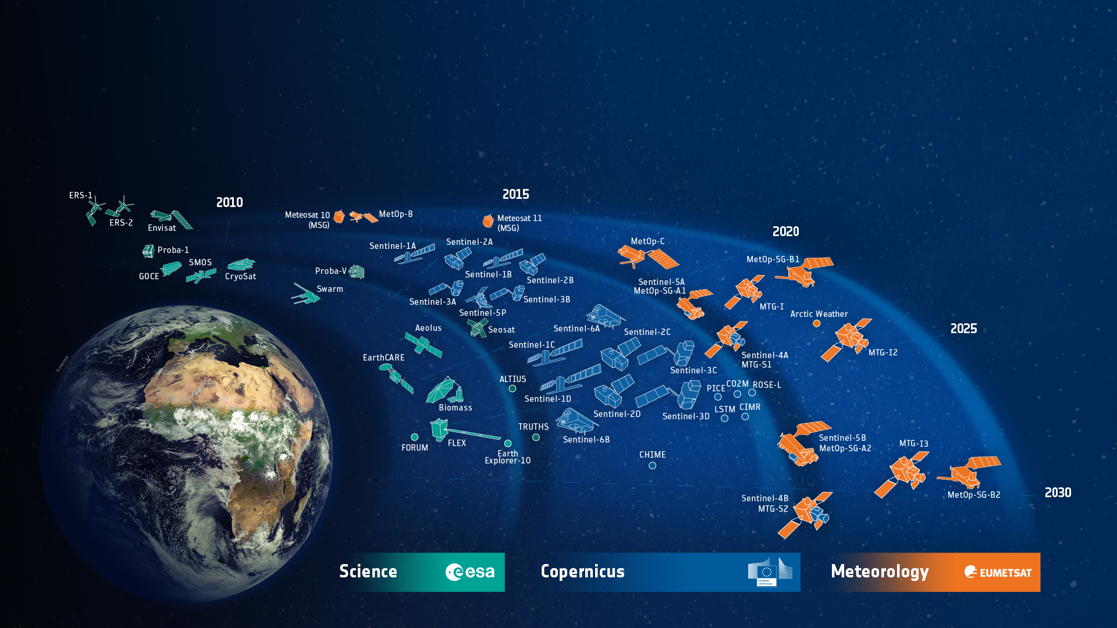





















ESA-Developed Earth Observation Missions
Satellites
25 under development
15 in operation
ESA UNCLASSIFIED – For Official Use
European Space Agency
Notes:
D/EOP has three main lines of activities: Earth Science, Copernicus and Meteorology
Since the latest launch of Aeolus on 22 Aug. 2017, we have 25 satellites in development and 15 satellites in operation.

Slide 5
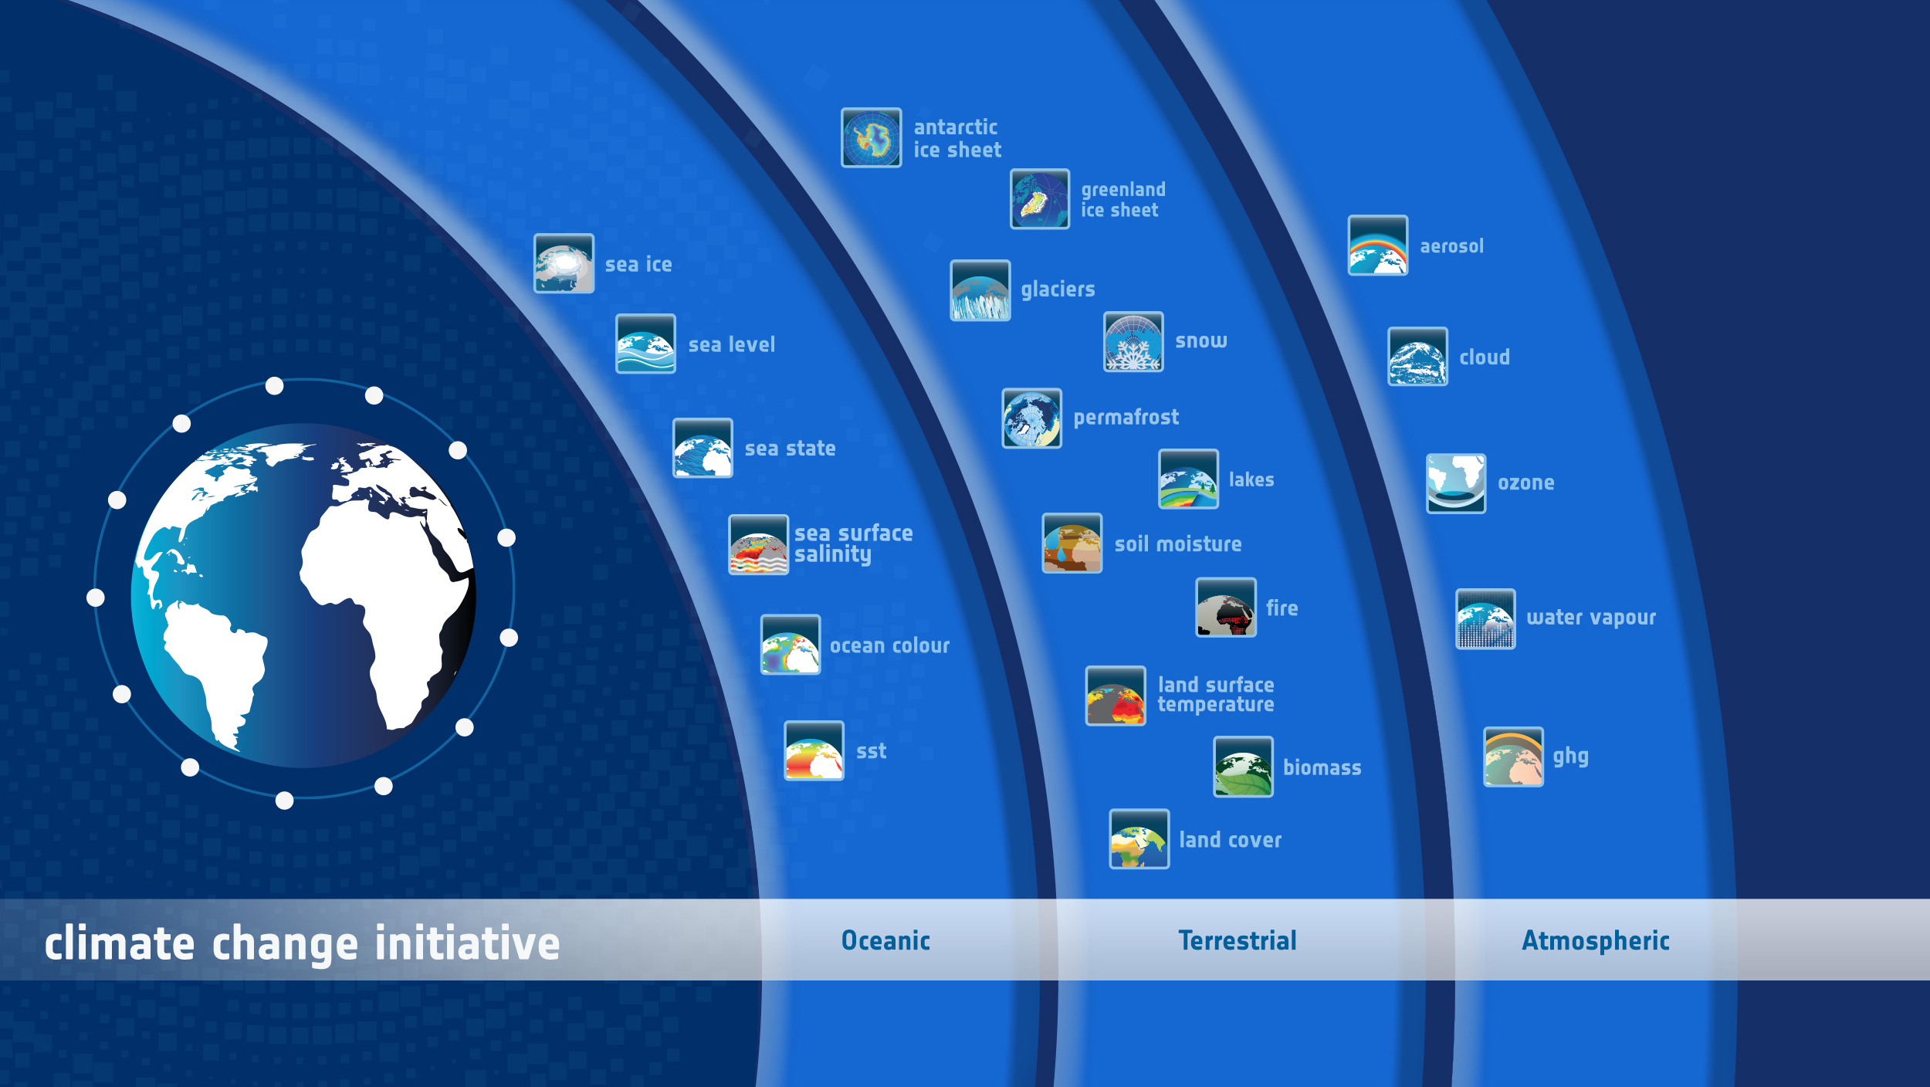



Established 2010
€160M
450 scientists
21 ECVs in total
13 ECVs transferred to C3S
Sea Level Budget

Slide 6
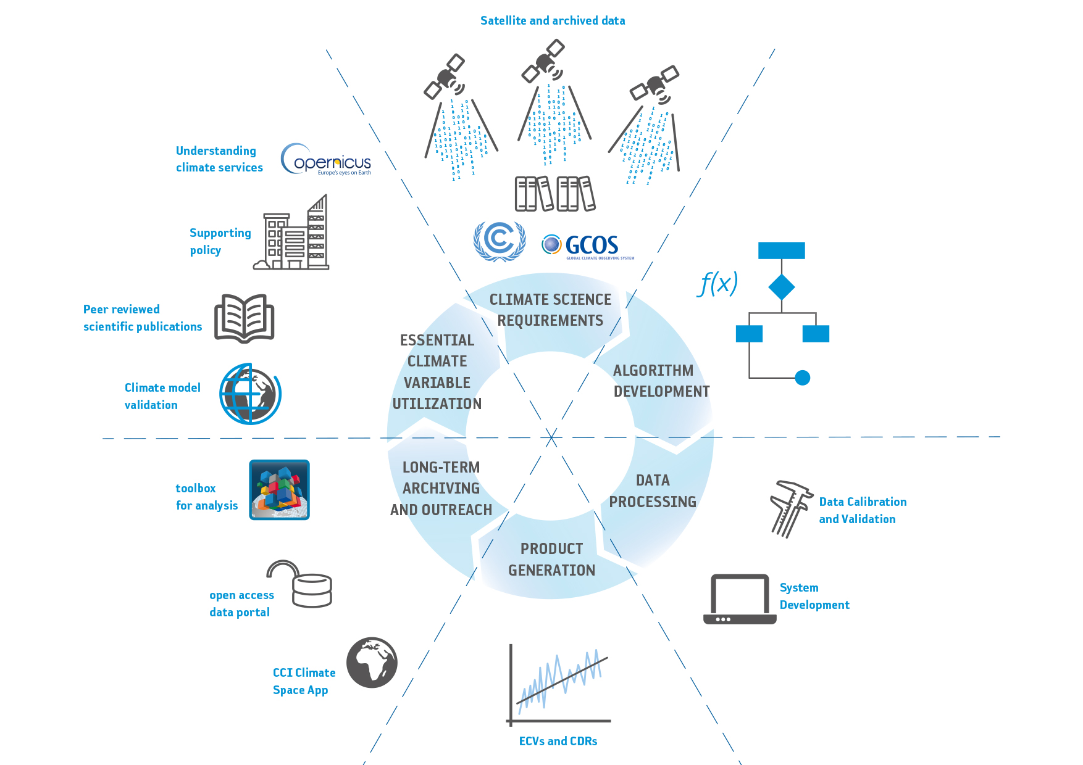
What we do in the CCI:
and VALIDATION

Slide 7
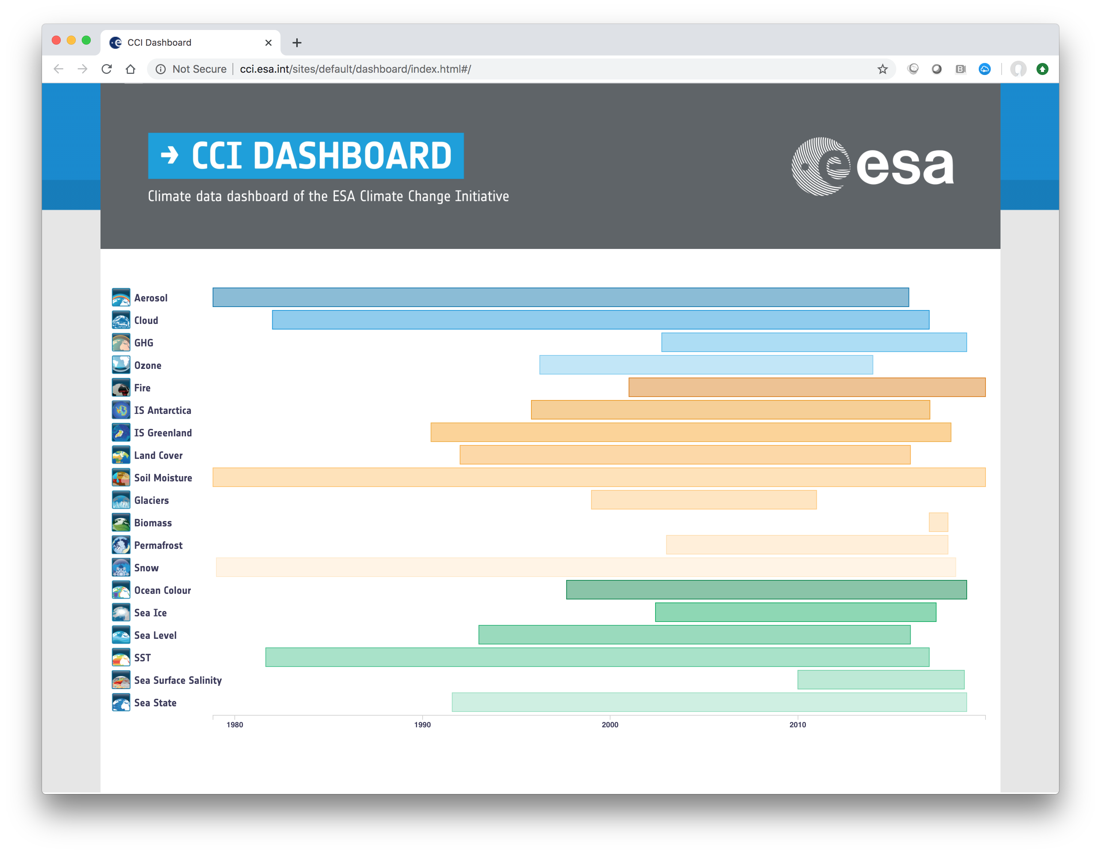
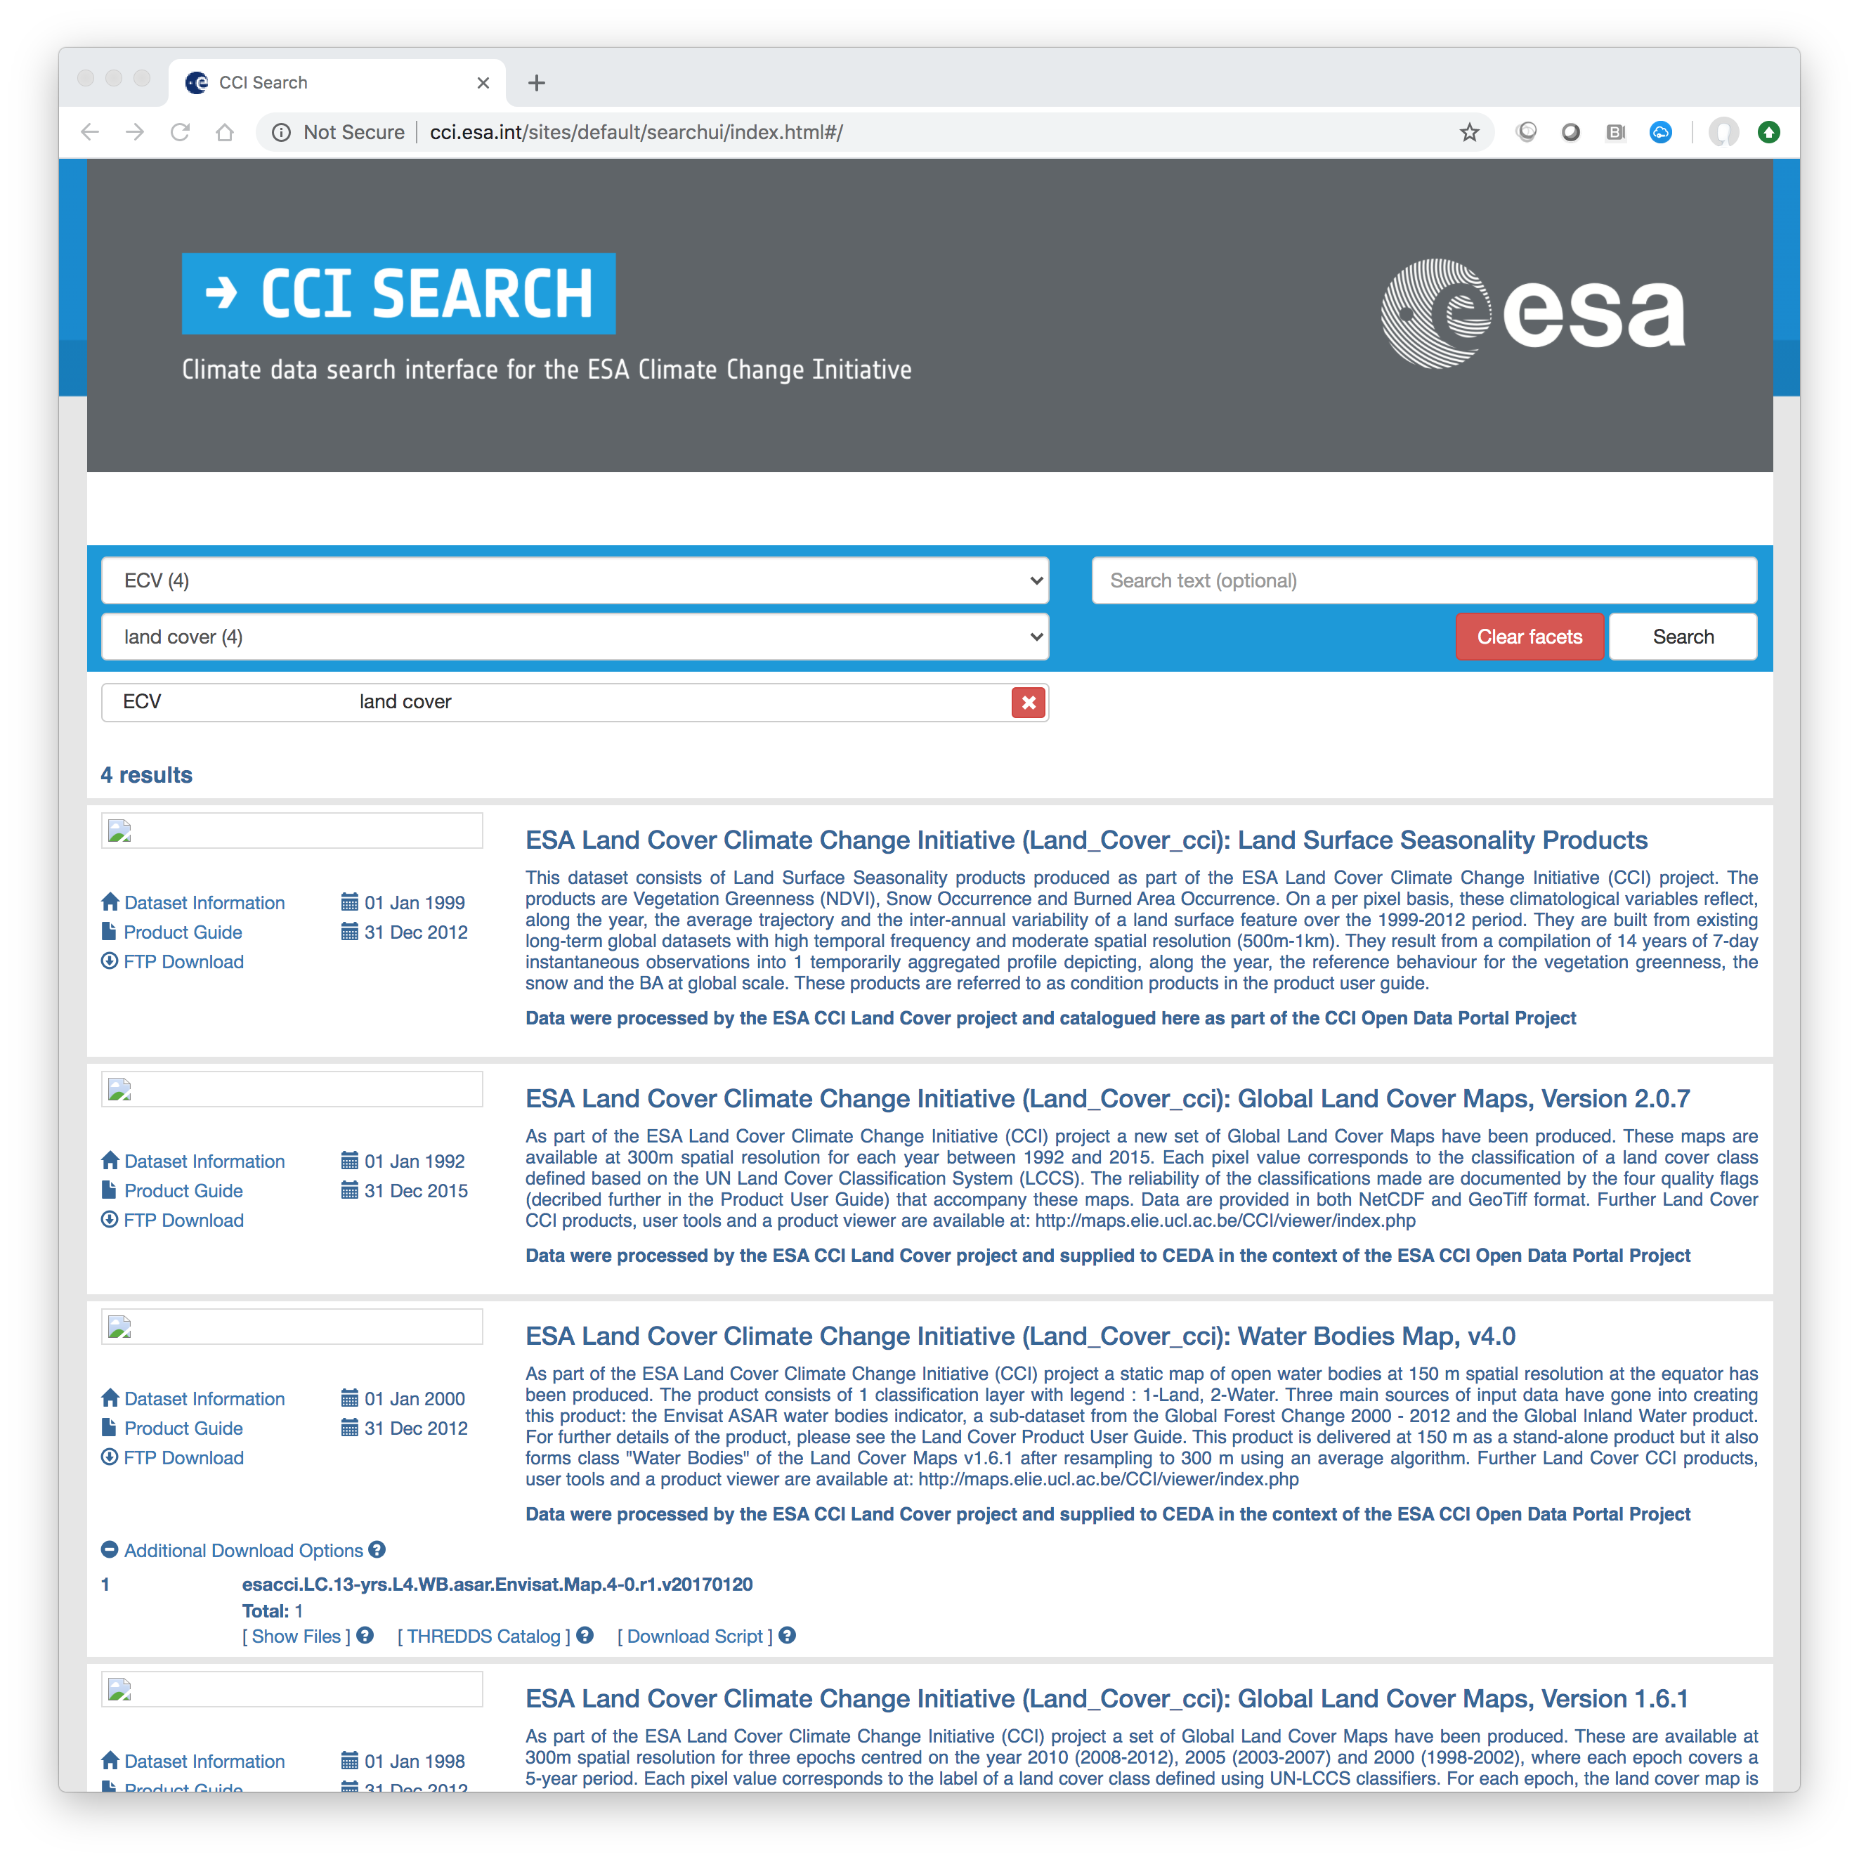
CCI Open Data Portal cci.esa.int/data

Slide 8

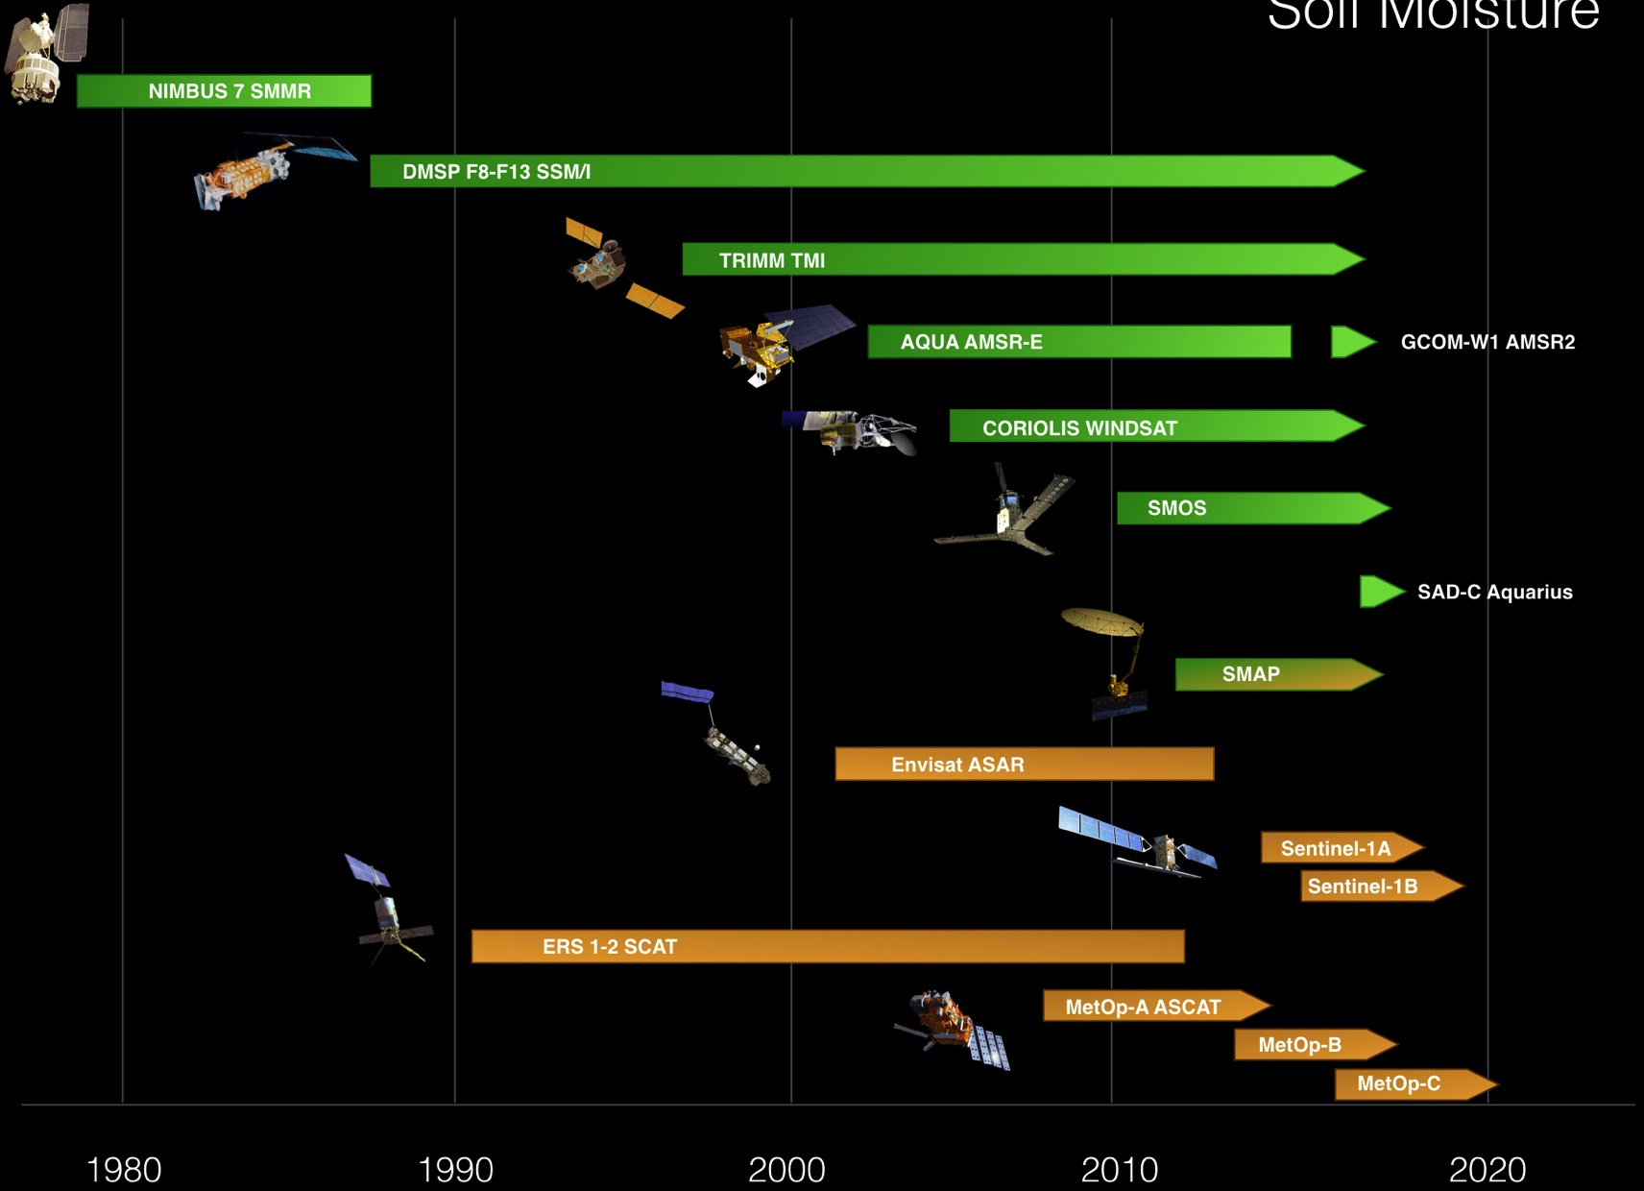








Exploiting satellite archive
Ç`
Soil Moisture ECV www.esa-soilmoisture-cci.org
➔ 35+ years of satellite data
Notes:
Satellites are excellent at providing consistent data over the whole world, sending back vital information to Earth on inaccessible areas.
However, they have finite lifespans of a few years to over a decade and there can be gaps between missions.
To produce data sets long enough for climate research, the combination and inter-calibration of many different satellite missions is required.
The European Space Agency’s Climate Change Initiative (CCI) programme does just this by merging data sets from different missions and sensors in to one continuous series of data.
Observations from ESA’s 30-year archive, together with currently operating satellites, all contribute to making up these data series.
Soil moisture is one such ECV where the data archive is 35 years in length and has been analysed via the ESA CCI

Slide 9
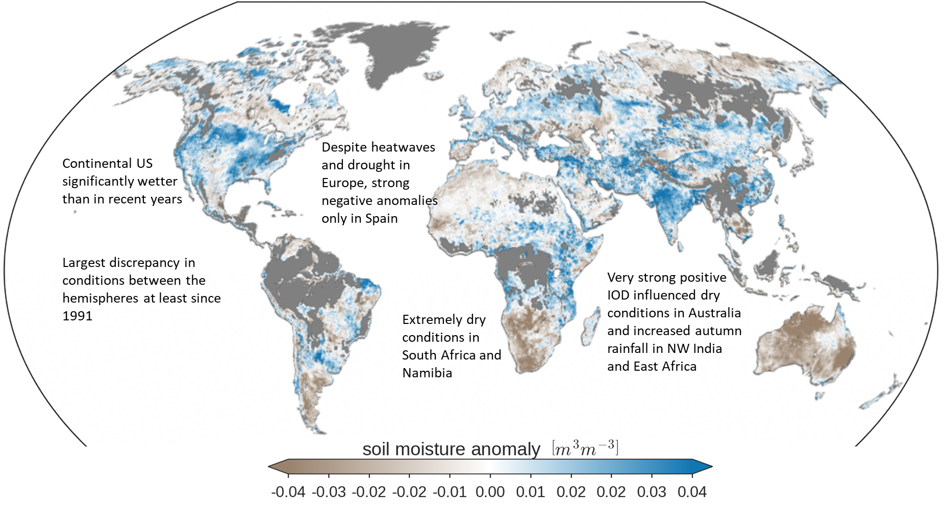
2019 Global Soil Moisture Anomalies
ESA CCI Soil Moisture v04.7 COMBINED product, 1991-2019
ESA CCI Soil Moisture,
BAMS State of the Climate, 2019 in prep.
CCI Soil Moisture is led by W. Dorigo, TU Wien

Slide 10

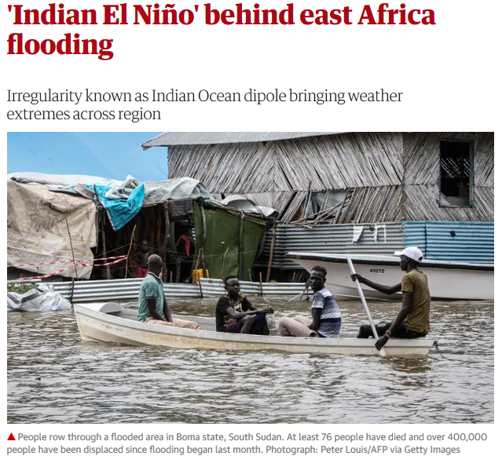
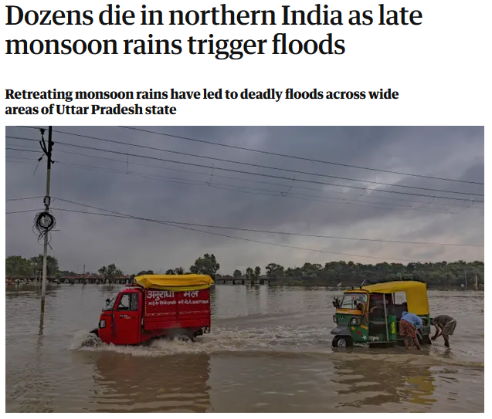
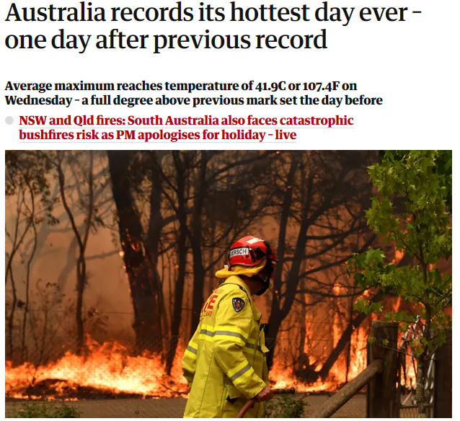
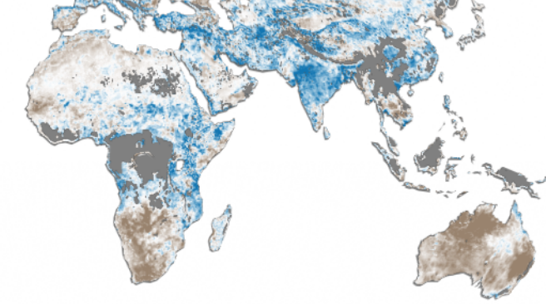
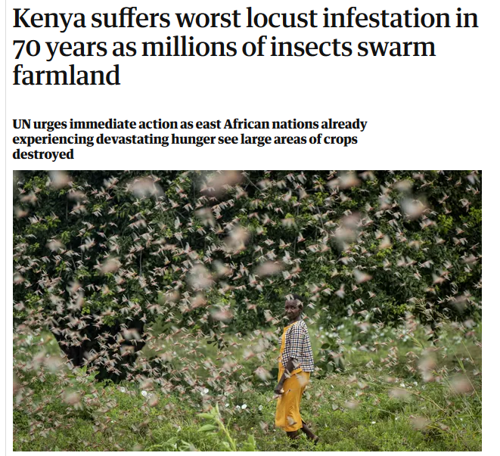
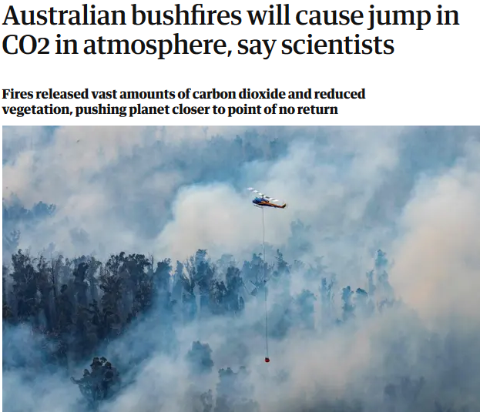
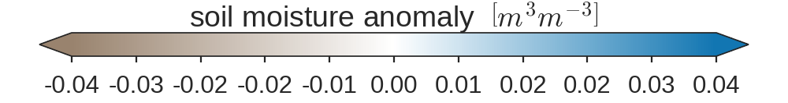
ESA Soil Moisture_cci BAMS State of the Climate, in prep.

Slide 11

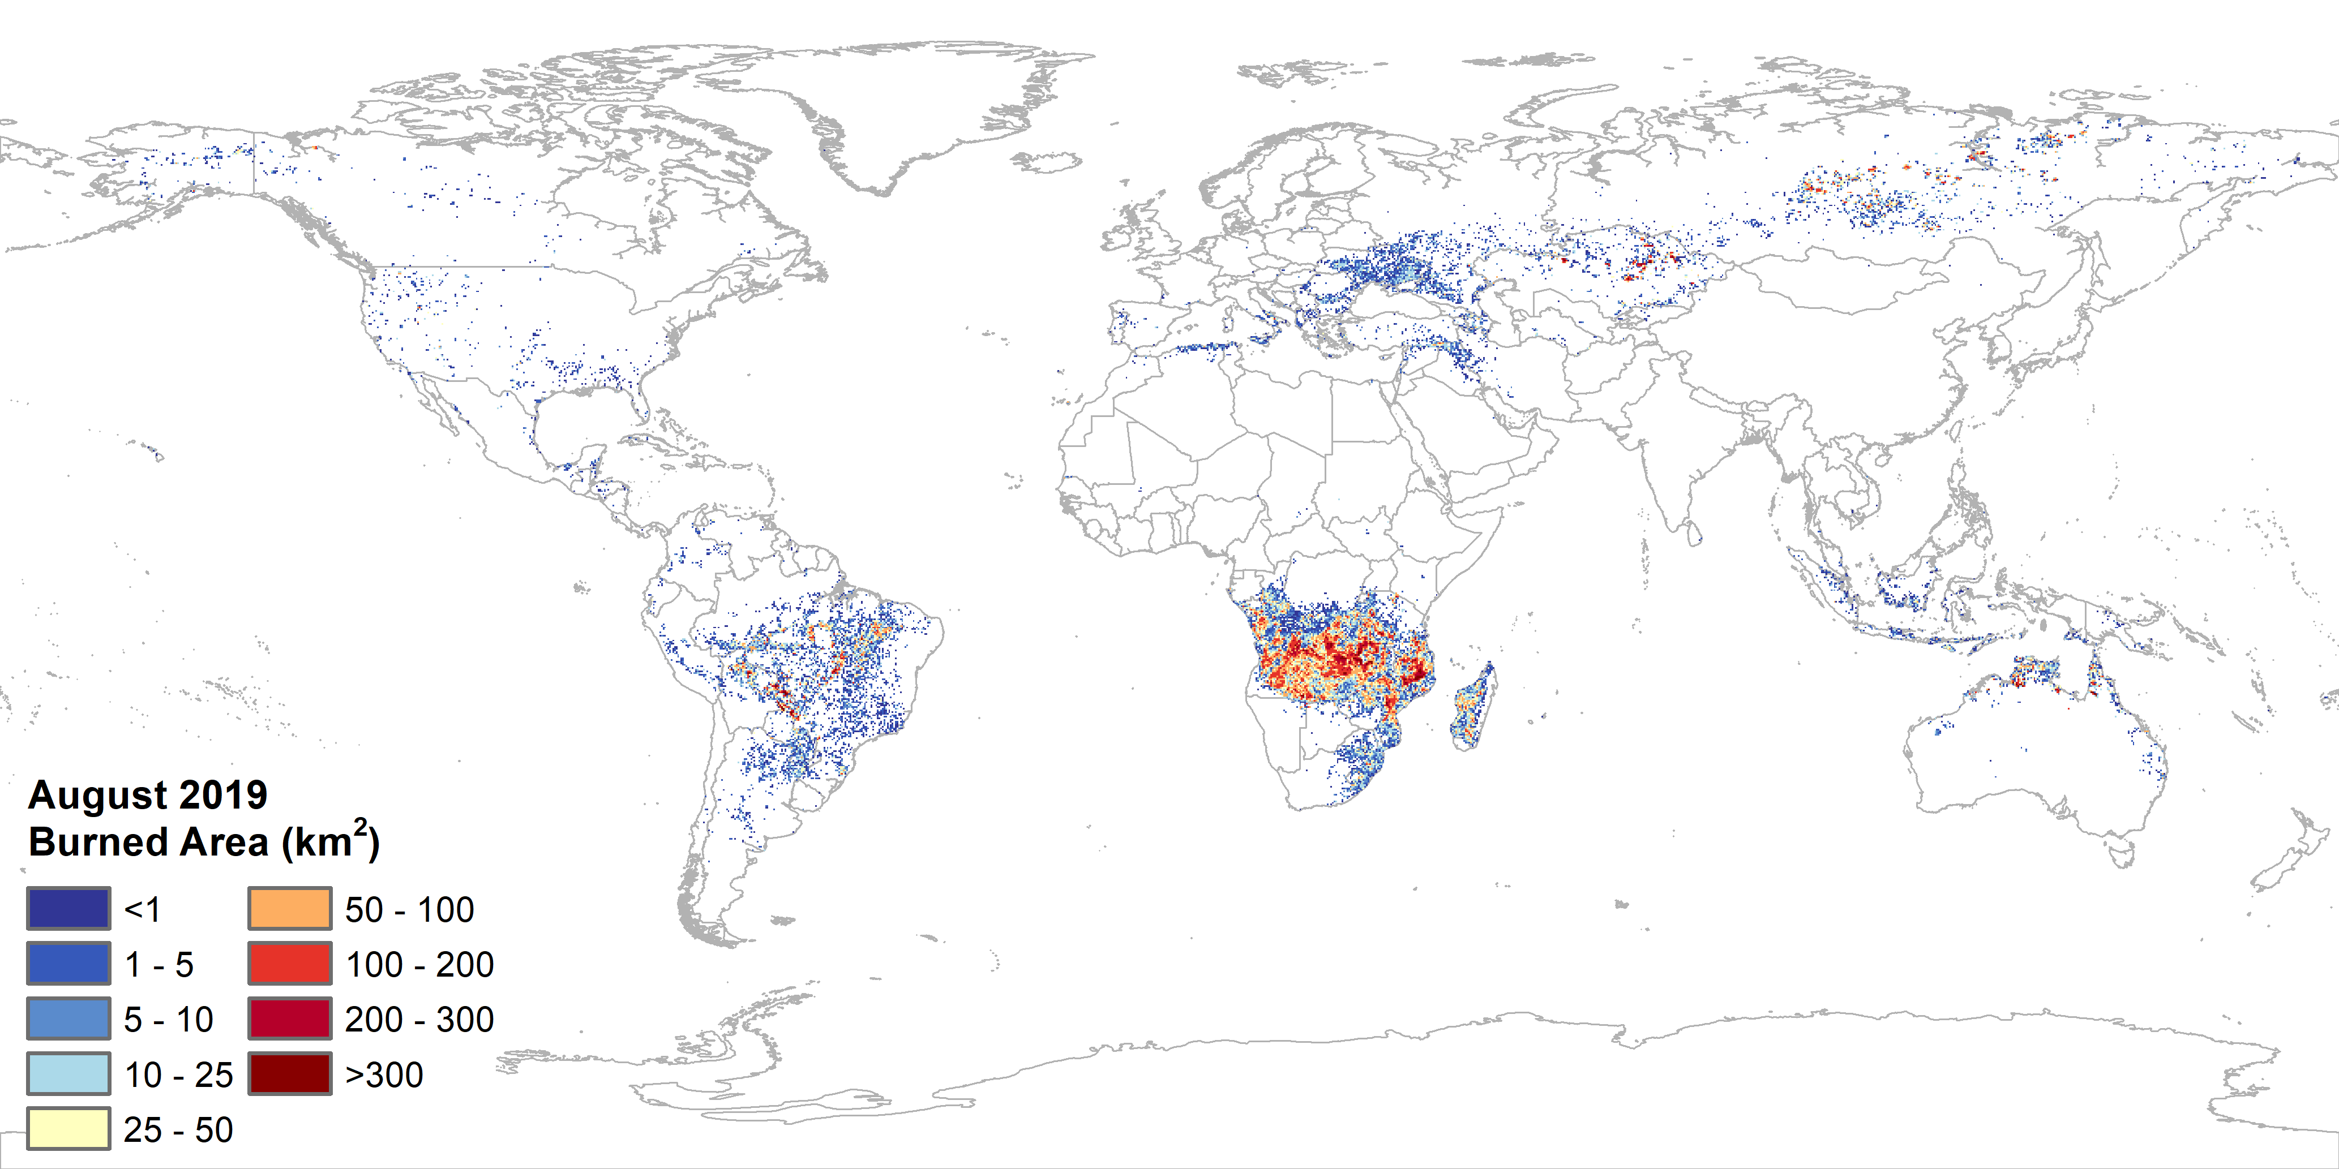
Fire Disturbance ECV www.esa-fire-cci.org
Global BA products:
MODIS (illustrated)
MERIS
AVHRR GAC
Sentinel-3
Combined multi-mission
product 1982-2019
Fire_cci led by E. Chuvieco, U. Alcala, Spain
Notes:
Global BA products:
- MODIS 250m
- Sentinel-3
- AVHRR
+ combined multi-mission product (1982-2019)
Small-fires database
- Sentinel-2A and B over Africa (2018 only)
- Sentinel-1 + Sentinel-2 over three African 500x500km test sites

Slide 12
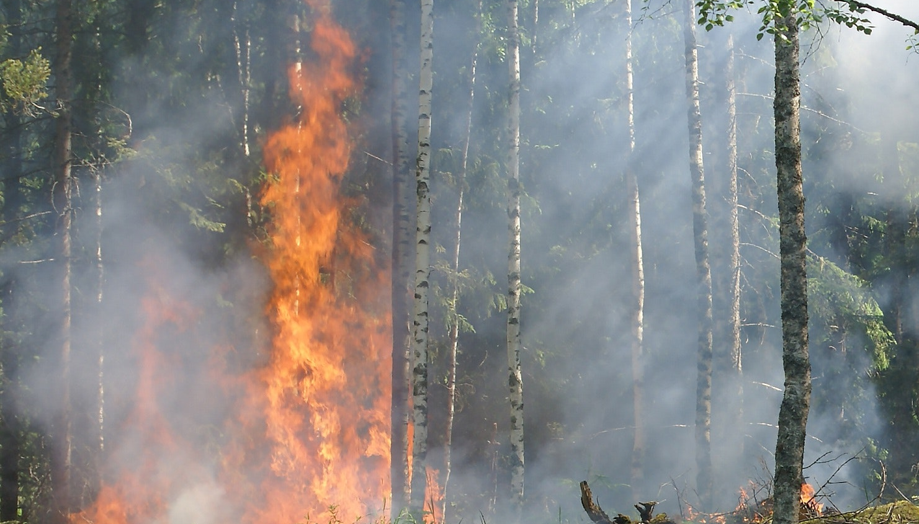
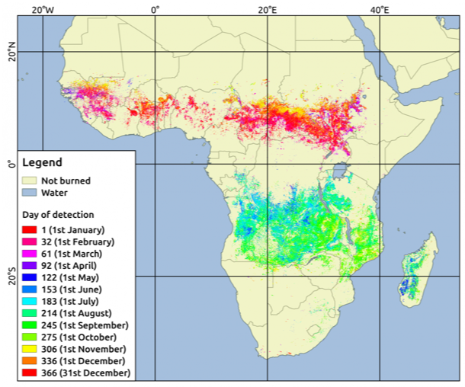
Small Fires (<100ha)
Using Copernicus Sentinel-2 data, an additional 2.2 million km² of burned area was detected across Africa in 2016.
i.e. 80% more than the std global MODIS BA product.
Small fire database of sub-saharan Africa
showing burned area detected during 2016 using Sentinel-2.
Roteta et al., 2019 https://doi.org/10.1016/j.rse.2018.12.011
European Space Agency
Notes:
Small Fires Database
Small-fires database
- Sentinel-2A and B over Africa (2018 only)
- Sentinel-1 + Sentinel-2 over three African 500x500km test sites
Uses 11,000 Sentinel-2 images and active fires from MODIS
All sub-Saharan Africa at 20m, Jan-Dec 2016
Roteta et al. 2019:
- Total BA estimated from our product was 4.9 M km2, around 80% larger area than what the NASA BA product (MCD64A1 c6) detected in the same period (2.7 M km2).
- On the negative side, Sentinel-2 based products have lower temporal resolution and consequently are more affected by cloud/cloud shadows and have less temporal reporting accuracy than global BA products.
- The product derived from S2 imagery would greatly contribute to better understanding the impacts of small fires in global fire regimes, particularly in tro- pical regions, where such fires are frequent

Slide 13
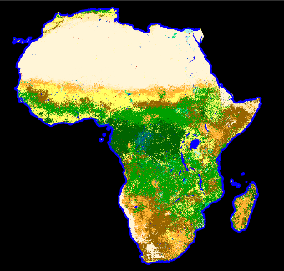
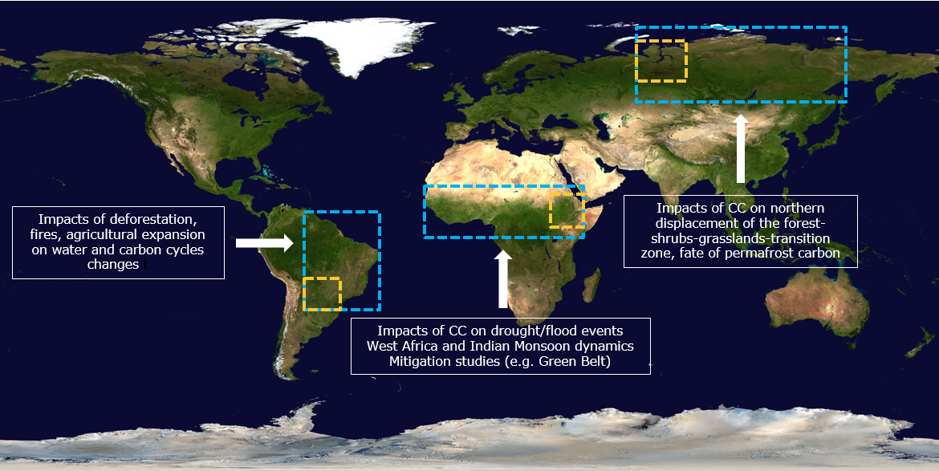
Land Cover ECV www.esa-landcover-cci.org
cci.esa.int/hrlandcover
Sentinel-2 Prototype LC maps
CCI LC yearly maps
1992 » 2015
2016 @ 20m
New HR LC maps in development
2017 @ 10m
Blue rectangles: 10m reference maps
Yellow rectangles: 30m LC change maps (1990-2015)
334 Tbytes – Sentinel-2
10 Tbytes – Sentinel-1
45Tbytes – Landsat 5/7/8
CCI HR Land Cover led by L. Bruzzone, U. Trento, Italy
Interactive viewer:
http://maps.elie.ucl.ac.be/CCI/viewer
CCI Land Cover led by P. Defourney, UCL Belgium
Notes:
Global MR Land Cover maps
300m - 1km 1992-2015
2016, 2017 and 2018 were processed and released by Copernicus C3S in Oct 2019
UN Land Cover Classification System (22 classes)
Sentinel-2 Prototype HR Land Cover maps
Africa 2016 at 20m
Mexico & Central America 2017 at 10m

Slide 14
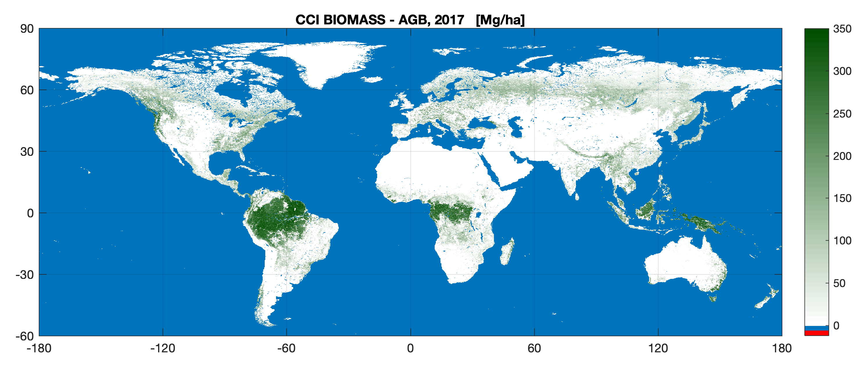
Above Ground Biomass ECV cci.esa.int/biomass
Data to inform the Global Stocktake for the Paris Agreement commitments and REDD+
First of a series of maps to quantify the change in forest biomass over time
CCI Biomass led by S. Quegan, U. Sheffield, UK
Notes:
Biomass is both a source and a sink of CO2: i.e. growth vs deforestation or forest degradation.
The primary science objective ESA’s Climate Change Initiative Biomass project (Biomass_cci) is to provide global maps of above-ground biomass (Mg ha⁻¹) for four epochs (mid 1990s, 2010, 2017 and 2018), with these being capable of supporting quantification of biomass change.
The mapping aims to achieve 500 m to 1 km spatial resolution with a relative error of less than 20 % where AGB exceeds 50 Mg ha⁻¹
Earth observation (EO) missions:
optical sensors (e.g., Sentinel 2A/B),
SAR C-band (Sentinel 1A & B)
SAR L-band (ALOS-2 PALSAR-2)
spaceborne LIDAR (e.g. NASA's Global Ecosystem Dynamics Investigation Lidar [GEDI])
At COP-25 in Madrid (Dec 2019), Biomass CCI released a new dataset for 2017: this has combined the widest possible range of satellite data - radar, optical and lidar - to construct an unprecedented high (1 hectare) resolution product.
New global product uses 2017 data and combines the widest range of satellite data - radar, optical and lidar - to construct a high (1 hectare) resolution product
The first in a series of maps to quantify the change in forest biomass over time
Data to inform the Global Stocktake for the Paris Agreement commitments and REDD+
1st in a series of maps to track change in global land based biomass
Changes in global biomass will impact on the amount of CO2 in the atmosphere (or sequestered in forests)
Quantifies vegetation biomass on land and so is relevant to mitigating climate change and informing the Global Stocktake for the Paris Agreement commitments and REDD+. (UN programme to Reduce Emissions from Deforestation and forest Degradation)

Slide 15
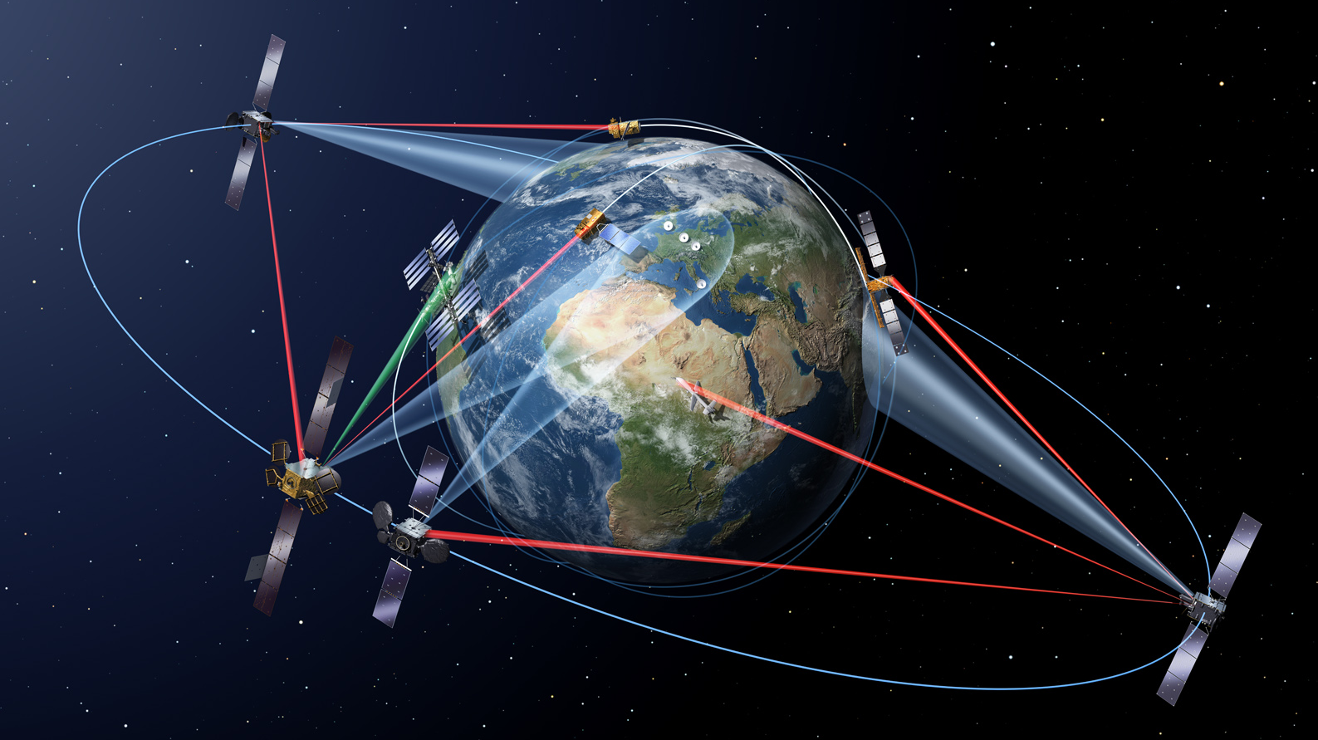
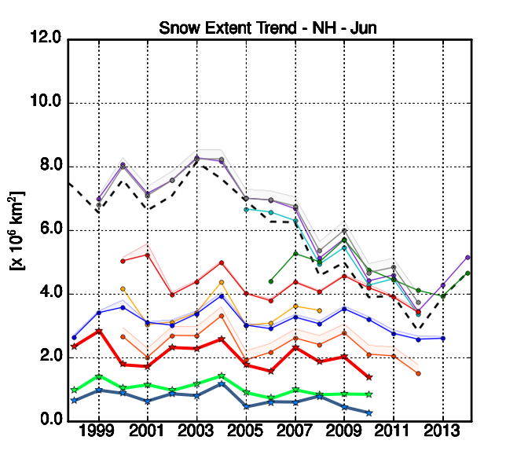
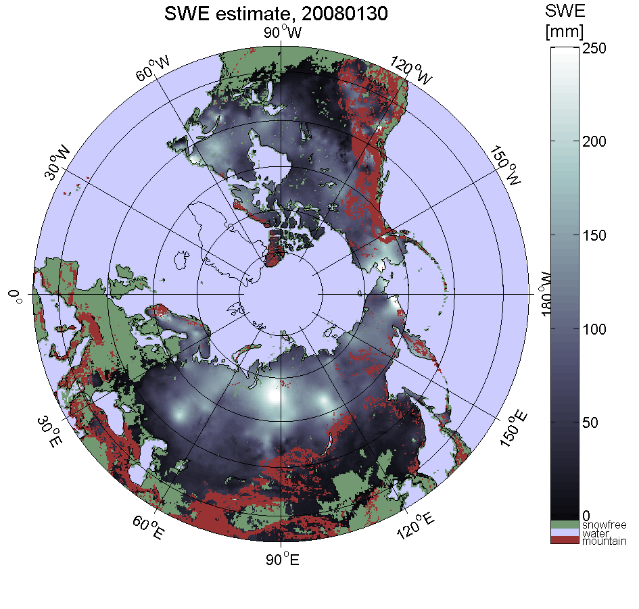
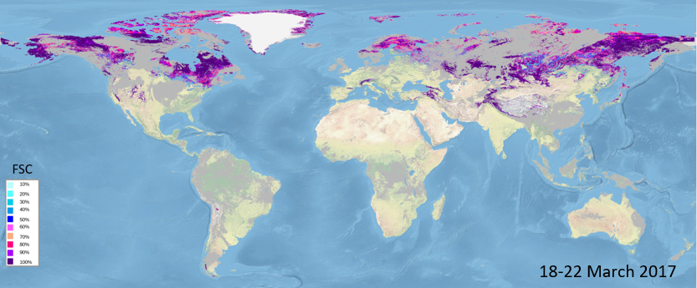

Integrating S5P
Snow ECV cci.esa.int/snow
GCW SnowPEx
Derksen & Brown 2012, doi:10.1029/2012GL053387
FMI/SYKE
Global snow extent, ENVEO
Large discrepancies between different NH snow extent assessments and CMIP5 models.
Snow_cci aims to reconcile these differences, and to develop new multi-mission global snow extent and snow water equivalent climate data records.
15
Snow_cci led by T. Nagler, ENVEO, Austria

Slide 16
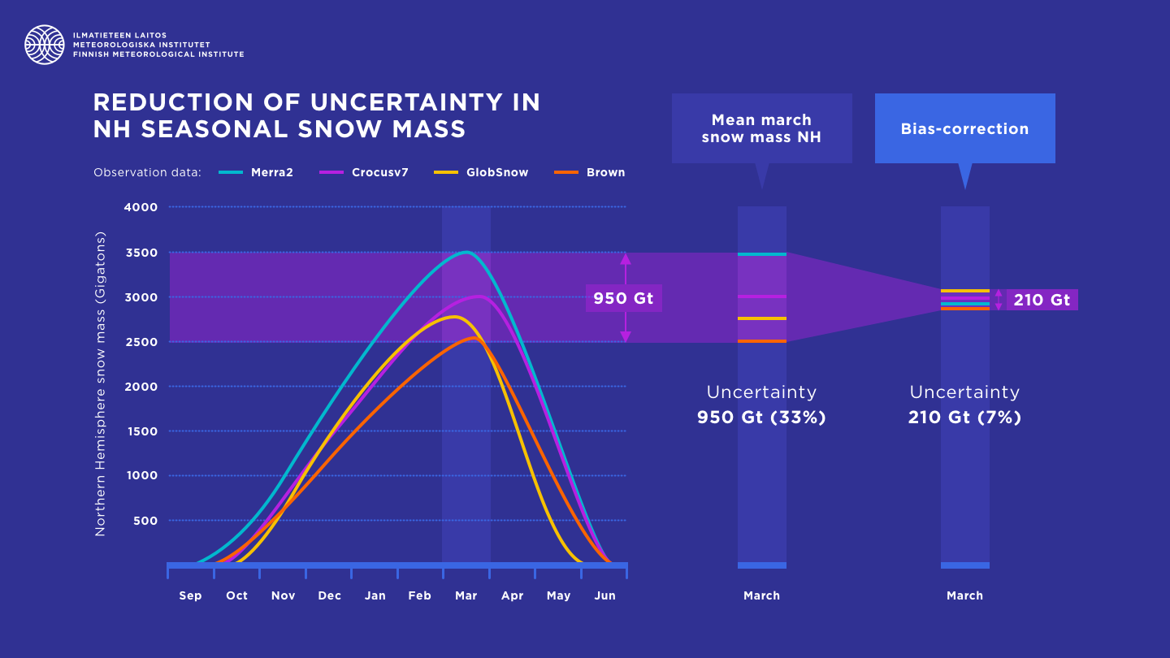
Integrating S5P
Snow ECV cci.esa.int/snow
Snow mass estimates now more reliable
Snow_cci combined 39-year (1980-2018) satellite-derived snow mass climate data record (GlobSnow 3.0) with ground-based snow depth measurements.
Bias-correction reduced uncertainty of NH annual maximum snow mass from 33% (950 Gt) to 7.4%(210 Gt)
Improved long-term CDR of snow mass has enabled continental-scale trends to be investigated For example, snow mass decreased by 46 Gt per decade across North America
Pulliainen, J., Luojus, K., Derksen, C. et al. Patterns and trends of Northern Hemisphere snow mass from 1980 to 2018. Nature 581, 294–298 (2020). https://doi.org/10.1038/s41586-020-2258-0
16

Slide 17
Permafrost ECV cci.esa.int/permafrost
Thawing Permafrost
CCI Permafrost led by A. Bartsch, B.GEOS, Austria
doi:10.5194/tc-14-497-2020
European Space Agency
Notes:
This animation shows the permafrost extent in the Northern Hemisphere from 2003 to 2017.
The maps, produced by ESA’s Climate Change Initiative, are providing new insights into thawing permafrost in the Arctic. Continuous permafrost is defined as a continuous sheet of frozen material and extends under all surfaces, except for large bodies of water.
Discontinuous permafrost is broken up into separate areas and can either be isolated or sporadic.
It is considered isolated if less than 10% of the surface has permafrost under it, while sporadic means 10% to 50% of the surface has permafrost under it.

Slide 18
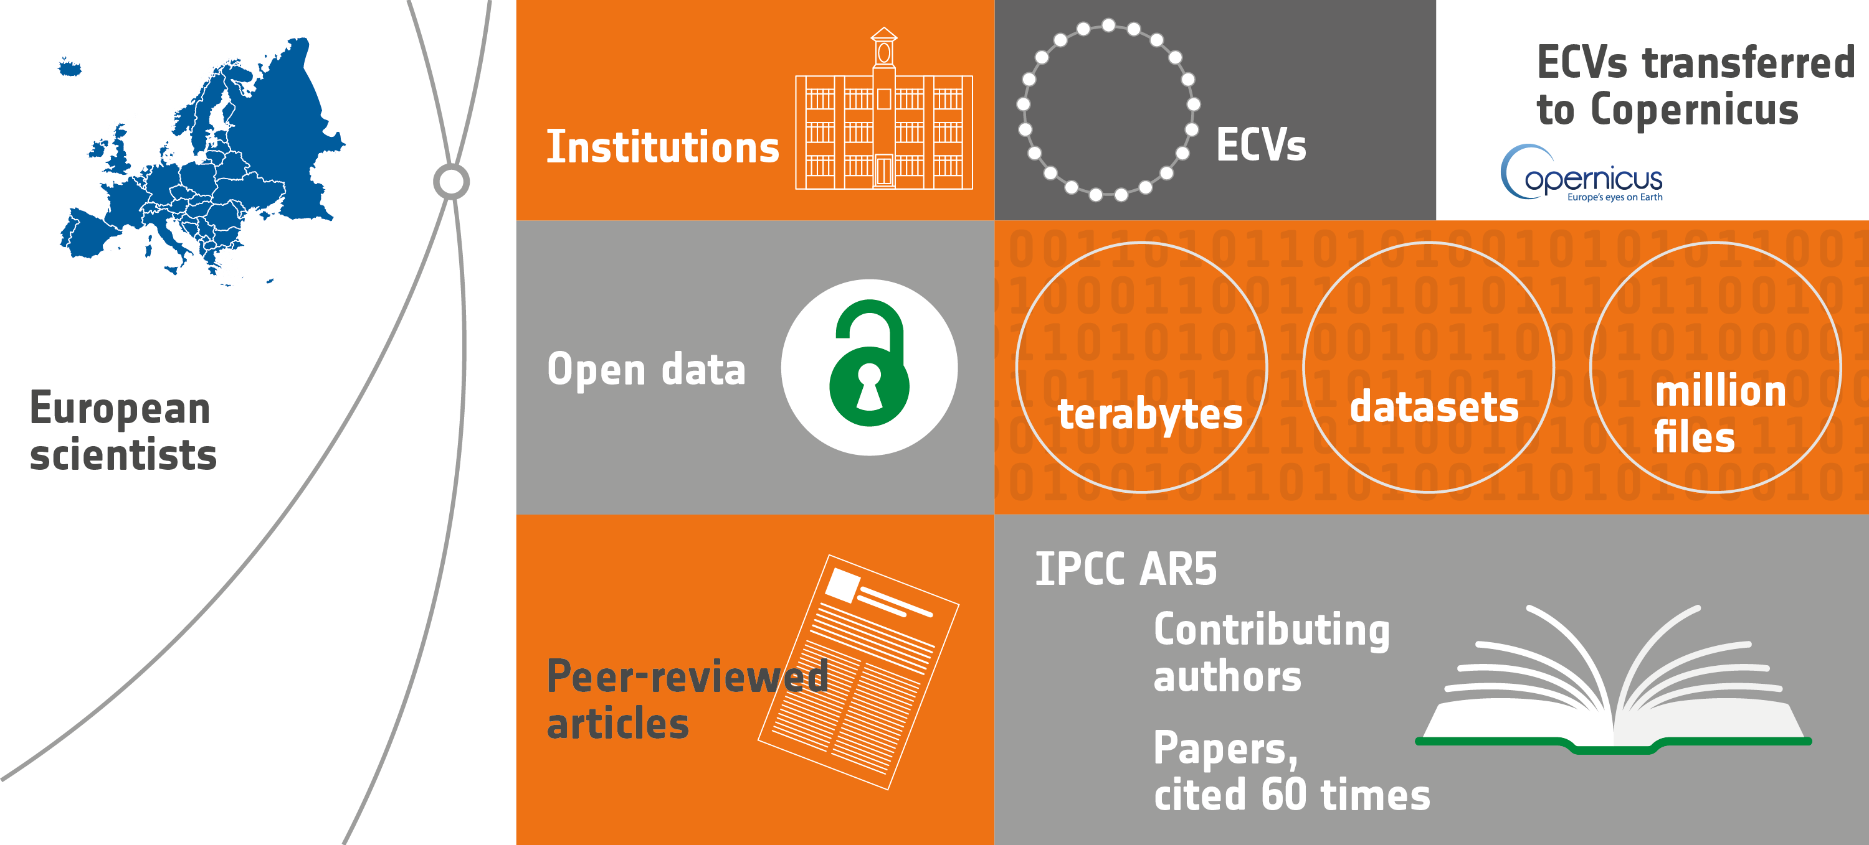
CCI Achievements
178
21
13
4.2
450
133
100+
640
28
15

Slide 19
Thanks for your attention
ESA Climate Change Initiative: cci.esa.int
simon.pinnock@esa.int

