Slide 1
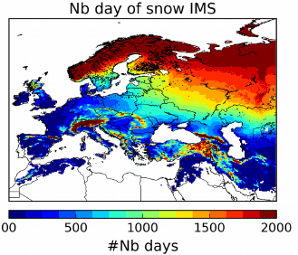
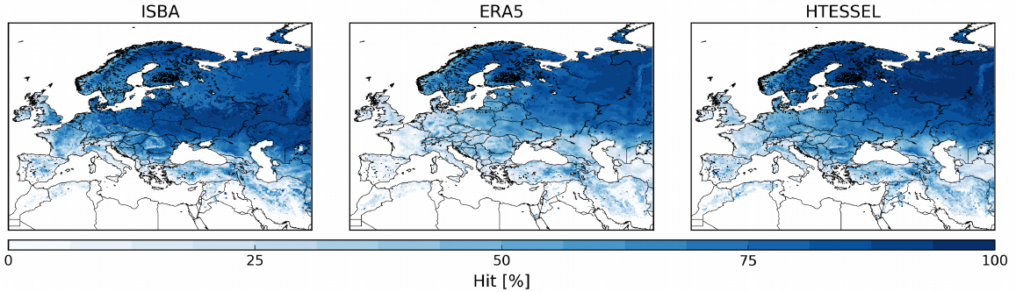
WP3: Meteo-France contribution - 2019
LDAS-Monde
  An open-source land data assimilation system
    Based on the open-source SURFEX modeling platform
    Integrates satellite data into the ISBA land surface model
  Global spatial resolution of 0.25°x 0.25°achieved (IO optimization)
  Assimilation of snow cover products initiated
    NOAA/NESDIS IMS used as a proxy of CCI product

Slide 2
WP3: Meteo-France contribution - 2020
LDAS-Monde
  Assimilation of snow cover products finalized
  Start the cross-cutting evaluation of
    LST-SM-LAI (3.1)
      Copernicus Global Land Service LST product can be used as a proxy
      First version of CCI product will be used
    Snow-SM-LAI (3.2)
      1 week stay of Clément Albergel at ECMWF: link to the Snow-CCI project
      Benchmarking with IMS product
      First version of CCI product will be used
    Permafrost-SM-LAI (3.3)
      First version of CCI product will be used

Slide 3
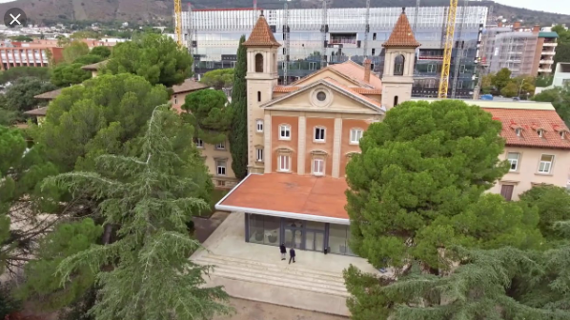
Welcome to CMUG Integration Meeting #9
Wednesday 6 & Thursday 7 November 2019
Barcelona Super Computer Centre

Slide 4








Aims of the meeting
Prof. Richard Jones, Met Office, CMUG Lead Scientist
1. Presentation and discussion of CMUG results
2. Discussion of ECV User Requirements (wrt needs of the Climate Research Community, CMUG and GCOS requirements)
3. Discuss the emerging product specifications for the new ECVs
4. Examine how projects are addressing an integrated perspective for consistency between ECVs
5. Discuss how to deal with uncertainties in products (how to capture and describe them for users)
6. Develop ECV projects' data needs for ECMWF reanalysis data
7. Allow CMUG and the existing ECV teams to demonstrate 'best practice' to the new ECV teams
8. Maintain oversight of the position within the international framework in which CMUG/CCI is operating

Slide 5
Inputs to the meeting
You!! The ECV teams and other CCI projects
Experts from C3S, GCOS, WCRP, EUMETNET, Future Earth, FIDUCEO, UKESM
CMUG results (URD, FR, DAR, QAR, MIP, SER, CS, ESMValTool)
Documentation from ECVs (URDs, DARDs, CECRs,… etc)
ESA CCI Project Guidelines [http://cci.esa.int/sites/default/files/ESA_CCI_Project_Guidlines_V1.pdf]
GCOS requirements [https://public.wmo.int/en/programmes/global-climate-observing-system/essential-climate-variables]
CCI Uncertainty paper
CCI Consistency paper

Slide 6
Planned meeting outputs
A report informed by the following:
Actions agreed by CCI projects, and by CMUG
Materials to inform CCI and CMUG research
Potential for joint CMUG / CCI scientific exploitation
CMUG / CCI outreach/engagement in the international arena
Clarity on requests for ECMWF reanalysis data
Feedback on Integration 9: what you liked and what could be improved

Slide 7
CMUG Objectives relevant to this meeting
1. Support integration within the CCI programme
- through requirements and user assessment from data users
- through feedback from a “climate system” perspective
2. Foster the exploitation of Satellite-derived Essential Climate Variables (ECVs)
- by promoting the use of CCI data sets to climate modellers.
- by building partnership and links with existing research organisations, networks and scientific bodies of the Climate Modelling Community.
3. Assess quality and impact of individual/combined Global Satellite Data Products in Climate Model and Data Assimilation contexts
- by assessing suitability of products for climate applications (e.g. climate modelling, decadal prediction, reanalysis, etc)
- by quantifying their added value on model performance in an objective manner
Notes:
CMUG work with all the CCI projects ECV, data, outreach etc on these results

Slide 8
CMUG current activities and results
Updated USER REQUIREMENTS for climate modelling applications, reanalyses, and Climate Services, and compared them with CCI ECV specifications
Assess the QUALITY AND CONSISTENCY of multiple CCI datasets in combination using state of the art climate models and provide FEEDBACK on this to the CCI teams
EXPLOIT CCI DATASETS through a ”Model Intercomparison Project” (SST, Sea Ice, Aerosol, Land Cover, Soil Moisture, Fire) using two different climate model
  Adapt climate EVALUATION TOOLS for CCI NEEDS – the Climate Monitoring Facility at ECMWF and the ESMVal tool will be developed for use on CCI data
Provide the CCI teams with an INTEGRATED PERSPECTIVE on research issues (uncertainty, data, Obs4MIPs)
Actively PROMOTE CCI DATASETS to the climate modelling and climate research communities through scientific engagement with programmes and initiatives (e.g. engaging with Horizon 2020 climate research projects, the CCI Data Forum)
ENGAGEMENT at an INTERNATIONAL LEVEL to ensure CCI datasets reach researchers around the world (e.g. through IPCC reports, GCOS, other international and regional initiatives)

Slide 9
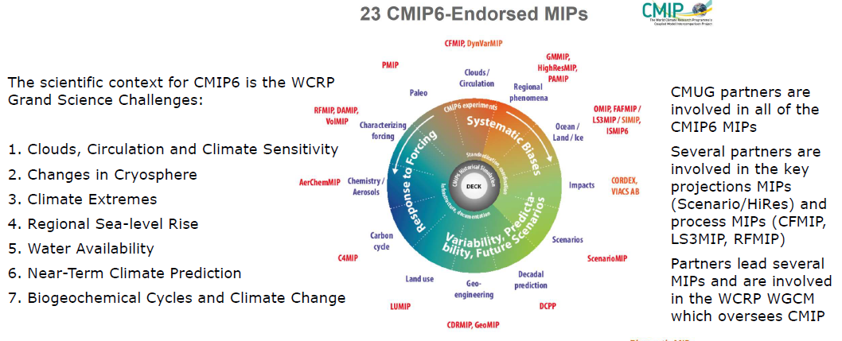
CMUG interactions with the “MIPs”

Slide 11
CMUG report on User Requirements
Purpose: to assist the CCI ECV and X-cutting projects on the needs of the Climate Modelling Community (CMC), Climate Research Community (CRC) and other expert users of climate data.
1) present an analysis of the satellite observation climate data requirements of the above communities (including C3S and other CS), detection and attribution of climate change, climate process studies, climate change impacts and climate/environmental monitoring.
2) covering the requirements for the 23 ECVs in terms of parameters, resolution and errors/uncertainties (and observation operators).
3) address the requirements for CCI datasets to be included in the Copernicus Climate Change Service and the Obs4MIPs interface.
4) cover overarching technical requirements and scientific linkages for the datasets

Slide 12
CMUG report on User Requirements
Starting Point
1) GCOS requirements (updated every 5+ years).
2) To inform other international initiatives (WCRP grand challenges, IPCC future research needs, UNFCCC Global Stocktake, ...)
3) The Climate Modelling Community, including the Obs4MIPs initiative.
4) C3S and other Climate Services
5) Expert users of climate information (Adaptation community, Insurance industry, ...)
6) The known requirements that were used to develop the 14 CCI ECVs .

Slide 13
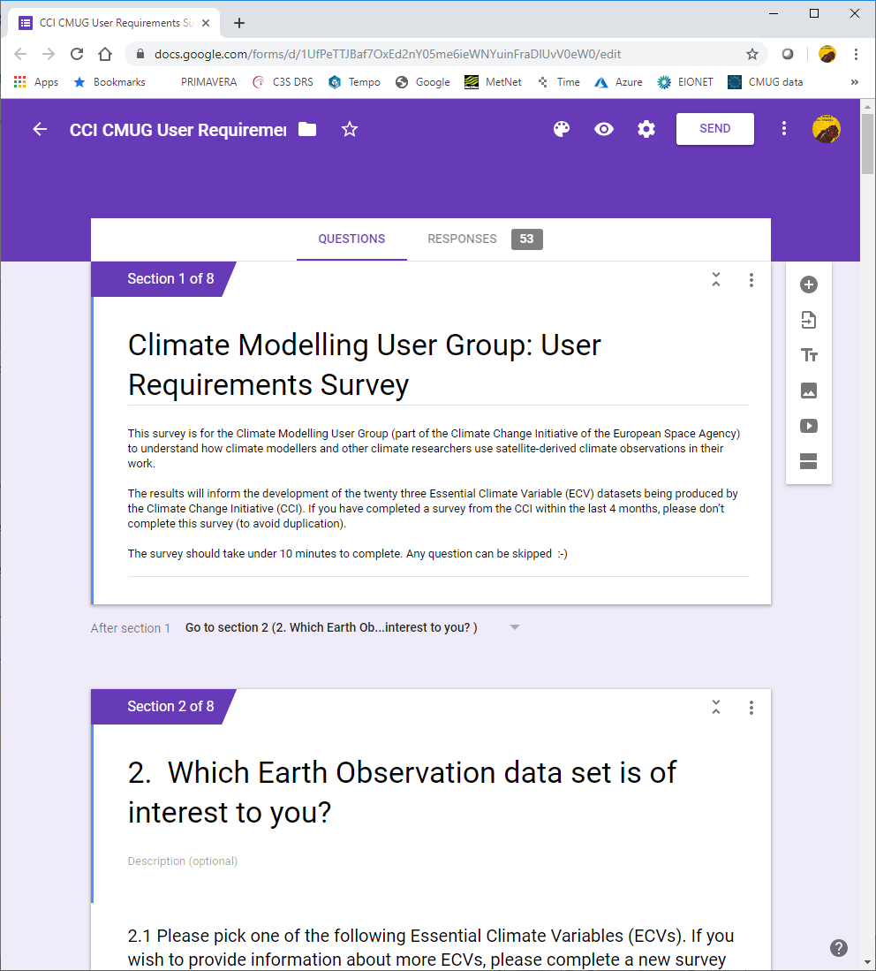
CMUG report on User Requirements
The process of gathering requirements and supporting information:
1) Climate Science papers
2) High level strategy documents
3) EXPERTS
- Online survey
- Interviews
- User groups

Slide 14
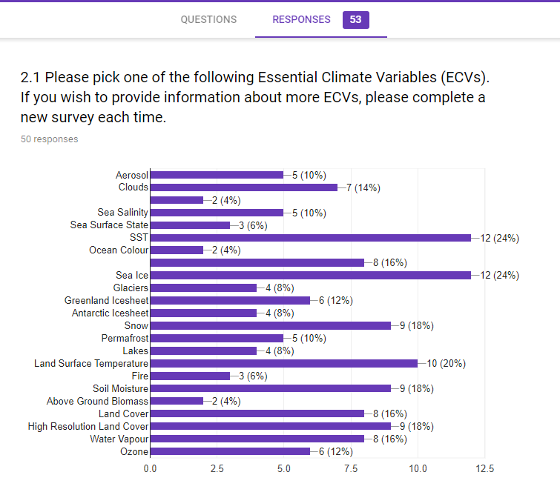
CMUG report on User Requirements
Responses:
144 ECV replies from 53 experts
GHG
SLR

Slide 15
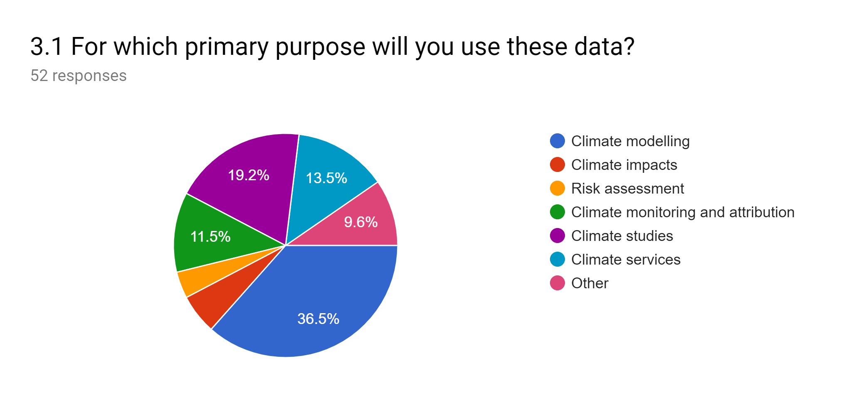
CMUG report on User Requirements

Slide 16
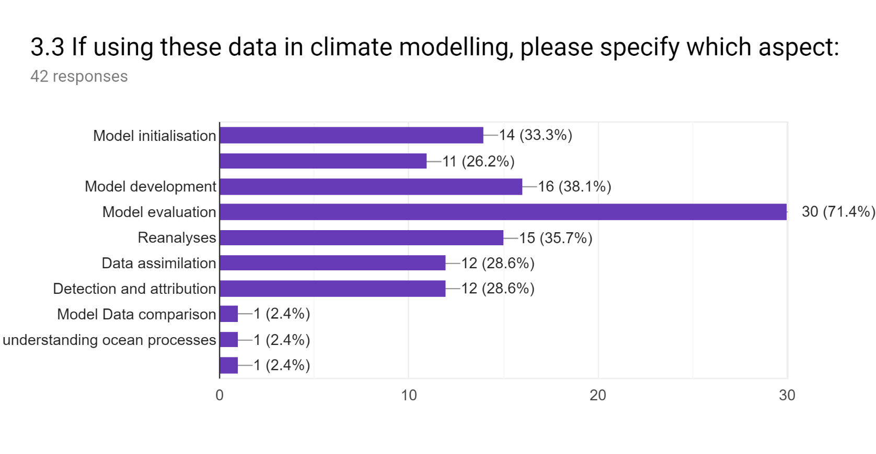
CMUG report on User Requirements
Definition of boundary conditions
Development of statistical downscaling

Slide 17
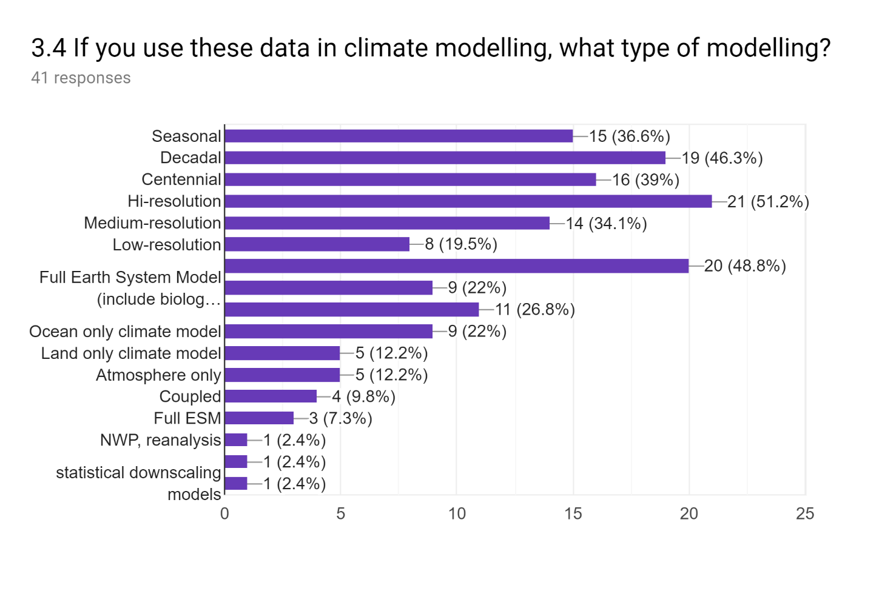
CMUG report on User Requirements
Coupled modelling
Full Earth system (inc. bio-geo-chem)
Atmosphere only modelling

Slide 18
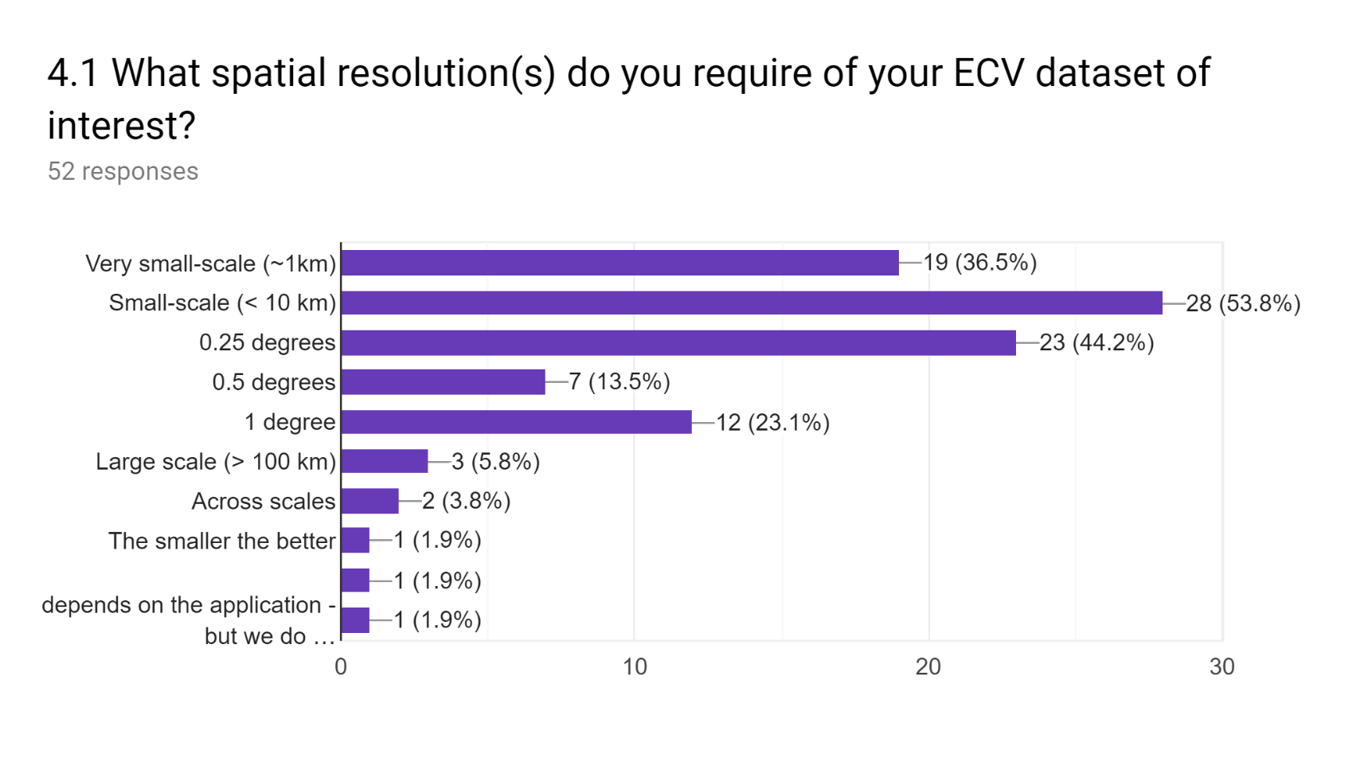
CMUG report on User Requirements

Slide 19
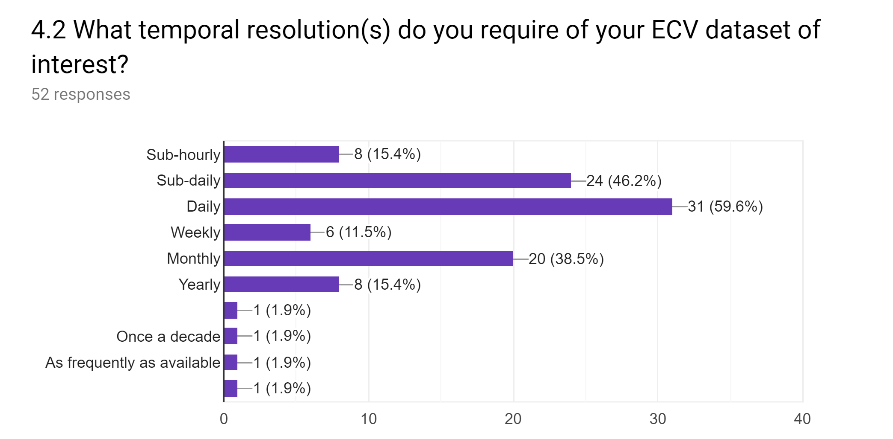
CMUG report on User Requirements

Slide 20
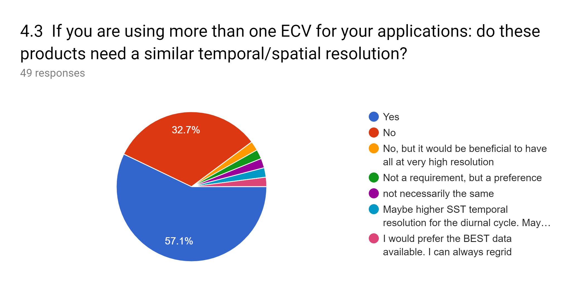
CMUG report on User Requirements
Notes:
Whole bunch of text based answers follow on PRECISION, ACCURACY, STABILITY, ERROR CHARACTERISATION, APPLICATION, EXTENT (eg global)

Slide 21
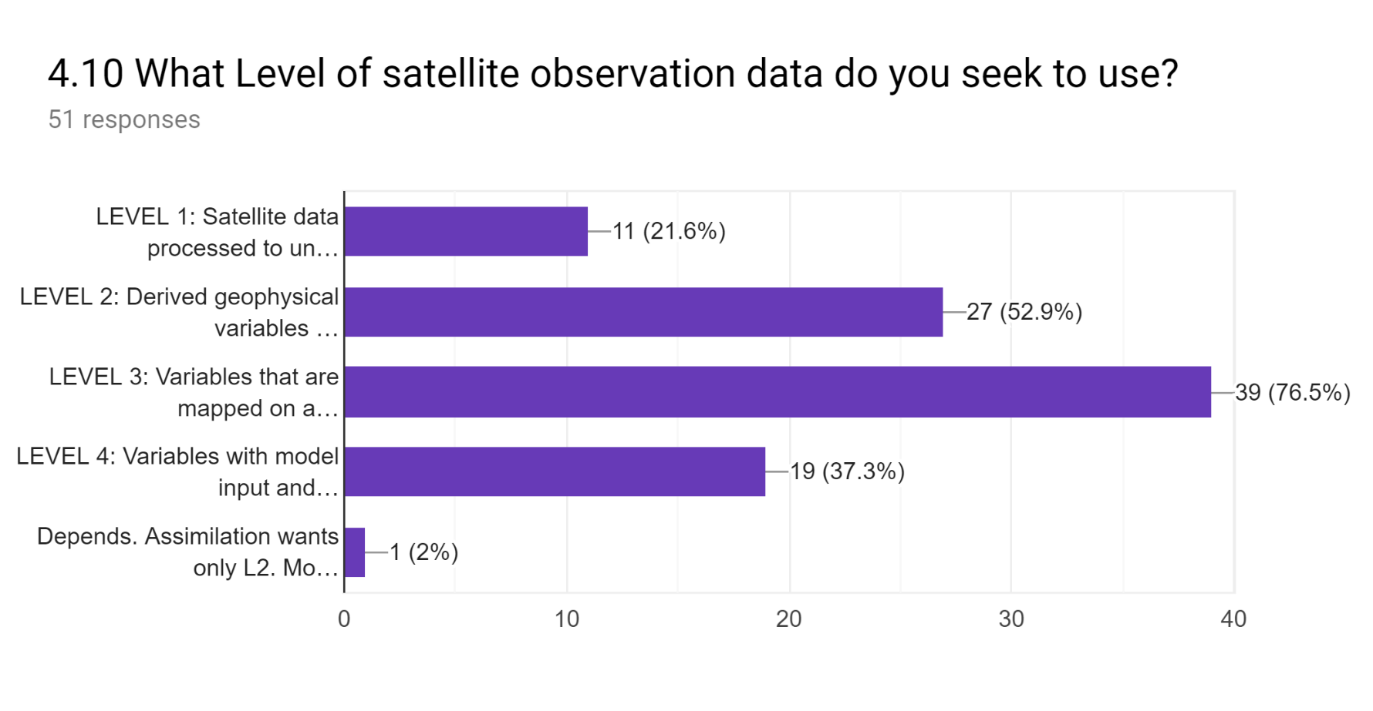
CMUG report on User Requirements

Slide 22
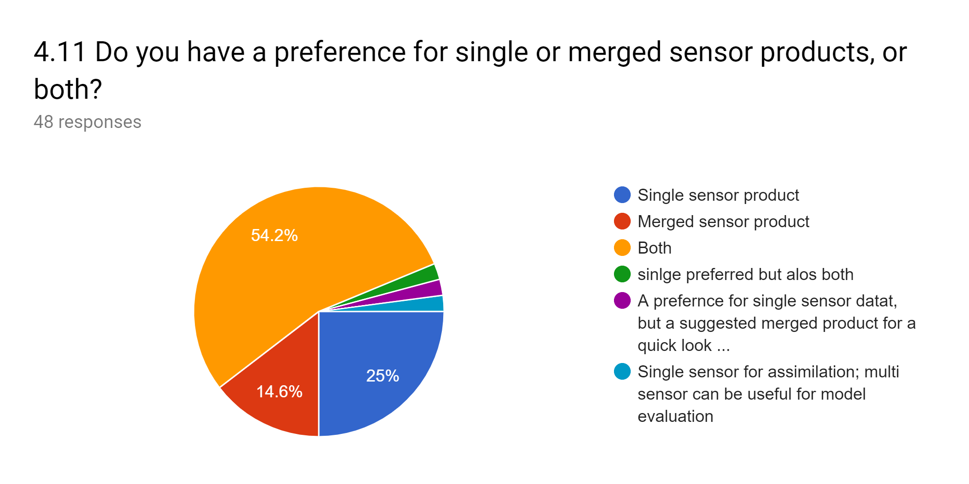
CMUG report on User Requirements
Notes:
More results on frequency, gridding,

Slide 23
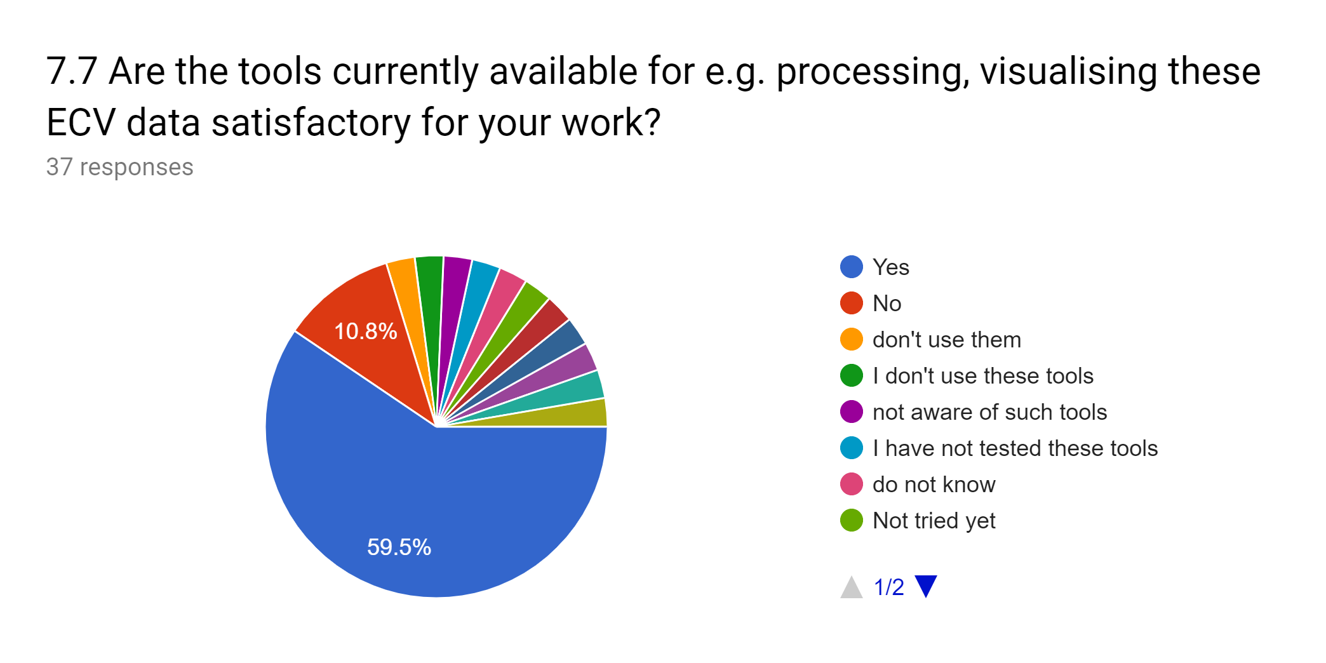
CMUG report on User Requirements

Slide 24
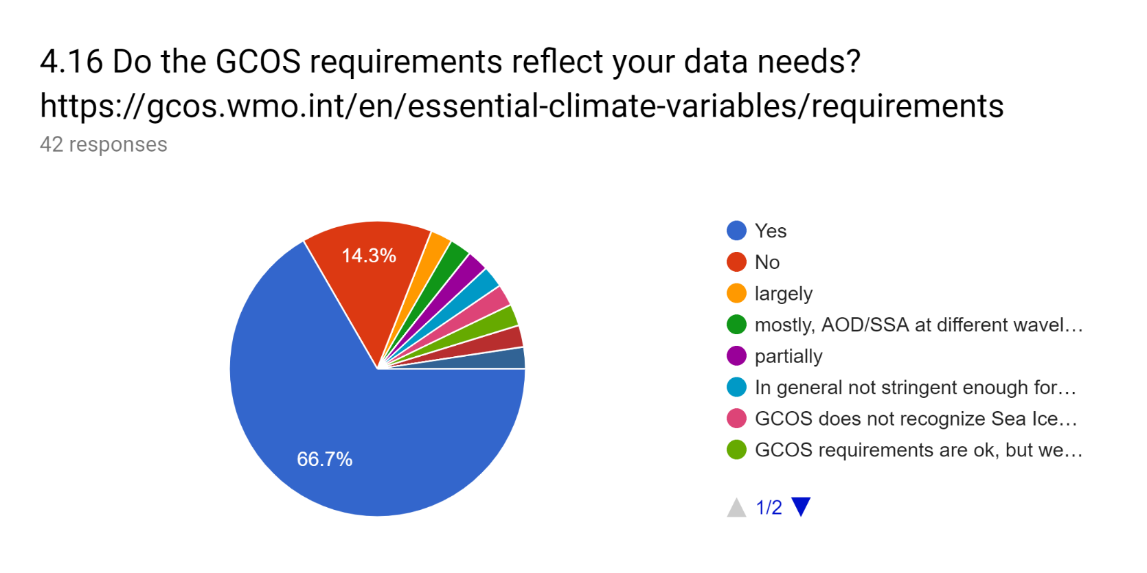
CMUG report on User Requirements

Slide 25
D2.3 Assessment of CCI Technical Documentation

Slide 26
D2.3: Assessment of product documentation
PURPOSE: to update the existing report (currently 3-years old)
To assess project deliverable documents such as:
  Product validation and inter-comparison Report
  Climate Assessment Report
  Comprehensive Error Characterisation Report
  Others e.g. Product specification document, User requirement document
Give feedback to ESA and the CCI teams:
  Through assessment of Quality, Uncertainty, and Maturity of the product
Notes:
Product validation and inter-comparison report: Steps and strategies used for the validation
Climate assessment report: an assessment of trends and variability in the CCI products compared to other products
Uncertainty characterisation report: document the best current understanding of uncertainties (i.e., components of error distributions)
Product specification document: complete description of the products
User requirement document: derive the specifications
Quality: Product validation and intercomparison report, product validation report, product validation plan
Uncertainty: Comprehensive error characterisation report
Maturity: Climate assessment report, user requirement document, product specification document,

Slide 27























Assessment of product documentation
Existing ECVs
New ECVs
Notes:
Some new ECVs will not currently have product documentation

Slide 28
Existing ECVs
ECV | Quality | Uncertainty | Maturity | GCOS requirements
SST | ✓ | ✓ | ✓ | ✓
Ocean Colour | ✓ | ✓ | ✓ | ✓
SSH | ✓ | ✓ | ✓
Sea Ice | ✓ | ✓ | ✓
Clouds | ✓ | ✓ | ✓
Aerosols | ✓ | ✓ | ✓ | ✓
GHG | ✓ | ✓ | ✓ | ✓
Ozone | ✓ | ✓ | ✓ | ✓
Land Cover | ✓ | ✓ | ✓ | ✓
Fire | ✓ | ✓ | ✓ | ✓
Soil Moisture | ✓ | ✓ | ✓ | ✓
Greenland IS | ✓ |  | ✓ | X
Antarctic IS | ✓ | ✓ | ✓ | X
Notes:
Cross-hatching (Quality): PVP / PVIR partly describes quality process or quality goals
Cross-hatching (Uncertainty): CECR partly describes the process for uncertainty characterisation or goals
Cross-hatching (Maturity): CAR partly describes process for achieving climate-based goals
Cross-hatching (GCOS): Partly meets GCOS requirements

Slide 29
New ECVs
ECV | Quality | Uncertainty | Maturity | GCOS requirements
Water Vapour | X |  | X | X
Sea Surface Salinity |  | X | X | X
Sea State |  | X | X | X
Lakes | X | X | X | X
Snow | X |  |  | X
Permafrost | ✓ | ✓
Land Surface Temperature
High res. land cover | X | X | X | ✓
Above Ground Biomass
Notes:
Cross-hatching (Quality): PVP / PVIR partly describes quality process or quality goals
Cross-hatching (Uncertainty): CECR partly describes the process for uncertainty characterisation or goals
Cross-hatching (Maturity): CAR partly describes process for achieving climate-based goals
Cross-hatching (GCOS): Partly meets GCOS requirements

Slide 30


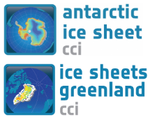

Assessment of product documentation
For Essential Climate Variables:

Slide 31
Land ECVs
ECV | Quality | Uncertainty | Maturity | GCOS requirements
Land Cover | ✓ | ✓ | ✓ | ✓
Fire | ✓ | ✓ | ✓ | ✓
Soil Moisture | ✓ | ✓ | ✓ | ✓
Lakes* | X | X | X | X
Land Surface Temperature*
High res. land cover* | X | X | X | ✓
Above Ground Biomass*
*new ECV

Slide 32
Ocean ECVs
ECV | Quality | Uncertainty | Maturity | GCOS requirements
SST | ✓ | ✓ | ✓ | ✓
Ocean Colour | ✓ | ✓ | ✓ | ✓
SSH | ✓ | ✓ | ✓
Sea Surface Salinity* |  | X | X | X
Sea State* |  | X | X | X
*new ECV

Slide 33
Atmosphere ECVs
ECV | Quality | Uncertainty | Maturity | GCOS requirements
Clouds | ✓ | ✓ | ✓
Aerosols | ✓ | ✓ | ✓ | ✓
GHG | ✓ | ✓ | ✓ | ✓
Ozone | ✓ | ✓ | ✓ | ✓
Water Vapour* | X |  | X | X
*new ECV

Slide 34
Cyrosphere ECVs
ECV | Quality | Uncertainty | Maturity | GCOS requirements
Greenland IS | ✓ |  | ✓ | X
Antarctic IS | ✓ | ✓ | ✓ | X
Snow* | X |  |  | X
Permafrost* | ✓ | ✓
Sea Ice | ✓ | ✓ | ✓
*new ECV

Slide 35
D2.1: Earth Observation Foresight Report
Aim: To assess requirements for Earth Observation developments to provide support to the climate modelling and information community
Objective: To inform the new ESA Climate Programme proposal for 2022 via a broad community consultation
Lead author: Richard Jones, CMUG Science Leader – Met Office Hadley Centre (Oxford University)
Contributing authors from CMUG partners (ECMWF, IPSL, MPI-Met, Meteo France, BSC, DLR, SMHI) and CCI project Science Leaders (covering 25 CCI ECVs and Cross-ECV activities).
Review by climate modelling/information/services stakeholders
Notes:
Original timeline: March to June 2019

Slide 36
Report Structure
High Level Drivers of Requirements for EO data, information and services
Climate information and services requiring EO data and research
EO activities required to enable and deliver the information and services
Gap Analysis
Conclusions/Recommendations

Slide 37
High level drivers (1)
UNFCCC requirements on monitoring, attribution and projections of climate change, its implications and response options
Main conduit for information is via IPCC WGI-III assessments and Special Reports
Requires indicators and measurements of:
  the causal factors of climate change (e.g. GHGs, land cover change)
  changes in the physical climate, natural and human systems
  trends in vulnerability and exposure factors (e.g. urbanization, land-use)
Leading to improvements in scientific understanding (e.g. WCRP Grand Challenges)
Supporting better predictions of future impacts/responses via assessment of:
  - needs for adaptation and building resilience
  - mitigation options

Slide 38

High level drivers (2)
UN 2030 Agenda for Sustainable Development
  Sustainable Development Goals
SDGs generally have climate sensitivities:
agriculture, water, health, infrastructure etc are at risk from climate-related hazards so building resilience to these can contribute significantly to SDG attainment

Slide 39
High level drivers (3)
UN Sendai Framework for Disaster Risk Reduction (2015–2030)
Priorities:
Understanding (e.g. vulnerability, exposure, hazard characteristics)
Strengthening governance and management
Investing in resilience
Enhancing preparedness, response capacity, and recovery
Climate-related to climate:
Improve understanding of current and projected future risks from climate hazards
Development of risk reduction strategies: early warning systems, index insurance
Assess potential for future intolerable risks (links back to UNFCCC/PA Article 8)

Slide 40
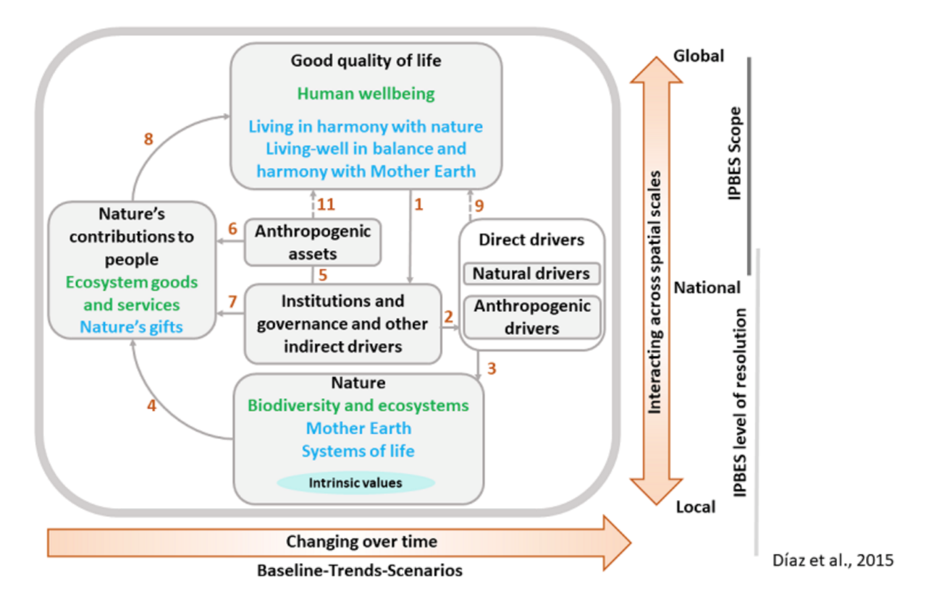
High level drivers (4)
Biodiversity and Ecosystem Services
UN Convention on Biological Diversity (UNCBD) and the Intergovernmental Science–Policy Platform on Biodiversity and Ecosystem Services (IPBES)
                Essential Biodiversity Variables (Biodiversity Observation Networks: GEO-BON) - e.g. phenology, NPP, ecosystem extent and fragmentation.
Notes:
IPBES was established in 2012
The CBD COP provided the following guidance with regard to IPBES:
CBD COP decision XI/2, Review of progress in implementation of national biodiversity strategies and action plans and related capacity-building support to Parties, paragraph 28:
The Conference of the Parties,
Invites the Intergovernmental Science-Policy Platform on Biodiversity and Ecosystem Services, in cooperation with the Executive Secretary, to develop a work programme that includes the preparation of the next global assessment on biodiversity and ecosystem services, to be launched in 2018, focusing on status and trends, the impact of biodiversity and ecosystem services on human well-being, and the effectiveness of responses, including the Strategic Plan and its Aichi Biodiversity Targets, building, inter alia, on its own and other relevant regional, subregional and thematic assessments, as well as on national reports, and requests the Executive Secretary to collaborate with the Intergovernmental Science-Policy Platform, where relevant.

Slide 41
High level drivers (5)
Economy (with links to SDGs, UNFCCC mitigation etc)
Many climate-sensitive sectors of the economy would benefit from improved climate information and prediction, e.g.
agriculture
offshore engineering and maritime operations
renewable energy (solar, wind, hydro, biofuels)
workforce productivity (impact of heatwaves, vector borne diseases such as malaria, buruli worm, dengue, etc.)
Sustainable Economic Development
Economic development in some countries could become unsustainable as a result of future climate change, reversing recent progress in poverty reduction. Accurate predictions of future limitations and adaptation strategies are needed.

Slide 42
Climate Information Services Requiring EO, 1
Monitoring and Reanalysis
Detection and scientific understanding of long term changes in climate and the functioning of the Earth System (e.g. water, carbon, energy cycles)
Monitoring of natural resources (e.g. water resources and quality, land cover)
Modelling and Attribution of Climate Variability, Change and Impacts/Risks
Accurate climate and impact prediction relies on accurate models, and therefore on model verification and process evaluation against observations.
Attribution of impacts/risks to changes in hazards needs observations of changes in possible confounding factors of vulnerability and exposure
Anthropogenic drivers of change (e.g. GHG sources and sinks, land cover)
High resolution fields for model downscaling

Slide 43
Climate Information Services Requiring EO, 2
Seasonal to Decadal Forecasting
To inform society and decision makers in climate-sensitive sectors (agriculture, energy, tourism, health)
Long term ECVs are essential for model initialisation and validation
Building Climate Resilience and Adaptation
Downscaling climate predictions to understand local impacts
Provision of detailed local information required to design interventions to build resilience to future climate change (e.g. mapping of mangroves, forests, wetlands, lake water quality, glacier water resources, soil degradation, urban expansion and heat islands, air quality, etc)

Slide 44
EO activities required for services (1)
Improving Assimilations and Reanalysis
e.g. Develop assimilation of land observations to improve reanalysis (ERA5-Land is a land model driven by the atmos reanalysis, not a model analysis of land observations)
Give high priority to data-poor regions, poorly observed parameters, regions sensitive to change, and key measurements with inadequate temporal resolution.
Attribution and Modelling of Climate Variability and Change
Cross-ECV budget/cycle analysis: provide observational constraints to improve model capabilities to predict future changes. Would also highlight key gaps in the observation network.
New short-term ECVs for model process evaluation (e.g. EarthCARE)

Slide 45
EO activities required for services (2)
New and Improved Climate Data Records
R&D to integrate data from new/future instruments: e.g. Sentinels, S-HPCMs, S-NGs, Earth Explorers, Altius, TRUTHS, MTG/Metop-SG, ...
New GCOS requirements: e.g. GHG fluxes; better cross-ECV consistency to address climate cycles and budgets
R&D to integrate valuable data from early instruments (~1960-1990), including data rescue activities (e.g. to collect regional direct broadcast archives)
New ECV products: e.g. Vegetation Optical Depth, sea-ice snow depth, snow albedo, melt pond coverage, ...
High resolution data sets for local adaptation activities (e.g. support to international development projects, civil protection agencies, NGOs)
Respond to specific requirements from climate services

Slide 46
Gap Analysis
Task to be completed:
Q1: What more is needed beyond what already exists or is already planned?
  Take into account:
  Existing climate services (Copernicus C3S, national, GFCS)
  Existing R&D programmes (WCRP, national, Horizon Europe, ESA, ...)
  Activities of other space agencies (EUMETSAT, NASA, ...)
Q2: What of the above falls within ESA's mandate?
  Focus on maximising the benefits from ESA's and ESA Member States' satellite infrastructure.
Q3: What are the highest priorities, and provides the greatest benefit vs. cost

Slide 47
WP3: quality assessment of CCI products
J.-C. Calvet on behalf of WP3 partners

Slide 48
WP3: quality assessment of CCI products
Objective
  Assess consistency and quality of CCI products
  Across ECVs
  Using climate (sub-)models and reanalyses
Effort: 50 pm
  Meteo-France (13 pm) – 3.1, 3.2, 3.3 + coordination
  BSC (15 pm) – 3.4, 3.8, 3.10, 3.11
  ECMWF (9 pm) – 3.12
  IPSL (8 pm) – 3.5, 3.6
  Met Office (5 pm) – 3.7, 3.9

Slide 49
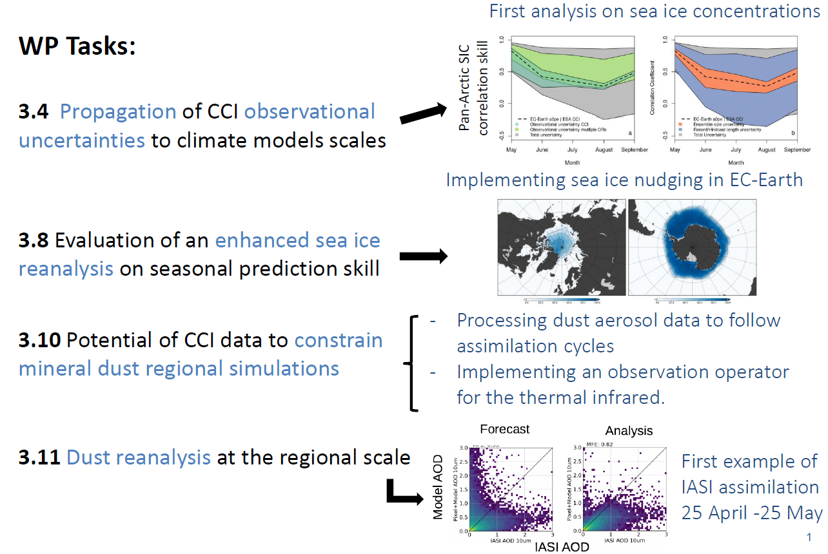
WP3: BSC contribution - 2019
LST-SM-BA
SIC and LST-BA
SSal-SST-SI-Clds
HRLC-Aero-LC

Slide 50
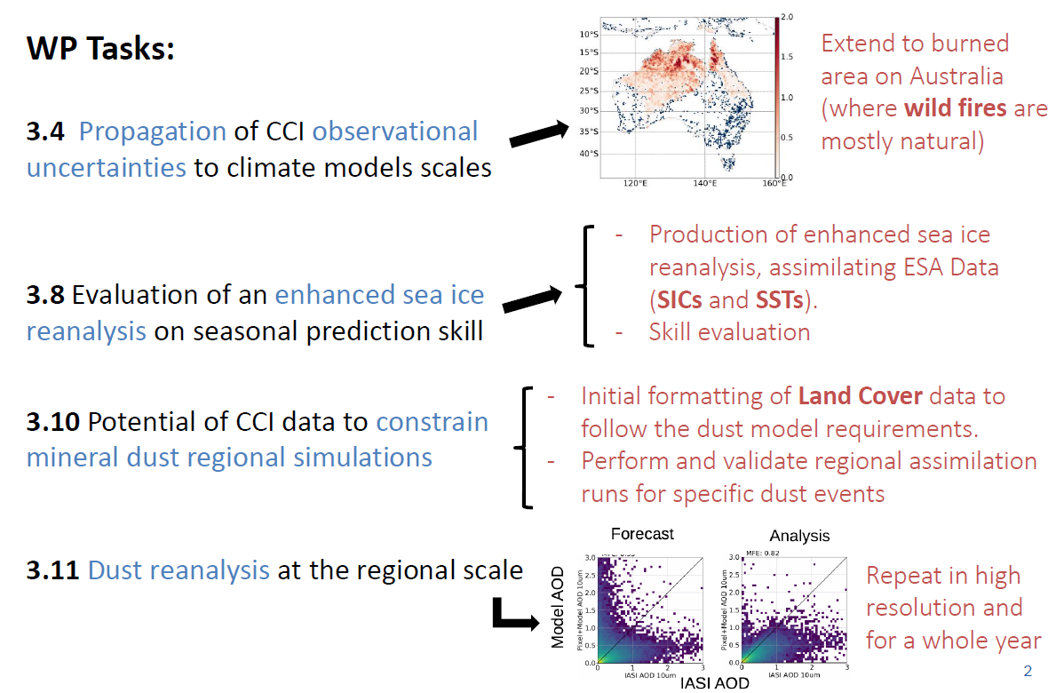
WP3: BSC contribution - 2020
SIC and LST-BA
SSal-SST-SI-Clds
HRLC-Aero-LC

Slide 51
WP3: ECMWF contribution - 2020
  Ozone and AOD (3.12)
    Assimilation of S3 AOD and S5P O3 retrievals in the IFS (CAMS configuration)
    Assessment of the
      Impact on analyses and forecasts
      Consistency with other assimilated observations, independent observations, ERA5
      Possible synergies with other observations

Slide 52
WP3: IPSL contribution - 2020
  LST-SM (3.5) through thermal inertia process
  LST-Snow-SM-ET (3.6) through (LST-Ta) driven processes
    Assess pedotransfer functions in ORCHIDEE
    Analyze the causes of model biases
    Impact of SM on nighttime LST

Slide 53
WP3: UKMO contribution - 2020
  Lakes-LST (3.7)
    What effect does lake temperature (or other parameters) have on the surrounding Land Surface Temperature (LST)?
    Can estimates of LST and its uncertainties be used to evaluate the importance of representing lakes in regional climate model (RCM) simulations?
    What are the interactions between lakes and the surrounding land areas?
  SSal-SST-SI-Clds (3.8)
    Through initialization of SI accounting for SST
  Ssal-Ssta-SST-OC-SSH-SI (3.9)
    Impact of the assimilation of CCI products with and without biophysical feedbacks

Slide 54
WP4 MIP type experiments

Slide 55
D6.1, Scientific Exploitation Report
PURPOSE:
Documents the scientific engagement, exploitation activities and their outcomes/successes.
Key engagement through:
CMUG project website (reports, newsletters, information on events)
Data forum (blog, showcase, community pages, links to CCI datasets)
CCI Open Data Portal
Uptake through other initiatives (e.g. Obs4MIPs, CMIP)
Newsletters, email bulletins
CMUG attendance at national and international climate research events (e.g. conferences)
Peer reviewed literature, articles in programme bulletins
Notes:
The last scientific exploitation report was conducted in May 2016

Slide 56
Scientific Exploitation Report next steps
Summarise the use of CCI datasets through outcomes of integration meetings and results presented in other relevant conference and publications.
Gather feedback on the uses of CCI data
  Contact with science leads
  Compile list of publications
Compile reports and engagement through integration meeting
  Use previous exploitation report
  Gather data from key engagement activities

Slide 57
CCI Publications
Notes:
Compiled from Paul Fisher’s list

Slide 58
July-September 2019 download statistics
ECV | Users | Methods | Accesses | Activity days
aerosol | 651 | 41 | 336365 | 753
cloud | 31 | 27 | 2962 | 63
fire | 245 | 27 | 65167 | 299
ghg | 40 | 25 | 24734 | 71
ice sheets antarctica | 16 | 16 | 59 | 16
ice sheets greenland | 16 | 13 | 146 | 16
land cover | 60 | 11 | 761 | 77
ocean colour | 23 | 19 | 1185 | 55
ozone | 40 | 23 | 793 | 43
sea ice | 34 | 22 | 5001 | 62
sea level | 34 | 9 | 78660 | 37
soil moisture | 123 | 52 | 238543 | 174
Notes:
User breakdown is poor- not captured where user is from or what they are using the data for.
Data taken from Alison Waterfall

Slide 59
Climate Services 1/7
CMUG Deliverable 7.1 report:
Climate Service Interface – Requirements and Roadmap

Slide 60
Contents 2/7
1. Key actors
Climate Modelling User Group (CMUG); Copernicus Climate Change Service (C3S); CMUG partners working in C3S
2. Scientific features of CCI data relevant to C3S
General scientific features of CCI data; Specific features of CCI data; Applications for CCI data in C3S
3. Technical aspects of CCI data versus Copernicus requirements
Data formats and conventions; Metadata; Data access; Level of processing; Data issues across ECVs; System and data requirements for climate datasets in C3S; CDS serving CCI data
4. Tools, architecture and supporting information for CDRs
Data Ingest tools; Access to metadata; User feedback; Data Analysis; Co-location of software and data; Climate Monitoring Facility
5. Institutional links and interactions

Slide 61
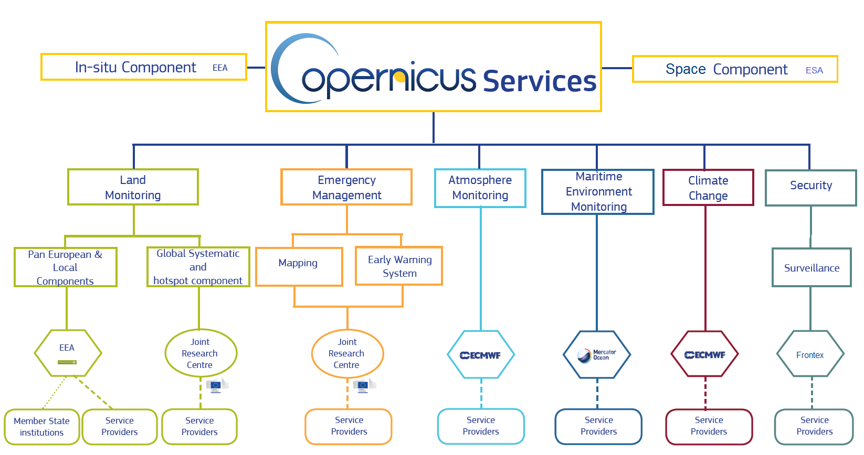
Organisation of the Copernicus Services 3/7
Notes:
CMUG partners: ECMWF, BSC, DLR, MeteoFrance, Met Office,…

Slide 62
General scientific features of a CCI dataset 4/7
has decadal or longer time scale datasets
has good global and regional coverage
has high temporal resolution (sub-daily to monthly).
has good uncertainty characterisation and good estimates of random errors
shows accurate and realistic climate variability
shows realistic estimates of long term climate trends
is validated (often against in situ data) homogenous, high quality climate data
has excellent provenance to source
is already well linked to user communities (research and others)
meets GCOS requirements

Slide 63
Specific features of CCI data 5/7
user requirement-based datasets
algorithm maturity
data Maturity
temporal coverage
consistency
added value
documentation

Slide 64
Technical aspects 6/7
Data formats and conventions
Metadata
Data access
Level of processing
Data issues across ECVs
System and data requirements for climate datasets in C3S
CDS serving CCI data
Data Ingest tools
Access to metadata
User feedback
Data Analysis
Co-location of software and data
Climate Monitoring Facility

Slide 65
Users of C3S data 7/7
Climate monitoring and attribution
Reanalyses
Seasonal forecasts
non-modelling climate applications
Adaptation community (including EEA)
Mitigation community (including national governments and the EC)
System users (e.g. town planner, governments, climate services at a national level, (for example the Climate Change Risk Assessment defines user requirements in the UK with respect to addressing climate change on different systems and sectors)
Sectoral users in the following sectors: water, agriculture, forestry, fisheries, energy, health, insurance, tourism, transport, infrastructure, natural environment, and others

