Slide 2
Contents
The Open Data Portal – what does it do?
How you can help

Slide 3
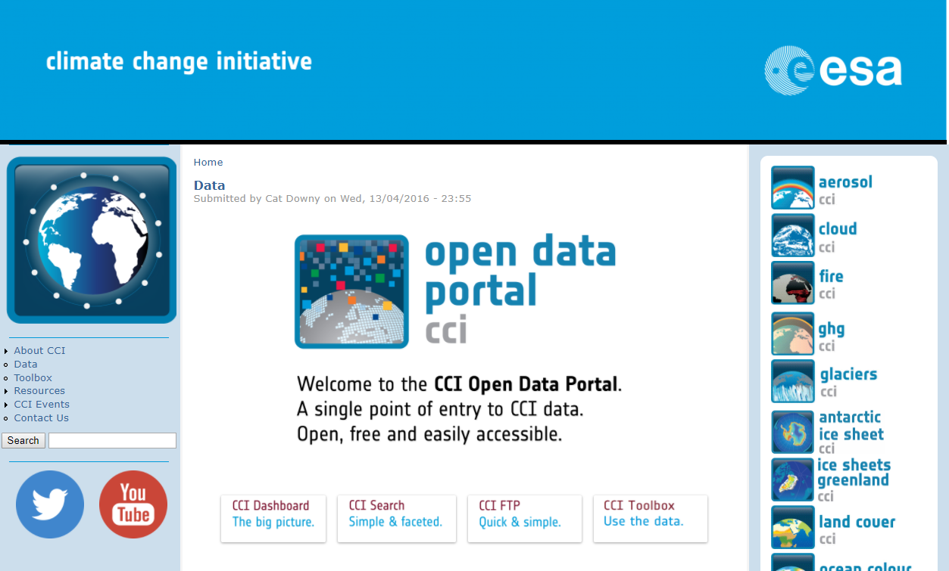
Open Data Portal – What
Single point of access to CCI Data
Central Data Archive
Search
Dashboard
Download
cci.esa.int/data

Slide 4
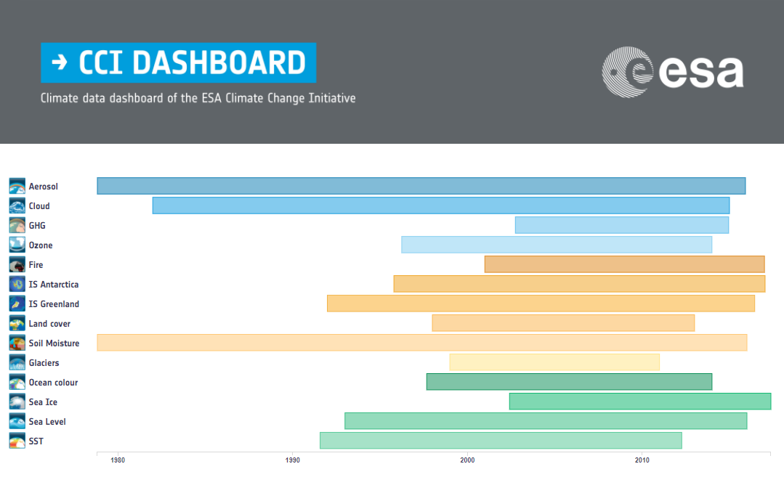
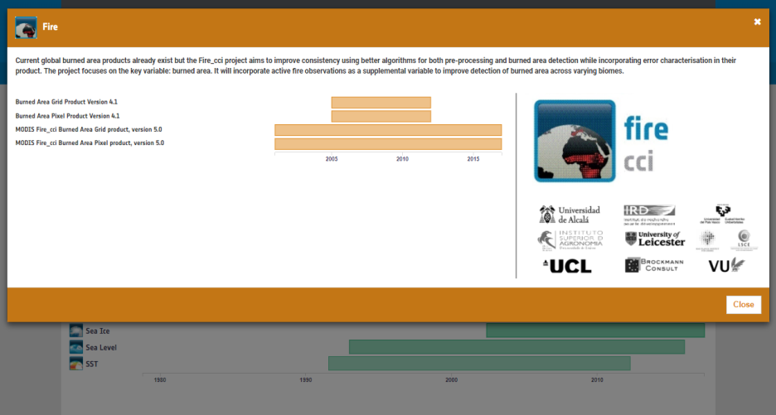

Slide 5
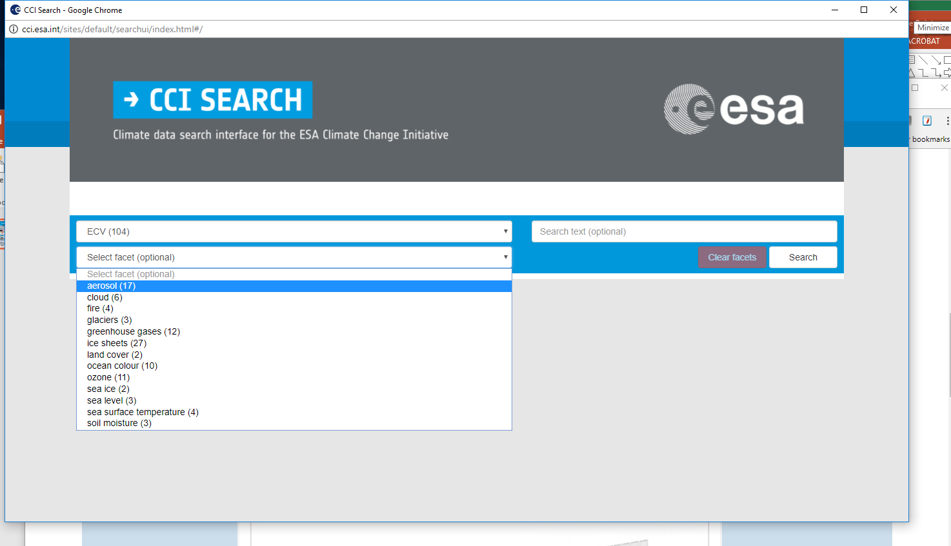

Slide 6
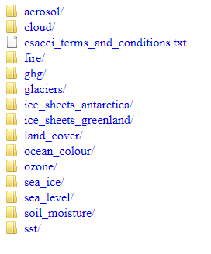
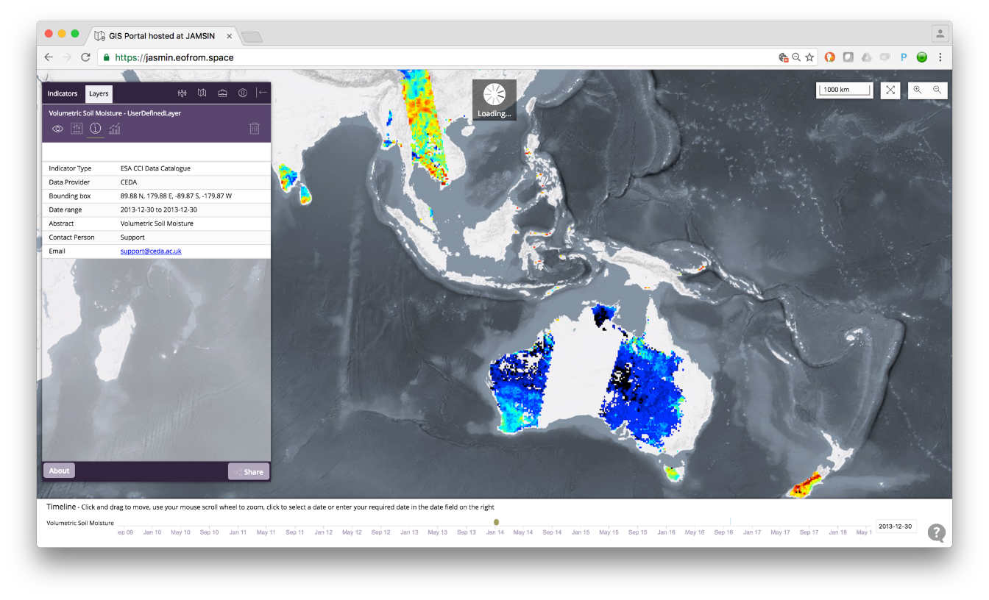
Download
Anonymous FTP
HTTP, OPeNDAP (netCDF, CCI standards compliant)
WMS, WCS (suitable gridded L3 data)

Slide 7
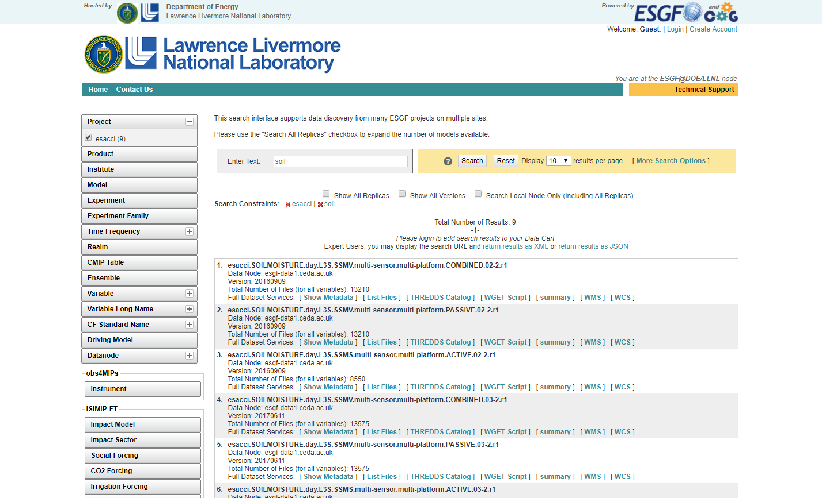

Slide 8

The Archive (October 2018)
14 ECVs
Over 100 datasets
4.2 million files
133 Terabytes
Managing the data at scale requires consistency
JASMIN (STFC/Stephen Kill)

Slide 9
The Catalogue
“Hand written” content for each dataset, pulled from your documents and information you provide
Information includes:
Dataset description (title and abstract)
Links to external documentation, papers, websites
Authors
Spatial / temporal coverage

Slide 10
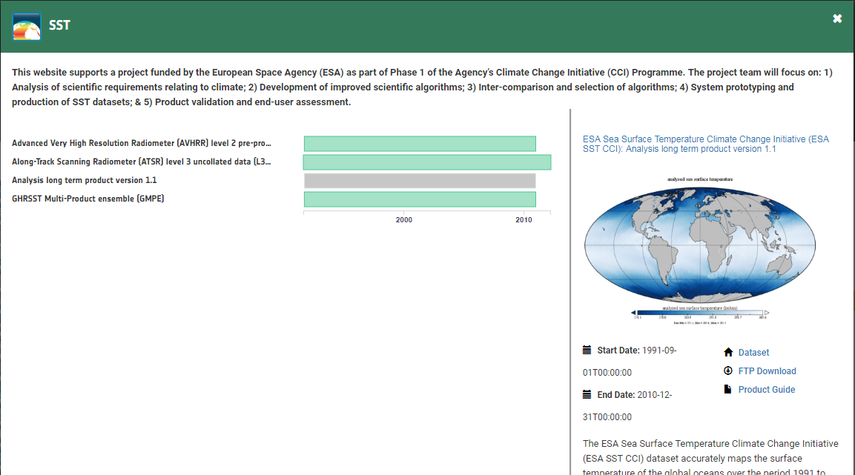
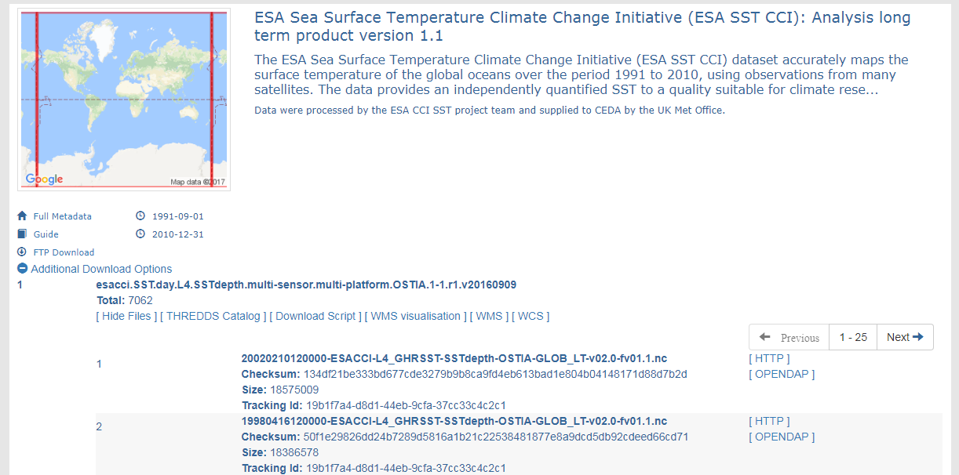

Slide 11
Looking Ahead:
More ECVs -> More data
Evolving the ODP -> easier to find, access and view data
Interfacing with the Toolbox -> relies on standards
(Even more than before ☺ )
We need the data to follow common conventions!

Slide 12
CCI Data Standards : Update issued 17 Sept 2018
All, but particularly new ECVs :
please check the document and flag any issues
Check and send us any new vocabulary terms:
ECV
Platform
Sensor
Frequency
Data type
Institute
Processing level
Product

Slide 13
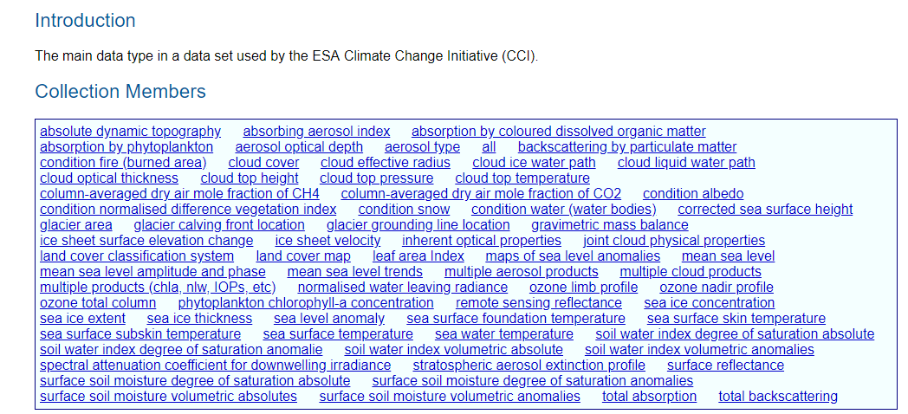
Example, dataType:

Slide 14
Data Standards Requirements
R-1 CCI projects shall produce data according to the CCI Data Standards Requirements:
a. Produced in netCDF-4 (classic) format
b. Conform with the CF (Climate and Forecasting) convention
c. CF standard names used for the main variables
d. Include the global attributes listed in the Data Standards document
R-2 Projects who have commitments to produce data in other formats, shall do this in addition to the standardized products, and shall ensure these products comply as much as possible to the CCI Data Standards (e.g. filenames, metadata)
R-3 CCI Data Producers shall engage with the CF community to help develop the standards they require for satellite data

Slide 15
R-4 The CCI projects shall ensure that INSPIRE compliant metadata records are created for each dataset. For datasets held in the CCI Open Data Portal, this requires the CCI projects to provide information to the Data Portal Team.
R-5 CCI Data Producers shall use terms from the CCI vocabulary tables in the netCDF global attributes, or if terms are missing they shall request that they are added to the tables.
R-6 The key primary variables in the file and their related ancillary variables (e.g. uncertainty) shall be identified, and the range of their expected values shall be indicated.

Slide 16
R-7 For consistency across CCI gridded products, variables shall have, as a minimum, the following dimensions: time, latitude, longitude (or alternative horizontal grid)
R-8 CCI Data Producers shall use the common directory structure for all output data made available to users
R-9 CCI Data Producers shall use the CCI filenaming convention for all output data made available to users

Slide 17
How you can help
Tell us about upcoming data
Follow the CCI Data Standards
Send us some sample files early
Ask for our help with format, metadata
Use the portal, and send us feedback: ECV teams and CMUG ☺

Slide 18
Thank you
Victoria.Bennett@stfc.ac.uk

