Slide 1
WV_cci overview presentation
Michaela I. Hegglin, University of Reading, UK
Marc Schröder, Deutscher Wetterdienst, Germany
and the WV_cci consortium

Slide 2
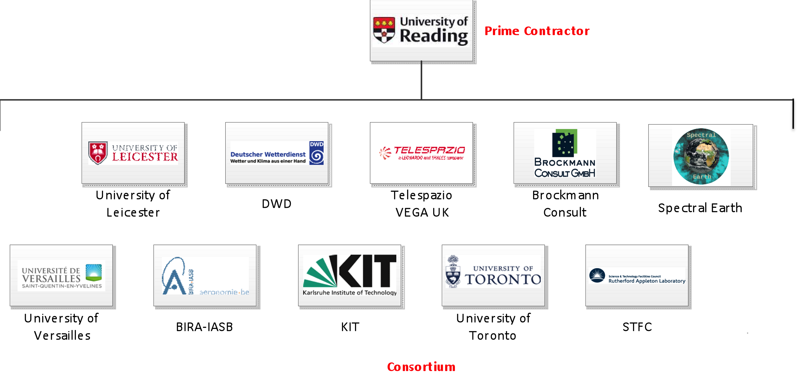

Project partners
University of Vigo

Slide 3
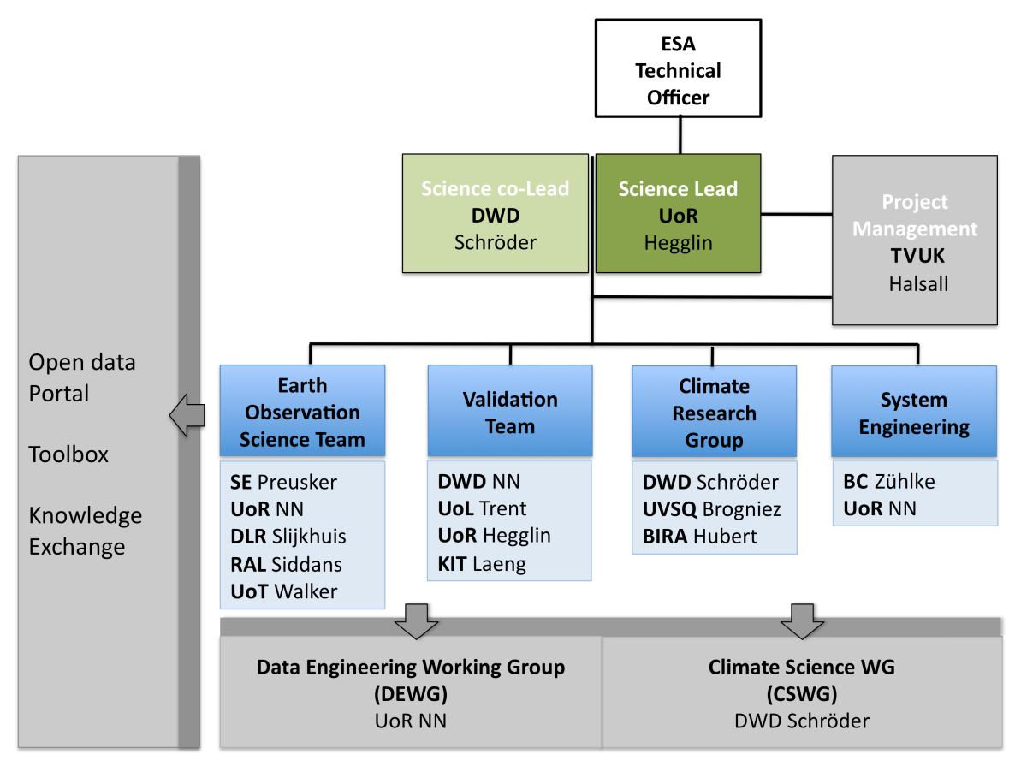
Project overview

Slide 4
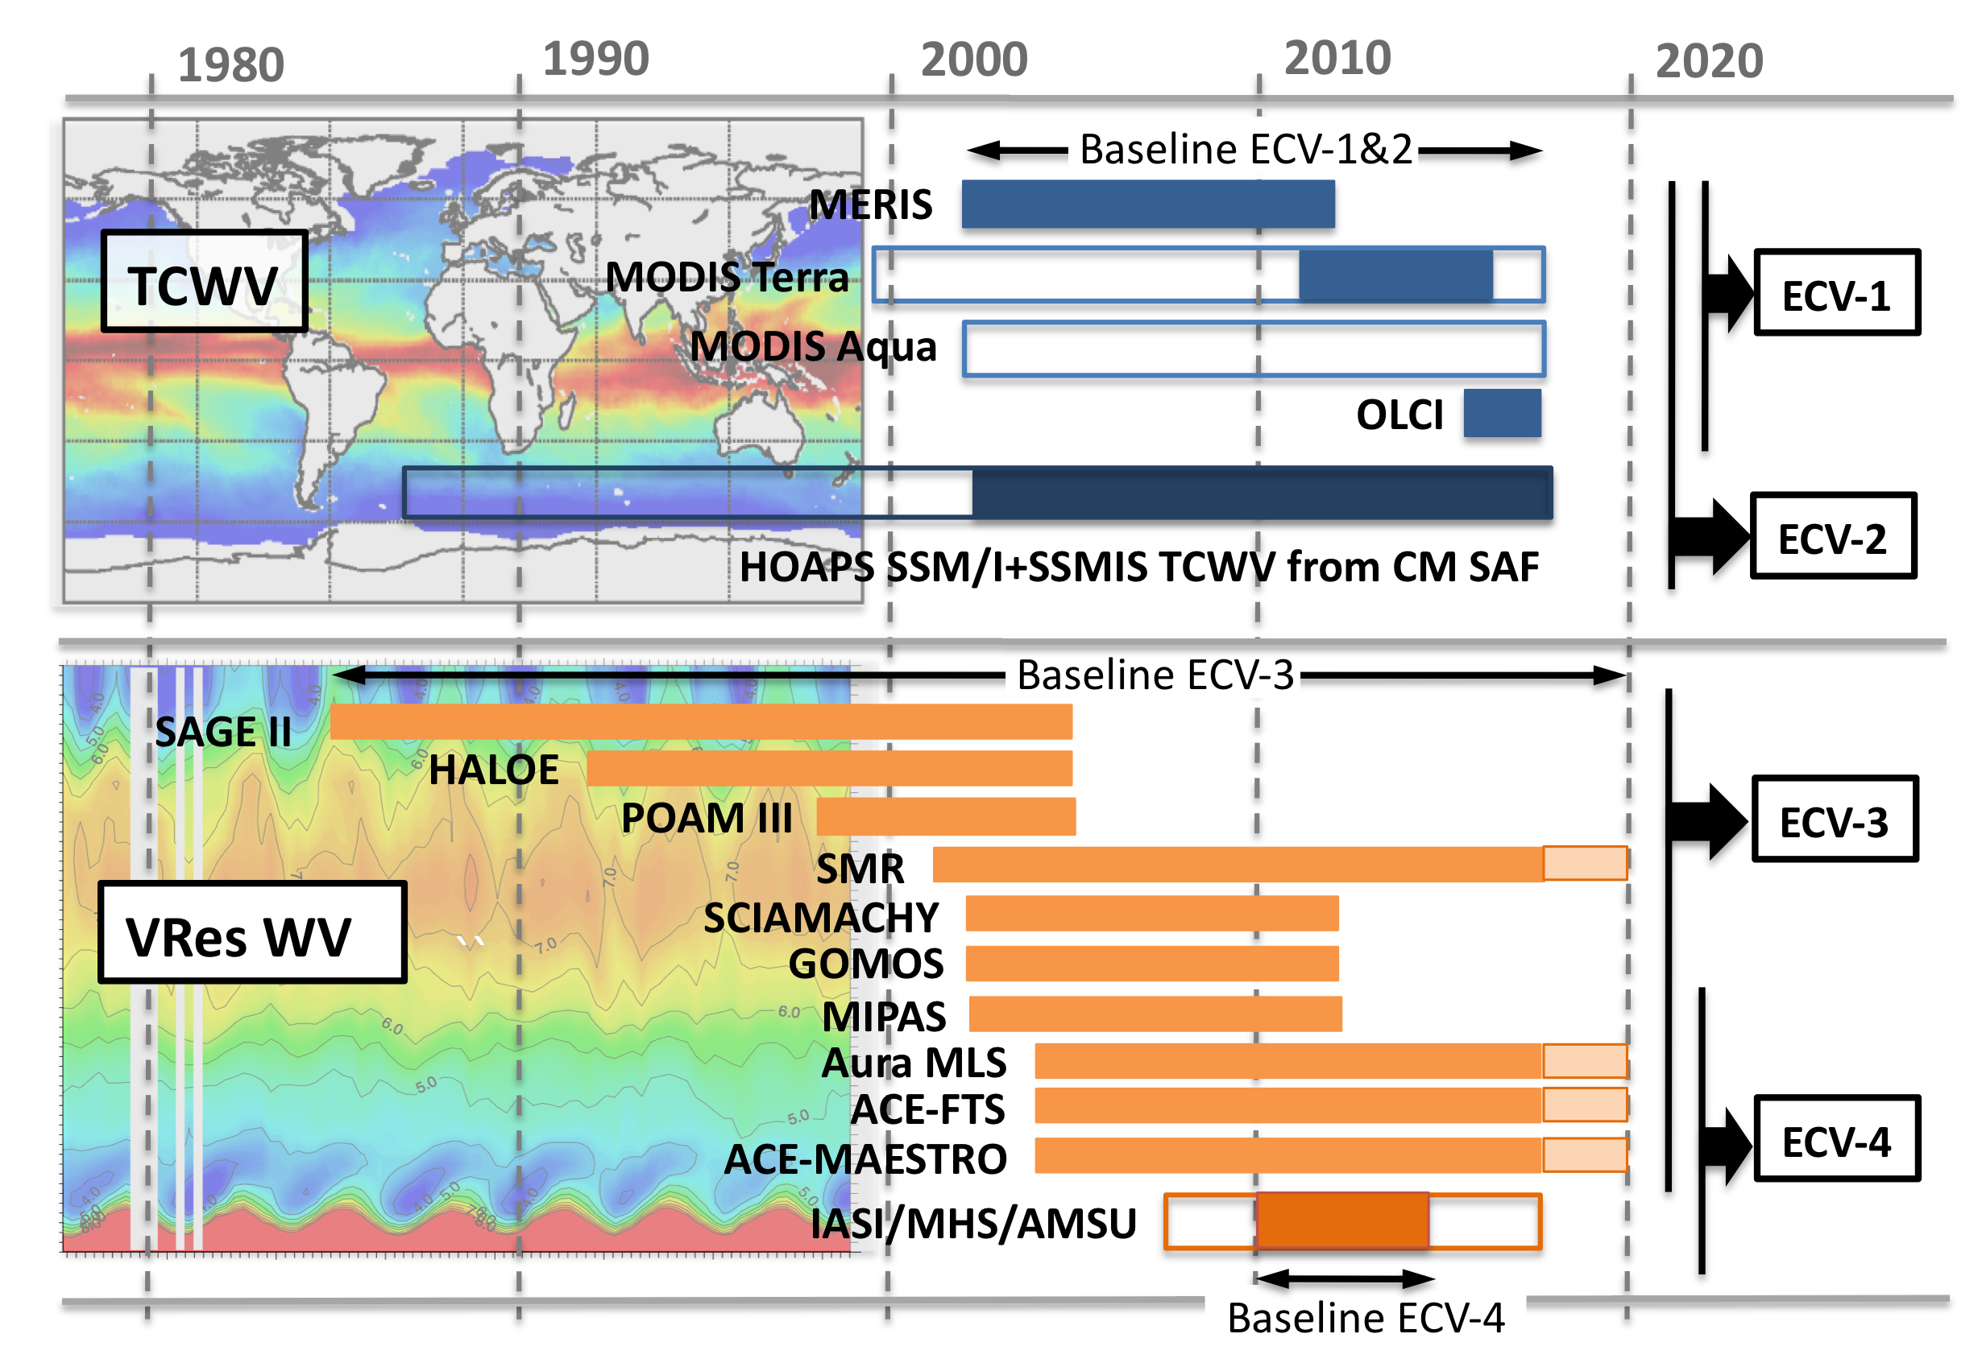
Data product overview
What data are we producing, and when?
Total
Column
Products
Vertically
Resolved (Profile)
Products for stratosphere (2D) and upper troposphere/lower stratosphere (3D)
Availability
by Sept 2020
by Dec 2020 (2D)
by May 2021 (3D)

Slide 5
Consistency of User Requirements (I)
Will your User Requirements be consistent with the needs of CMUG, the Climate Research Groups (CRGs), and GCOS requirements (table), including source traceability?
Product | Frequency | Resolution | Uncertainty | Stability dec⁻¹
TCWV | 4h | 25km | 2% | 0.3%
Tropospheric profiles | 4h | 25km / 2km | 5% | 0.3%
Stratospheric profiles | Daily | 100-200km / 2km | 5% | 0.3%

Slide 6
Consistency of User Requirements (II)
TCWV
Resolution: 0.05°(~5 km) and 0.5°(~50 km), with microwave observations oversampled and NIR data averaged, respectively. 4h temporal resolution is beyond observing capabilities.
Uncertainty: High quality of precursor version has been demonstrated in e.g. Lindstrot et al. (2012, 2014) and Schröder et al. (2013). Achieving 2% will be challenging.
Stability: Stability of precursor version has not been addressed. HOAPS v4 stability is 0.00 ± 0.008 kg/m² (“reference”: merged microwave REMSS data record, period: 1987-2014). Demonstrating stability at global scale will be challenging.
Compliance testing (achieved accuracy / GCOS) follows Loew et al., (2017).

Slide 7
Consistency of User Requirements (III)
Stratospheric profiles
Resolution: Determined by the resolution of the worse-resolved parent dataset. Vertical resolution of 2 km is not achievable ( rather 3-4 km); same for the horizontal resolution: 100-200 km is not realistic, rather 400-500 km.
Uncertainty: Random error of 5% can be achieved for individual instruments, but the instruments are deviating from each other up to +- 10%, though in the some cases it can go down to +-3%.
Stability: Datasets can have drifts with respect to each other (as small as 0.3% per decade); absolute/true drift (against CFH) of datasets needs further investigation.

Slide 8
Uncertainties in CDRs
How will you deal with uncertainties in products?
URD will help define uncertainties in the most useful way for users. Our suggested approach will be two-fold:
Top down: Assessment of overall bias, RMS and stability derived in comparison to reference data sets, including a statistical analysis of the final record
Bottom up: Propagation of uncertainties of both input data sets and merging/homogenisation methodology, also considering Stengel et al. (2017) and Merchant et al. (2017).
For the stratospheric product, we will closely co-operate with the WCRP/SPARC TUNER (Towards UnifiedError Reporting) activity to obtain self-consistent instrument errors. Further cooperation is planned with the WCRP/GEWEX water vapor assessment (G-VAP), EUMETSAT CM SAF on microwave-based FCDRs and ESA on NIR data.
Full error propagation calculation when used in models.

Slide 9
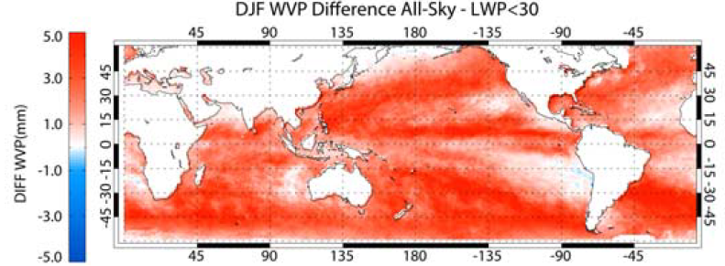
Needs for ECMWF reanalysis
What are your data needs for ECMWF reanalysis data?
Stratospheric/UTLS profiles
No need for production of datasets
Validation of UTLS limb sounder will rely on ECMWF temperature fields
(needs tropopause height)
TCWV Sohn and Bennartz (2008)
ECMWF reanalysis data needed for
estimating the clear-sky bias.
Minimum parameter list:
TCWV, cloud cover, LWP, P.

Slide 10
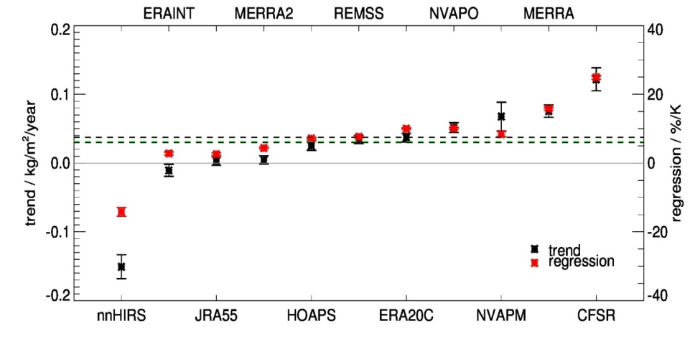
Product specification development
How will your product specifications develop to meet the needs of your individual CRG (how will the CRG use the proposed products in their applications)?
User needs are being assessed and PSD product specification will be following the defined requirements as much as possible.
EphysLab: analysis of atmospheric rivers and low-level jets in Eulerian and Lagrangian frameworks.
University of Versailles: Evaluation of climatology and seasonality in CMIP6 simulations.
BIRA: Evaluation of different available stratospheric
CDRs using SWOOSH and GOZCARDs.
DWD: Analysis of temporal changes in TCWV and
comparison to theoretical expectation,
intercompare ESA TCWV data
following G-VAP approaches. Schröder et al.,
submitted to Rem Sens

Slide 11
Consistency between ECVs
How will you address the integrated perspective for consistency between the ECVs, including identification of gaps?
Consistency between TCWV and Vertically Resolved CDRs will be tested.
LST and SST from ESA CCI projects will be used as input in WV_cci activity on theoretical expectation.
ESA CCI cloud mask* used as input to ECV-1 and ECV-2.
Consistency as defined in Immler et al. (2010) will be assessed as well.

Slide 12
Feedback from CMUG session
Utilisation of WV_cci ECVs in Climate Monitoring Facility at ECMWF would be
appreciated and supported.
Utilisation of WV_cci ECVs in ESMValtool would be appreciated and supported.
Other non-covered options (first, non-consolidated ideas):
Utilise high spatial resolution of ECV-1 (Level 2: ~0.3 km, Level 3: 0.05deg, other resolutions possible if required), e.g., assess impact of sub-grid variability at global land scale.
Model evaluation in areas with large variability in topography.
Constraint models with WV_cci data to see impact on water vapour feedback.

