Slide 1
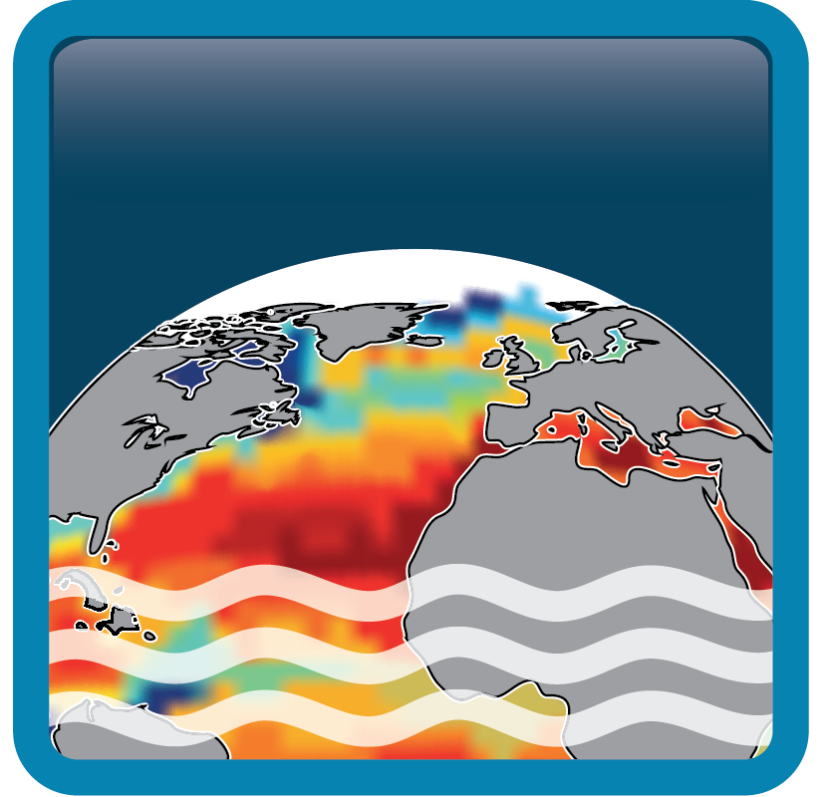

Sea Surface Salinity
Climate Change Initiative
CCI CMUG Integration Meeting
Exeter 2018
Scientific Co-lead: J. Boutin (LOCEAN),N. Reul (IFREMER)
Climate Research Group: D. Stammer and J. Khoeler (UHAM)
Project Manager: Rafael Catany (ARGANS)

Slide 2
Outline
CCI SSS project overview
Definition of the SSS community: Preliminary results of the User Survey
How will CCI SSS product meet the needs of the community
Summary
Data production type, and when? *additional

Slide 3
CCI SSS Project overview
Long term multi-mission salinity Climate Data Record based on a combination of SMOS (2010-) with Aquarius (2011-2015) and SMAP (2015-) L-band radiometers. Additionally C/X-band radiometers will be used to extend the time series back to 2002.
Ground based data from the in situ ARGO ocean profiling network (i.e. interest in uppermost profile), ship SSS measurements (e.g. from the Global Ocean Surface Underway Data (GOSUD) Project http://www.gosud.org/) together with specialized oceanographic research data sets will be used as reference measurements via PI-MEP, part of them for guiding the development/ verification of the algorithm development, part for validating the products.

Slide 4
CCI SSS Project overview
Demonstrate the value and impact of the SSS ECV in climate science research, in 5 case studies:
1: North Atlantic salinity anomaly
2: Climate variability reconstruction in the Atlantic
3: Water cycle in the Bay of Bengal
4: Salinity stratification and small-scale variability
5: Comparing salinity variability between observations and models
+ Assimilation (Option)
More information:
http://cci.esa.int/salinity

Slide 5
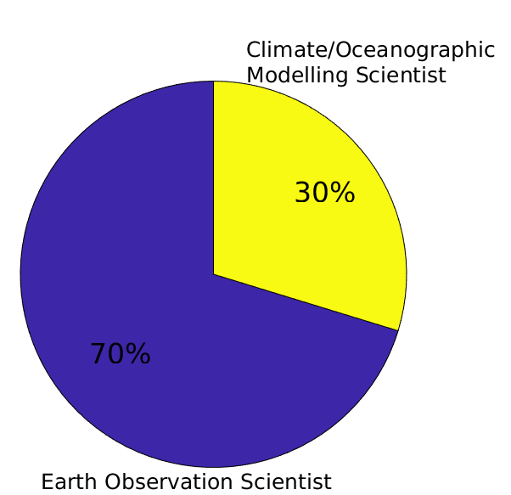
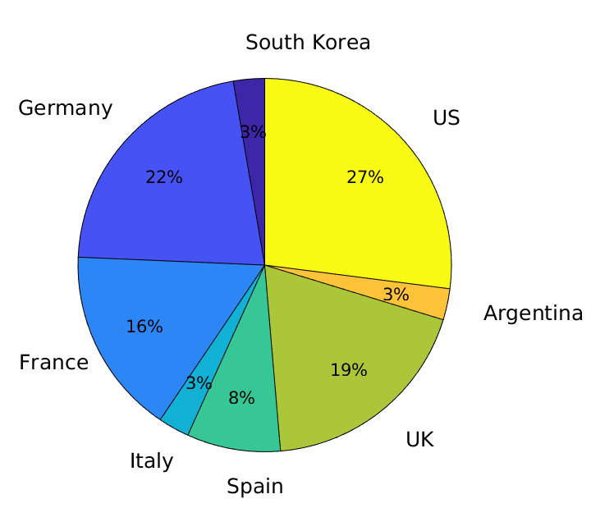
Definition of the SSS community
Who are the final end Users
Preliminary results of the User Survey
Geographical distribution and Sector occupation
3%
70 %
International community but with a clear EU dominant population
Interest might be towards EO applications (70%) and Model-based studies (30%)

Slide 6
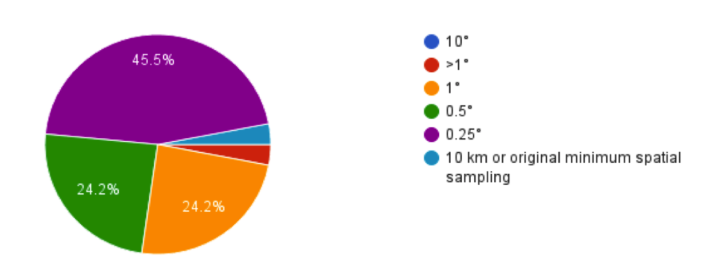
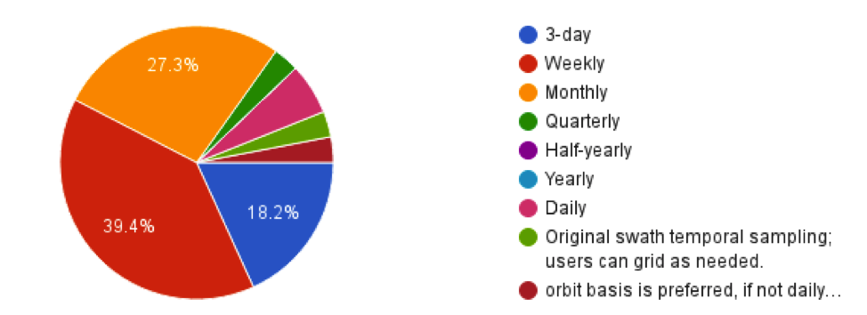
Definition of the SSS community
What are the User Requirements
CRG
Climate Research Users
Preliminary results of the User Survey
Spatial Resolution
3%
GCOS
Accuracy of 0.1 psu,
Horizontal resolution of 1-100 km;
Hourly to monthly temporal resolution
Temporal Resolution
Courtesy of Khoeler, J. and Stammer, D. CCI+SSS URD 2018
User requirement of the spatial and temporal resolution within the GCOS ECV requests
0.25˚ and weekly product

Slide 7
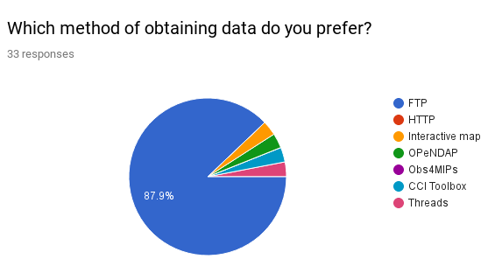
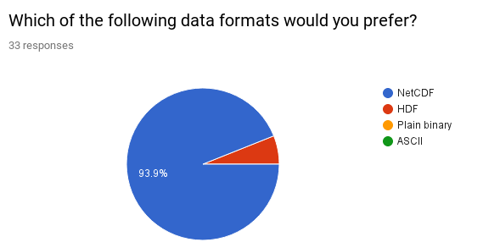
Definition of the SSS community
What are the User Requirements
Preliminary results of the User Survey
3%
Courtesy of Khoeler, J. and Stammer, D. CCI+SSS URD 2018
Data preferred distribution via FTP servers and in NetCDF format

Slide 8
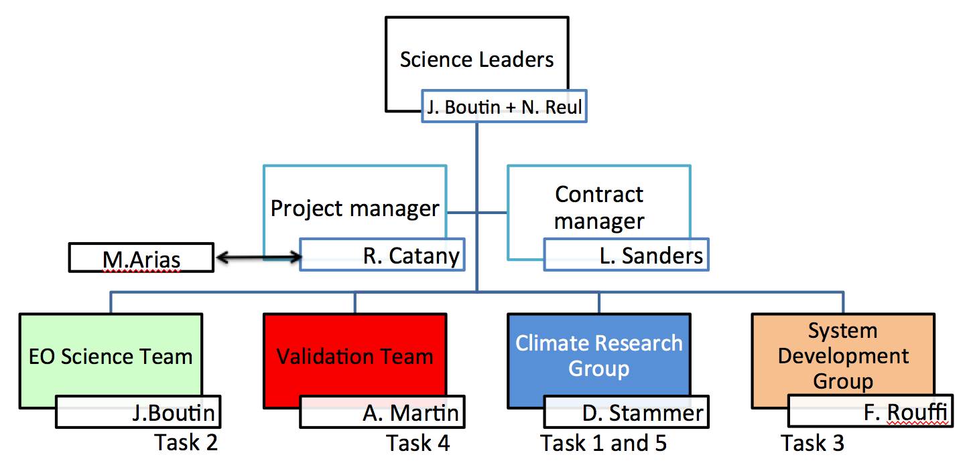
How will CCI+SSS product meet the needs of the community
Structure of the consortium of having CRG and Validation teams independent from the EOST (Production) team will ensure CCI SSS product meets expectation of final end user
EOST
Validation
CRG
SDG

Slide 9
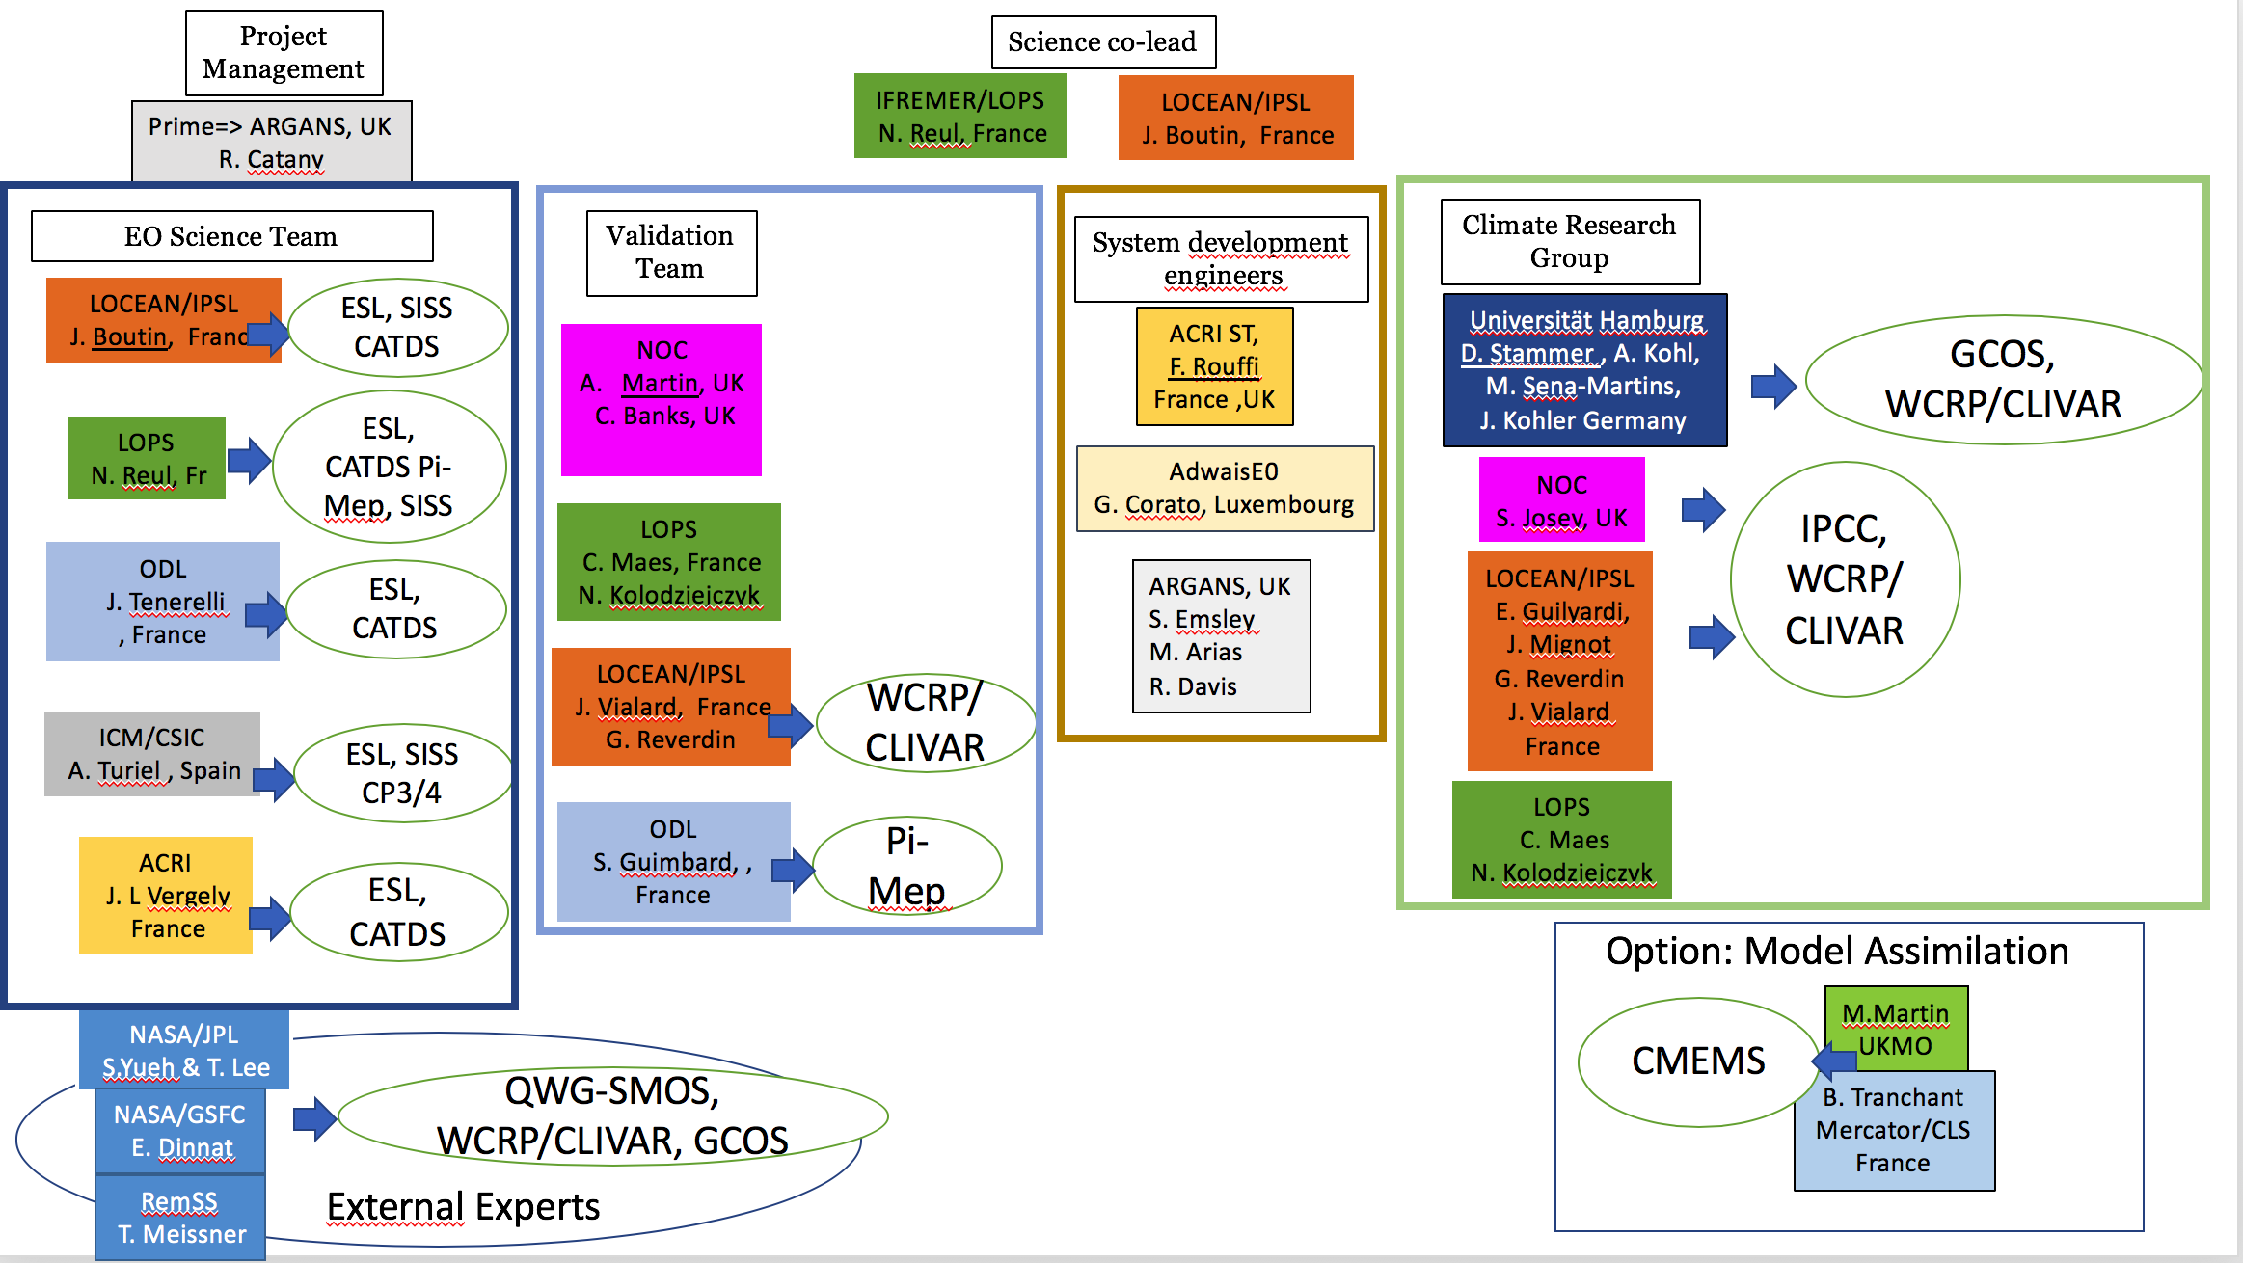
How will CCI+SSS product meet the needs of the community

Slide 10
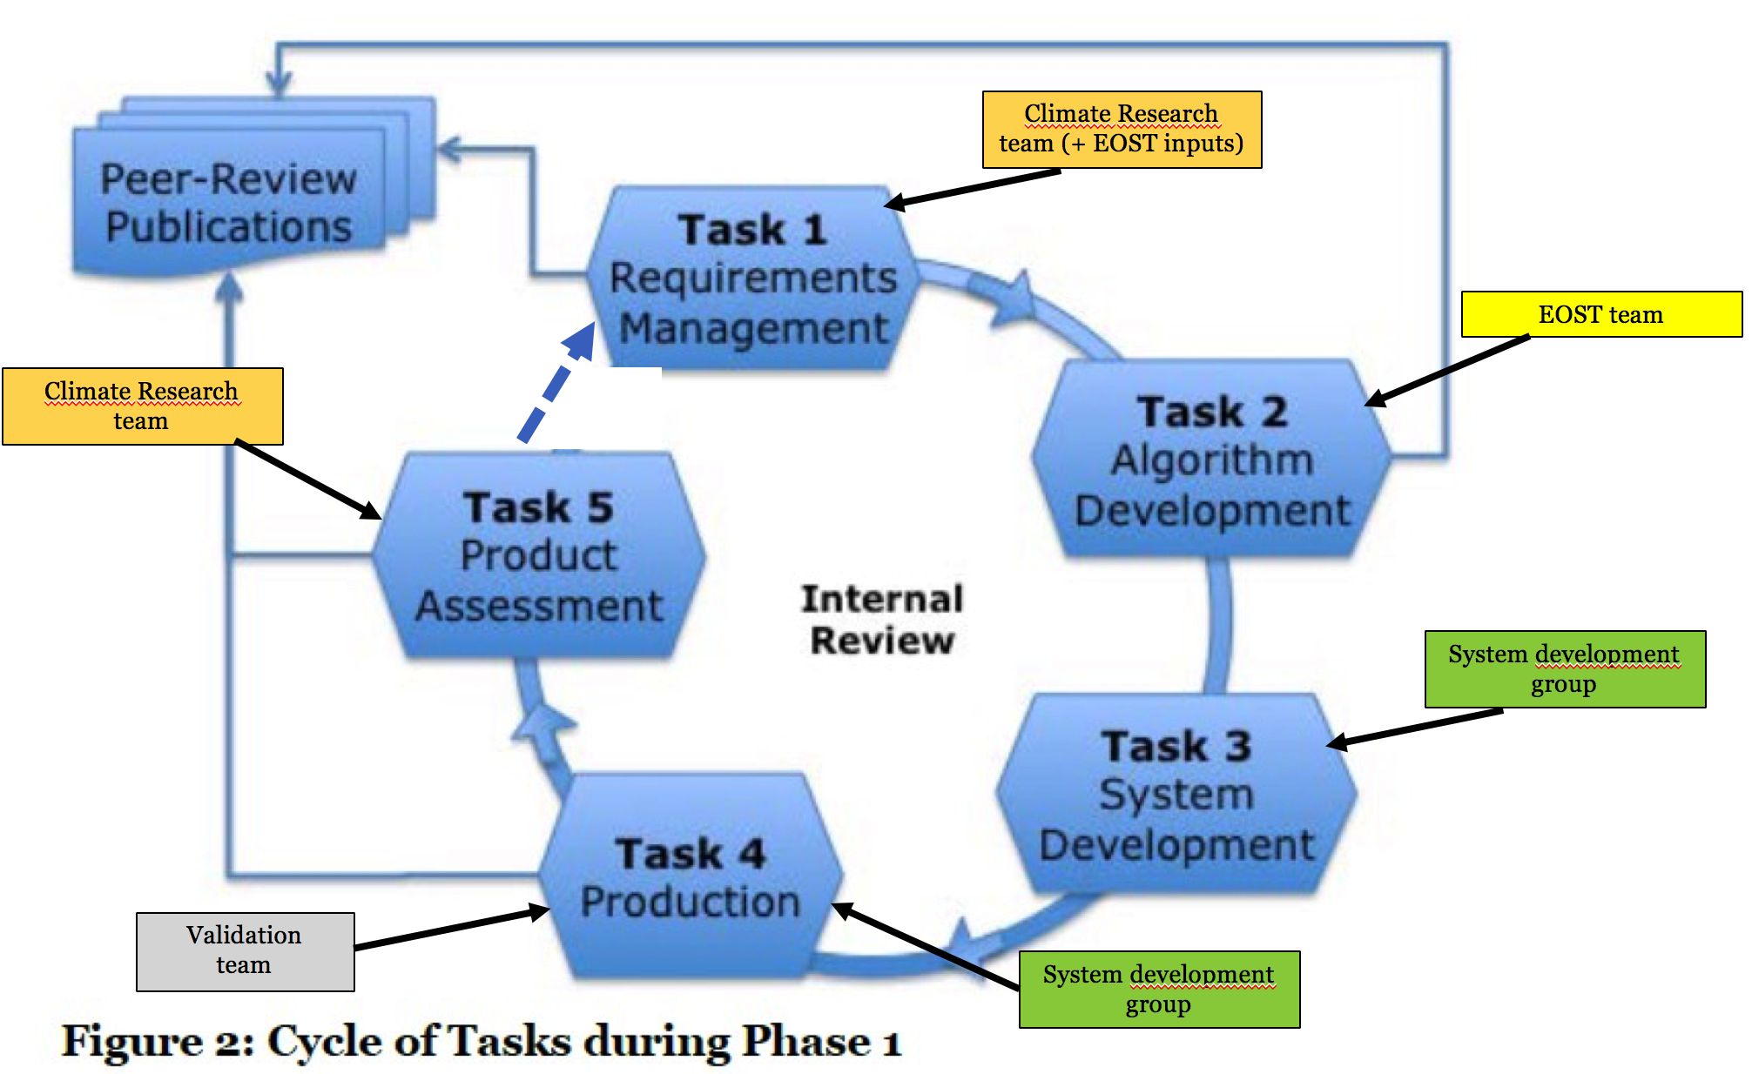
How will CCI+SSS product meet the needs of the community
Cycle ensure
Production and Validation CCI+SSS dataset
User Requirement Survey

Slide 11
Summary
CCI SSS product interest of worldwide community – survey continues, to be publicized during the international salinity conference, Paris, next week
Users who participated to the survey are mainly from Earth Observations and Model community. New contributions are welcome.
The structure of the consortium will ensure that Validation and CRG teams are independent from the EOST teams and do do not influence each other. So final CCI SSS product will respond the needs of the User Requirement only

Slide 12

Thank you for your attention
http://cci.esa.int/salinity

Slide 13
Additional slides about status of the processing

Slide 14
Status of the project: Data production
OPERATIONAL CHAIN: Implementation of the current SMOS, SMAP, AQUARIUS level 2 processing in the CCI+SSS operational chain ongoing => will allow to adjust auxiliary data and level 2 algorithms during Year 2 & 3 of the project
LABORATORY BREADBOARD: Development of a first merged product (to be delivered before mid 2019) using existing level 2 SMOS, SMAP, AQUARIUS SSS and after correcting systematic biases:
Bayesian method for relative biases correction at SSS level and uncertainty estimates⇨ SSS biases estimated in different acquisiton geometries over several years (self-consistent method). Natural variability can be used in order to drive the fluctuation amplitude. A 3 sigma filtering is used in order to remove intermittent RFI and other outliers.

Slide 15
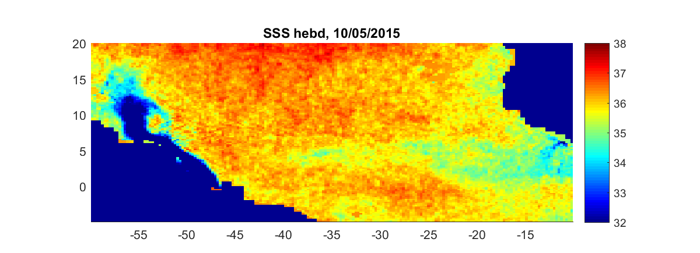

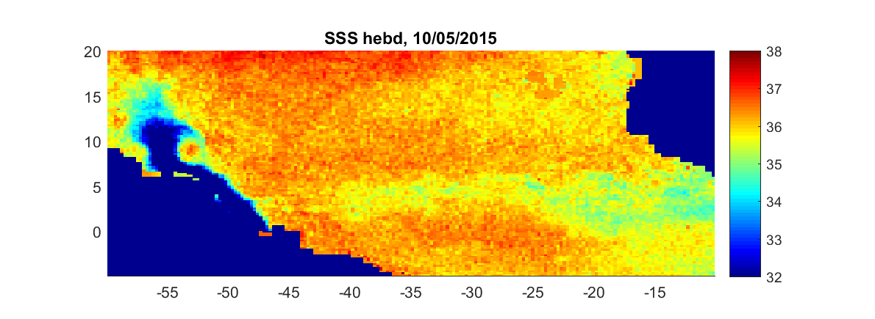
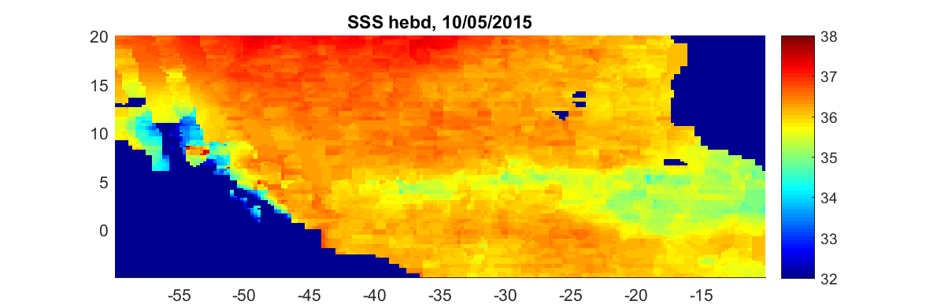
What data are you producing, and when?
SMOS+SMAP+AQUA
SMOS only
To be improved:
-SMAP version to be updated
-Optimize the use of SSS with different resolution (AQUARIUS 150km, SMOS/SMAP ~45km)
-ensure that the estimated uncertainty is consistent with the observed change when one instrument disappears
SMAP only
AQUARIUS only
Amazon River outflow. Example of merging different retrieval agorithms, Weekly (Courtesy of Jean-Luc Vergely and Jacqueline Boutin)

Slide 16
Thank you for your attention
rcatany@argans.co.uk
http://cci.esa.int/salinity

Slide 17
Status of the project: Uncertainties estimates
Uncertainties on level 2 SSS are characterized for each individual sensor by inter comparing measurements taken by the various sensors and by the same sensor in different geometry
Common statistical approach for error propagation and systematic error mitigation to deliver uncertainties estimates at level 3/4 are used to:
  propagate errors in a Gaussian context
  estimate relative biases
Keep traceability of adjustments between various data sets (indicators to be discussed with users)

Slide 18
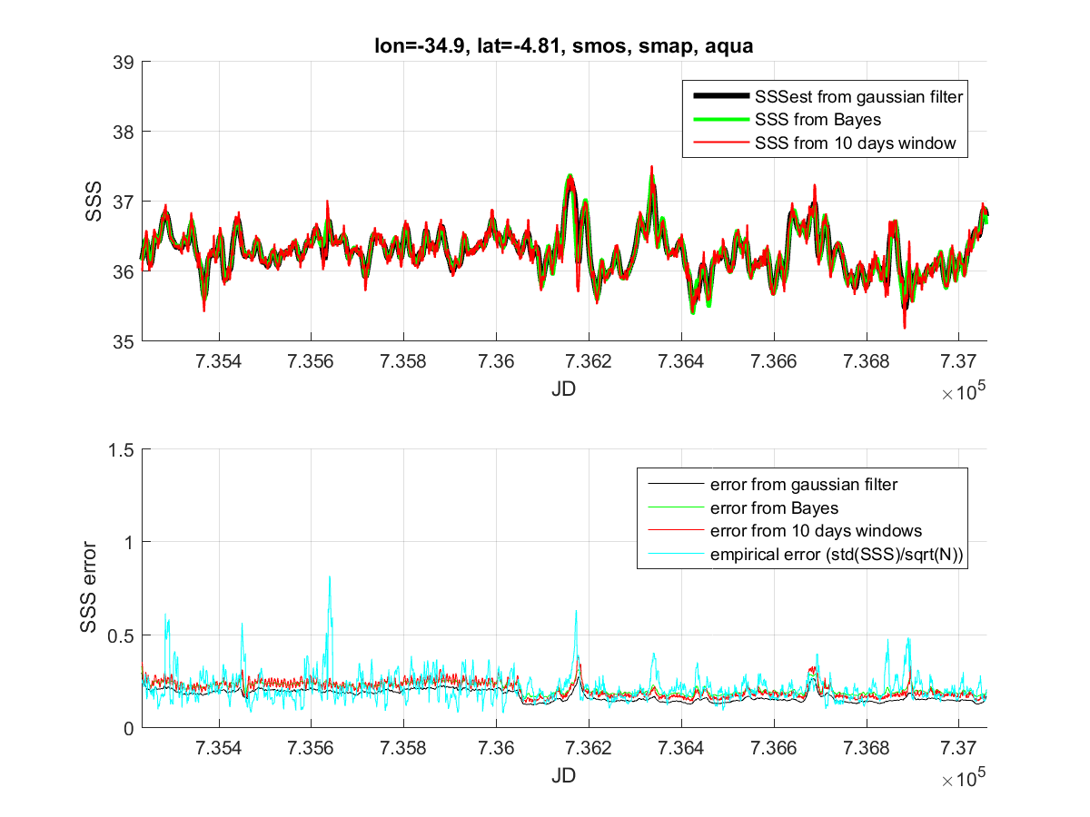
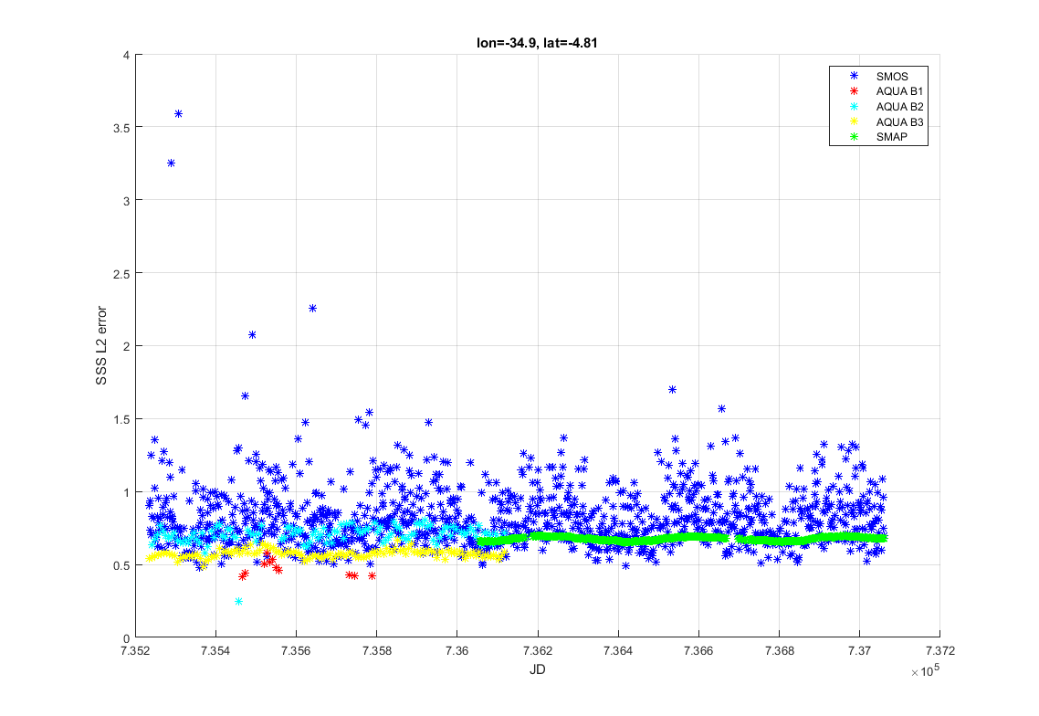
Example of SSS and error estimate in one pixel
L2 error
L4 error
2010
2018
Vergely & Boutin, preliminary results

