Slide 1



ESA CCI Soil Moisture
Some results phase 2
Wouter Dorigo
Vienna University of Technology
Department of Geodesy and Geoinformation

Slide 2
A short summary of ESA CCI SM v03.2/v03.3
Input data products
12 active and passive microwave L2 products
L-, C-, X-, Ku-band
Resolution: ~25-100 km
Revisit time: 1-7 days
→ Merged ESA CCI soil moisture v04.3
0.25° resolution
Daily product
Period 1978-2017

Slide 3
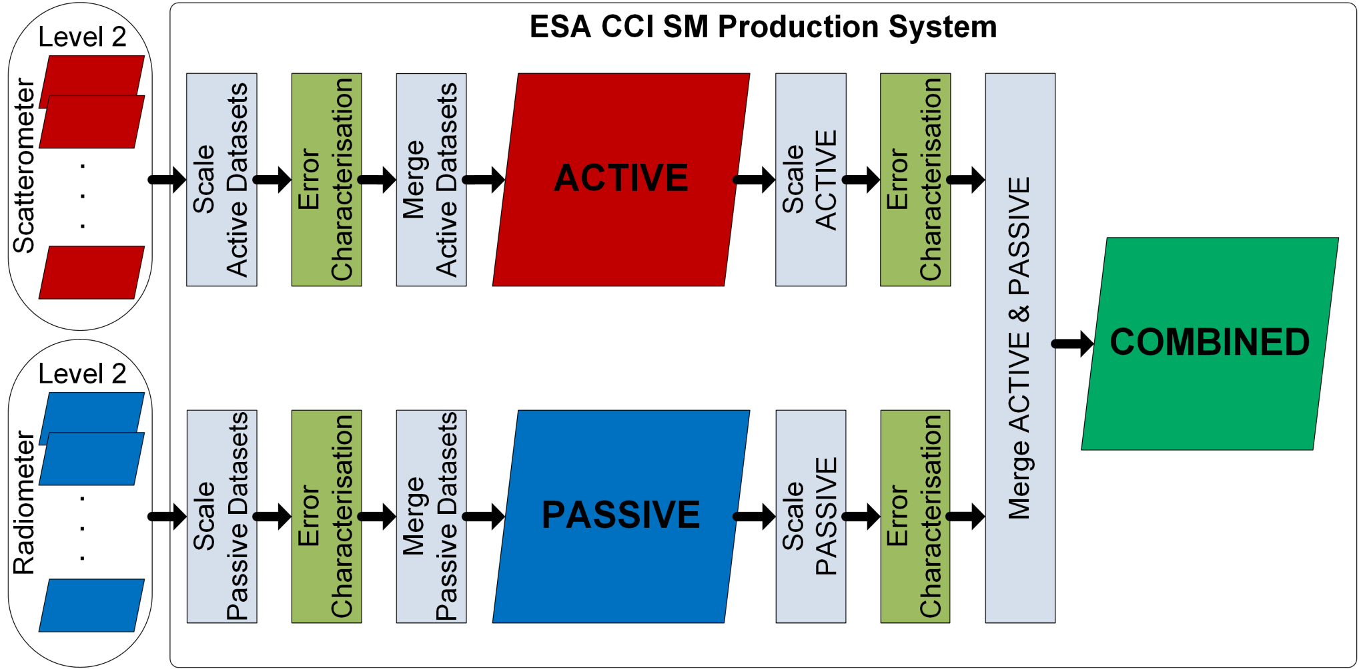
Not 1 but 3 products
[Dorigo et al., RSE, 2017]

Slide 4
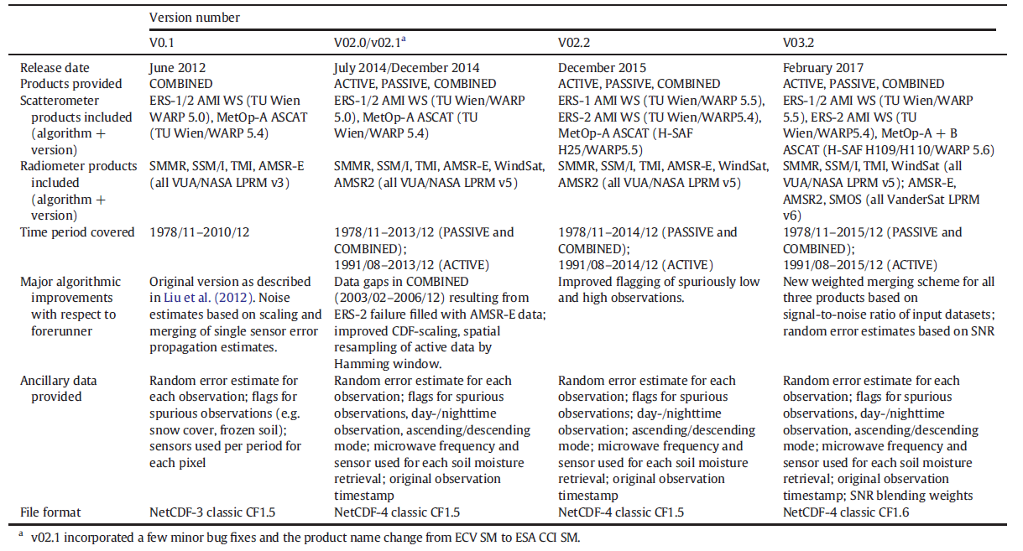
Public releases of ESA CCI SM
V03.3
V04.2
V04.4

Slide 5
Development and testing cycle
Science updates
Internal validation
Release to key users
Minor bug fixes
Public release
Improvement + bug fixing

Slide 6
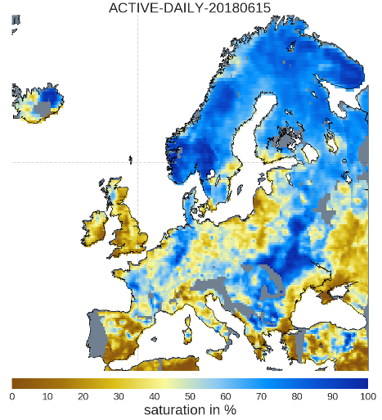
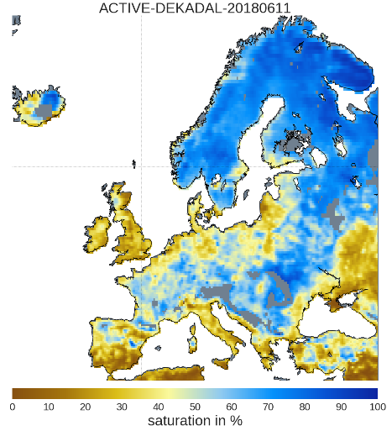
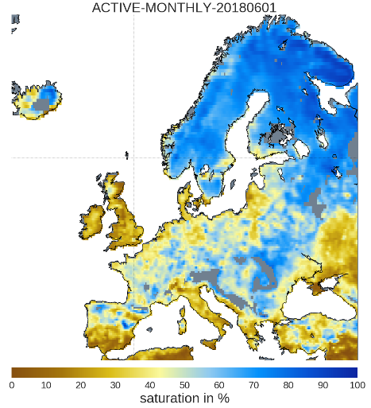
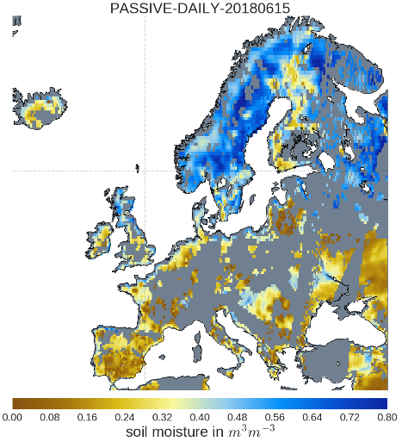
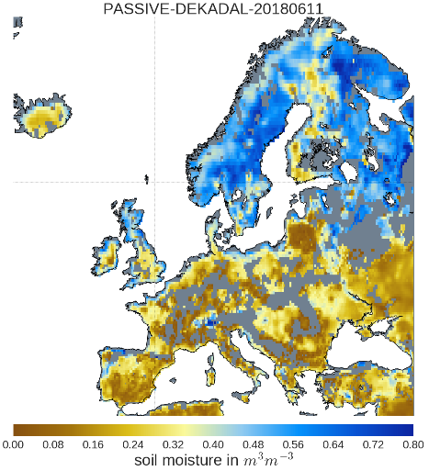
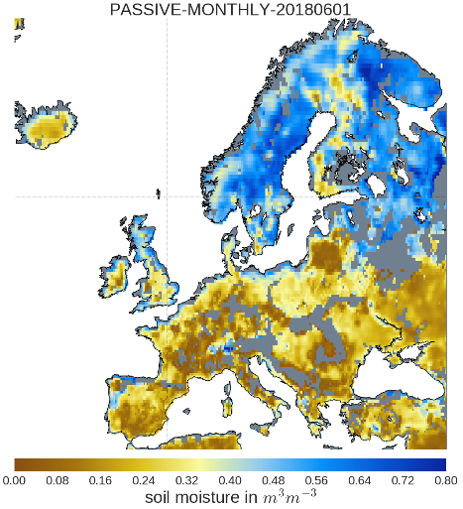
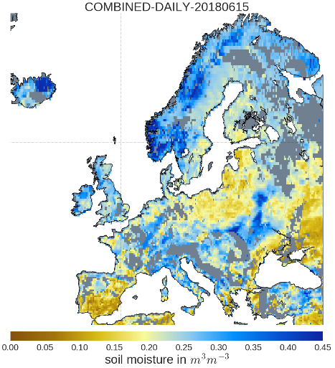
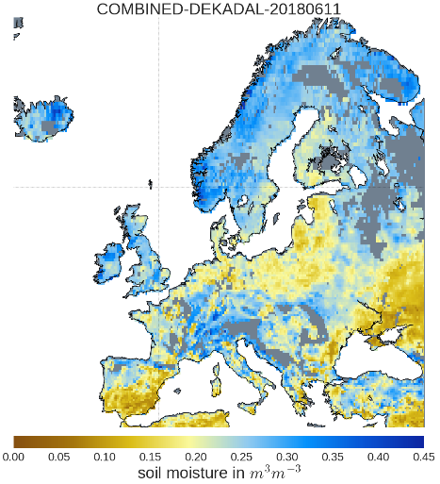
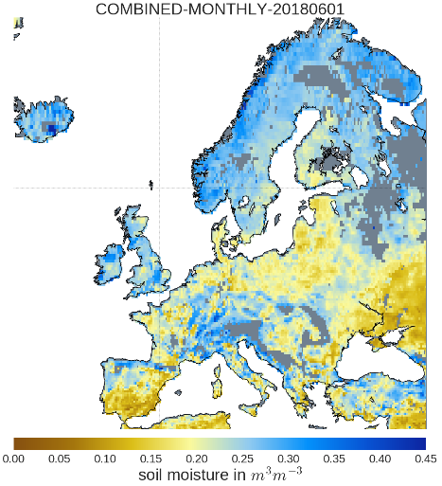
From CCI to C3S
DAILY
(2018-06-15)
DEKADAL
(2018-06-11 to 2018-06-20)
MONTHLY
(2018-06-01 to 2018-06-30)
Operational production since June 2017 within C3S
  Updated every 10 days
  maximum of 10 days latency
Challenging transfer between scientific prototyping and operational production
  Due to delay, data inputs may have changed
  Software updates
ACTIVE
PASSIVE
COMBINED

Slide 7
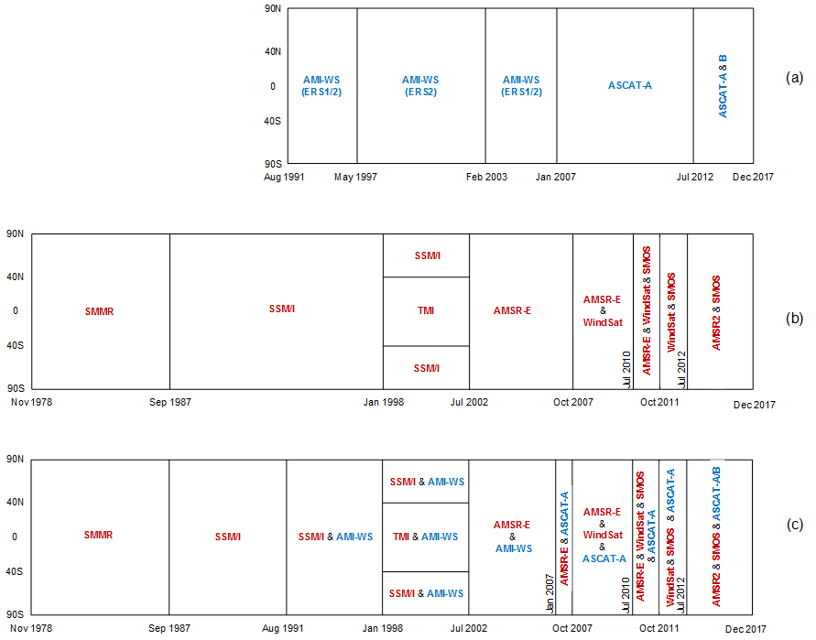
Merging periods and sensor selection of the ESA CCI SM v4 products

Slide 8
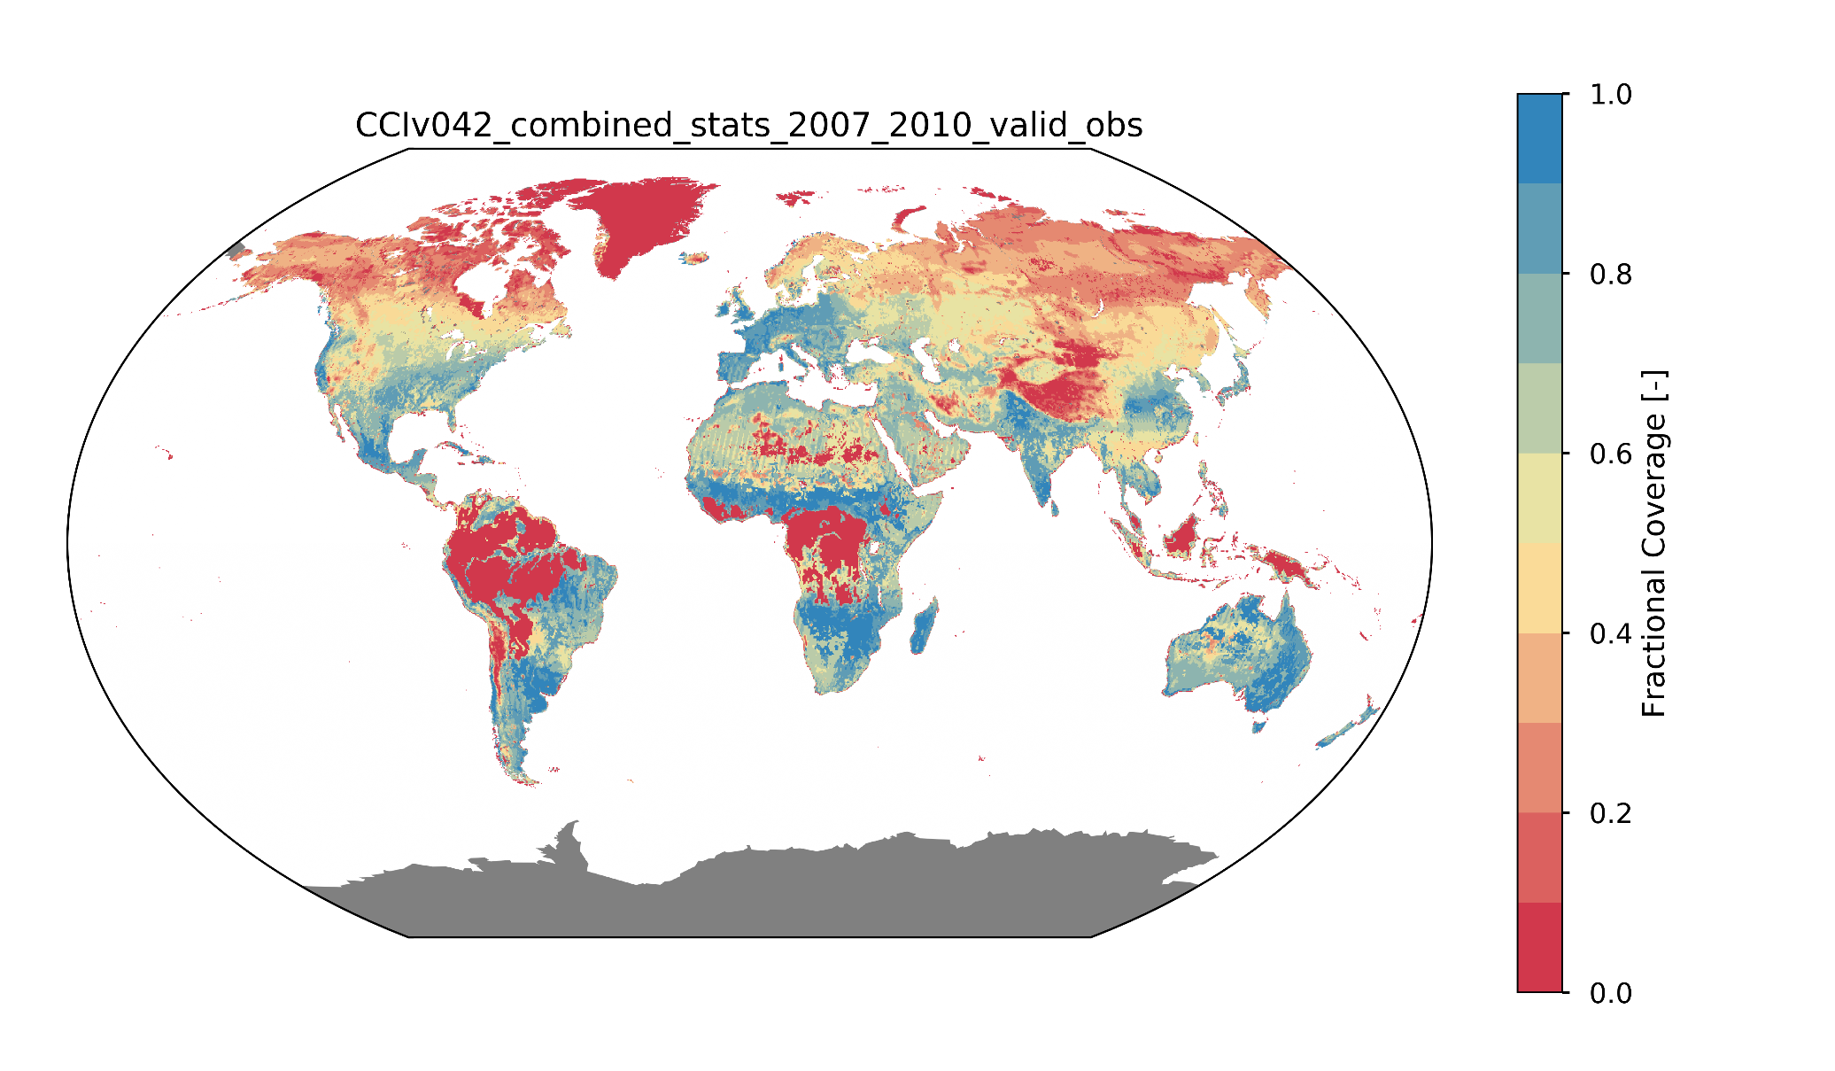
V4: Valid observations

Slide 9
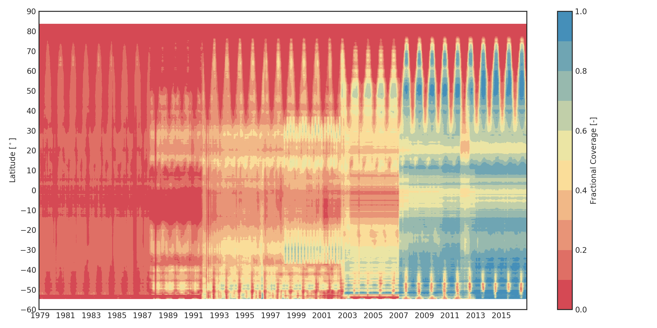
V4: Valid observations

Slide 10
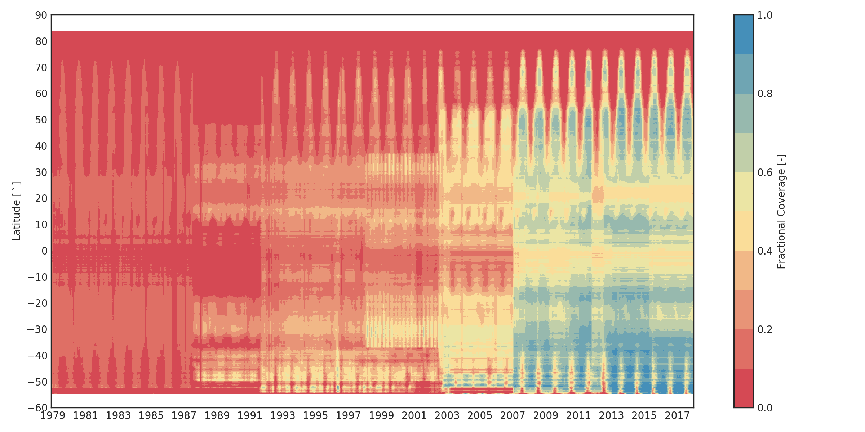
V5: Valid observations

Slide 11
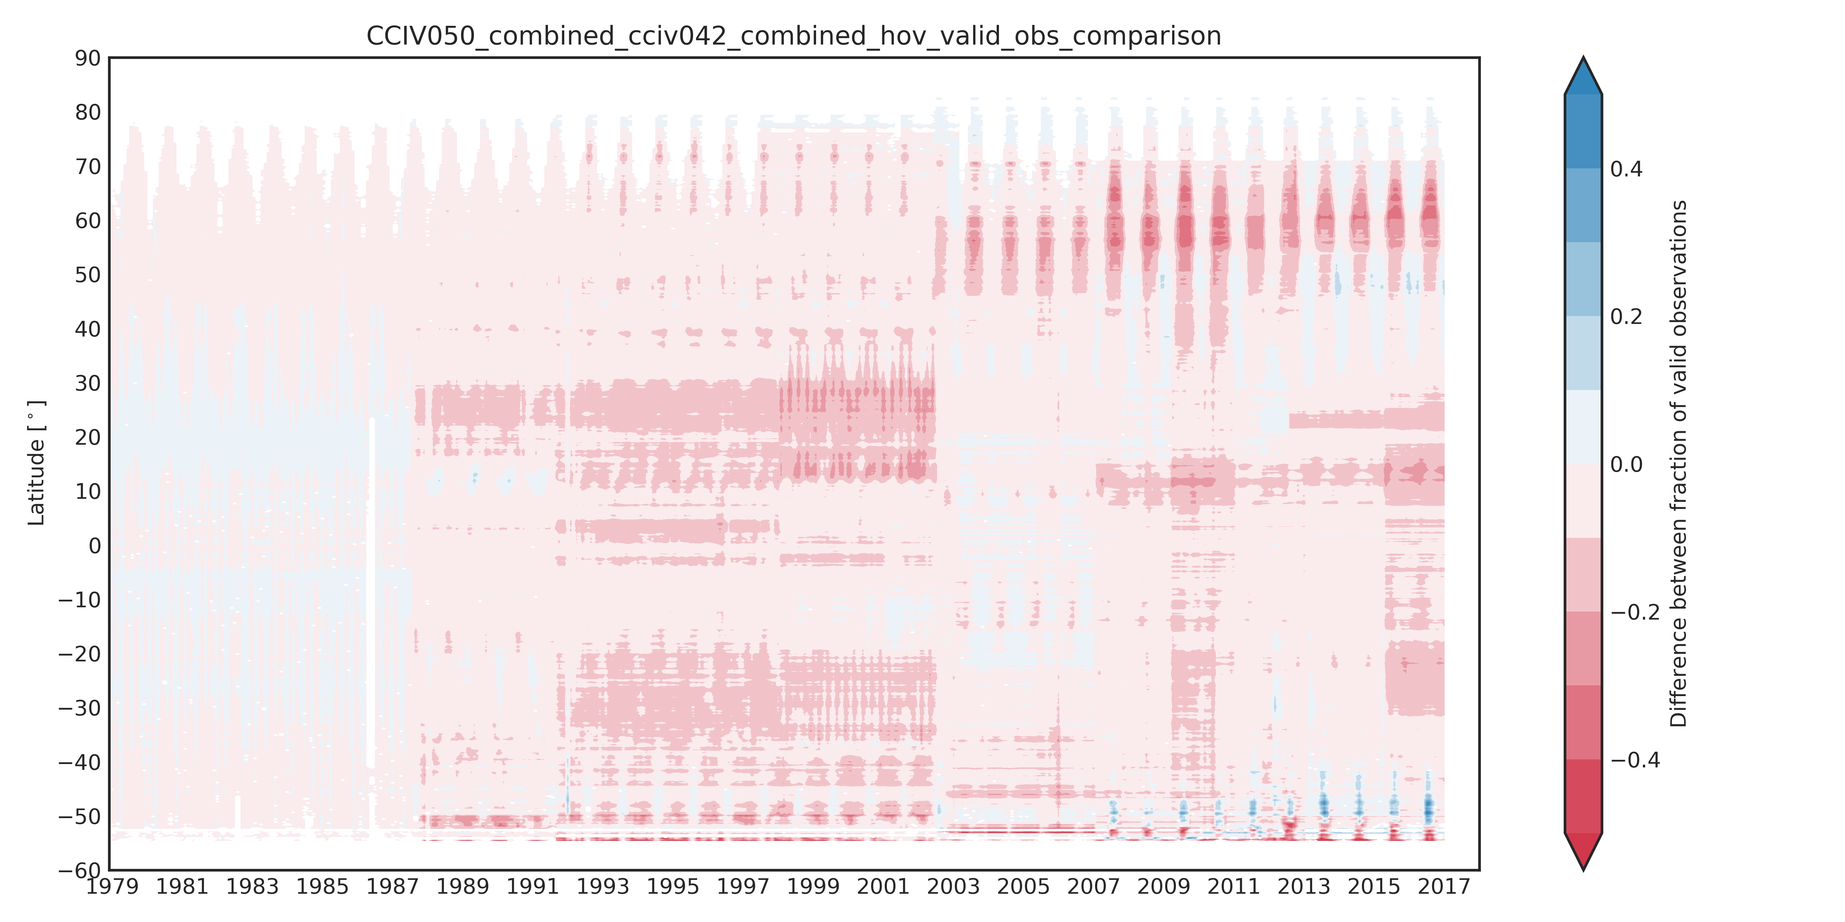
Valid Observations: Difference V5-V4

Slide 12
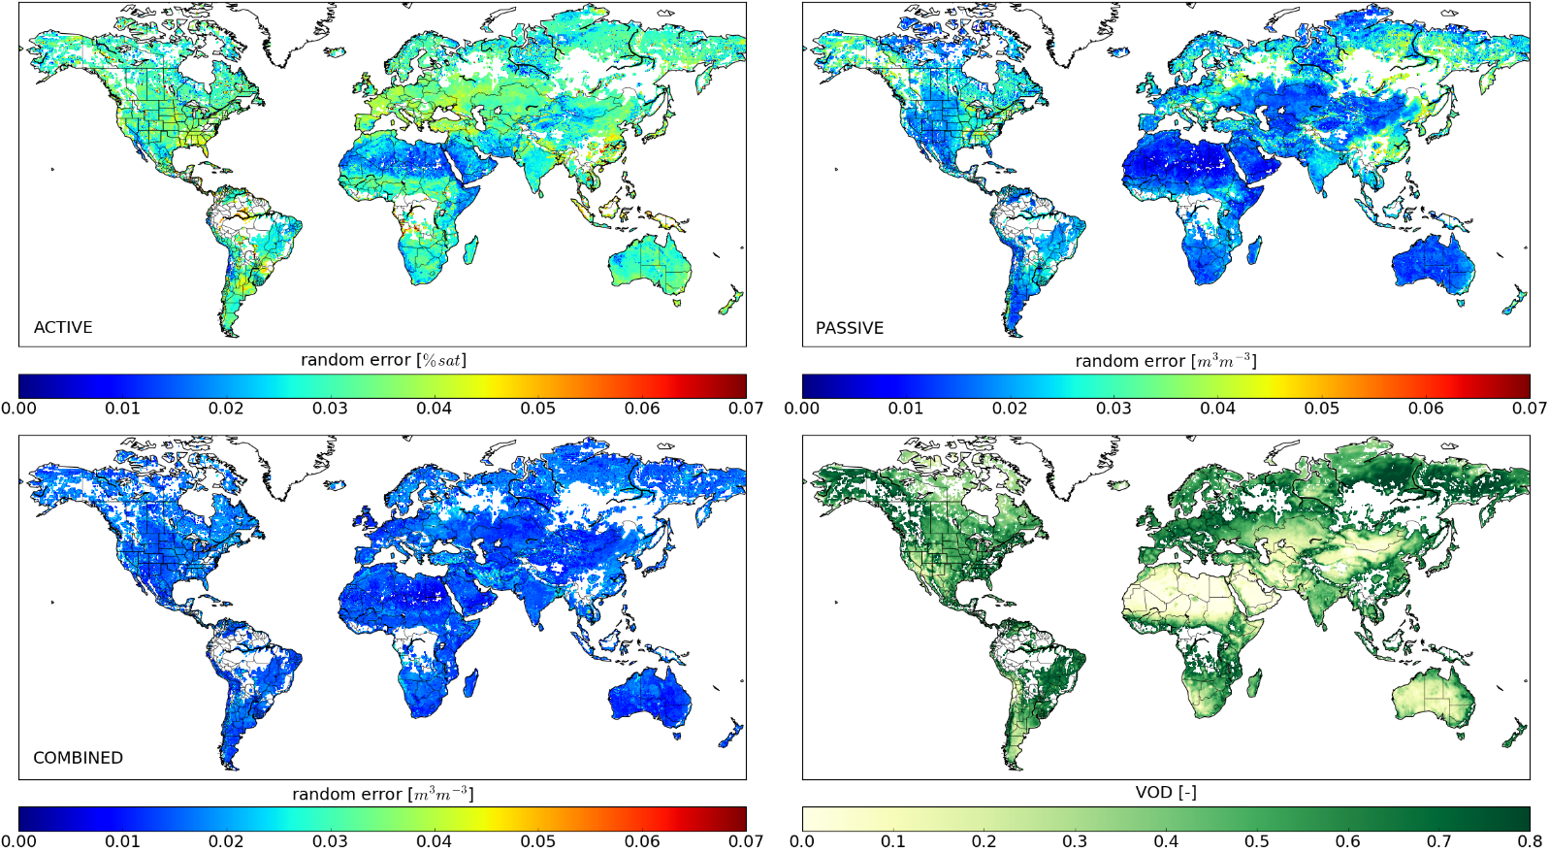
Some lessons learnt
Thoroughly test new releases
Assess impact of each individual data or algorithm change
Software should be as modular as possible
Continuing communication important: even expert users often don‘t read the manual
Average error variances of ACTIVE, PASSIVE, and COMBINED for the period July 2012-December 2015 [Dorigo et al., RSE, in rev.]

Slide 13
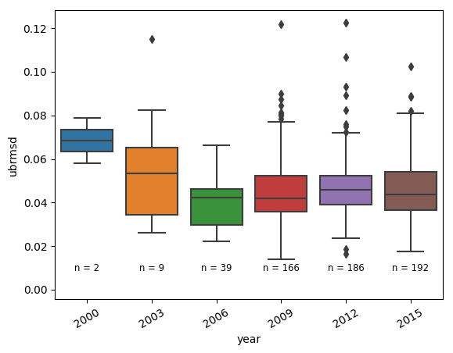
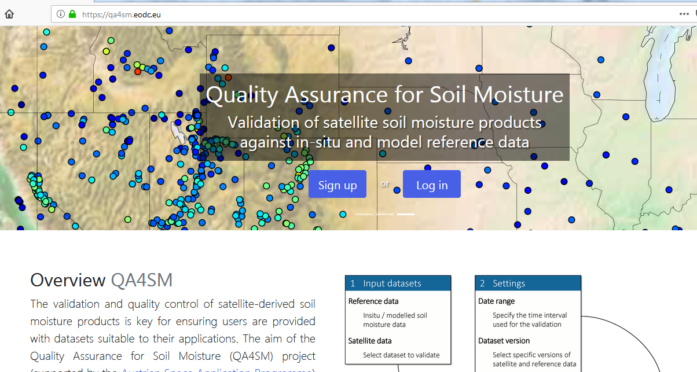
Major challenges for the future
Integrating new sensors
Becoming entirely model-independent
Improved uncertainty estimates
Improved consistency with other ECVs
  Snow, LST, lakes, biomass,
Focus on stability assessment
  Fiducial long-term reference data needed

Slide 14


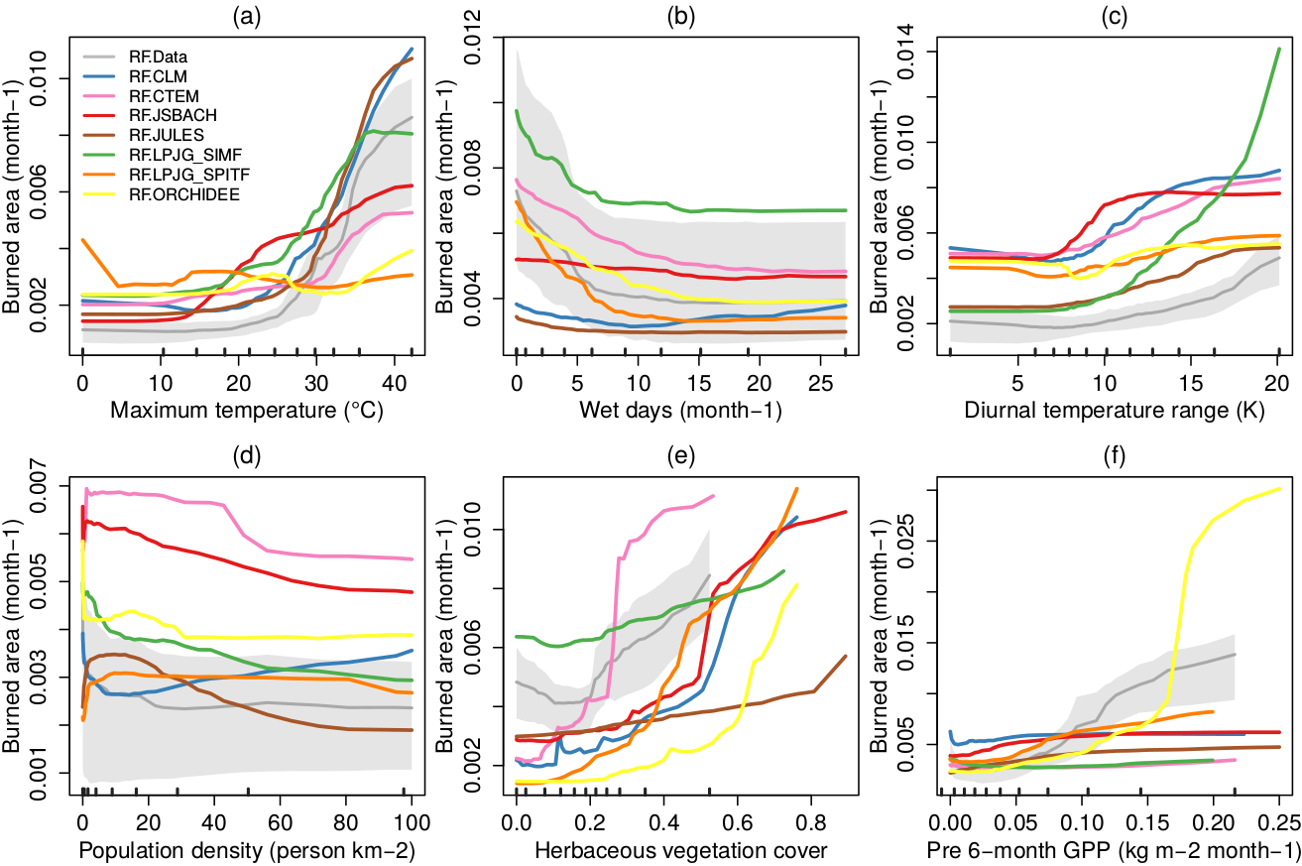


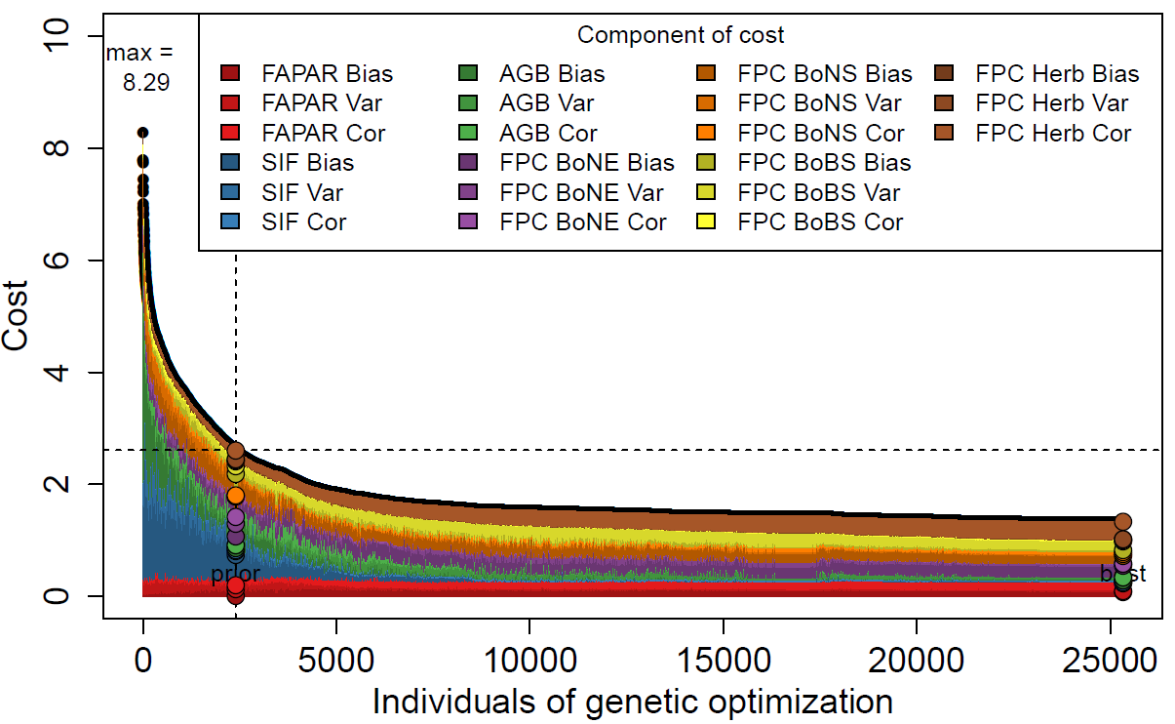
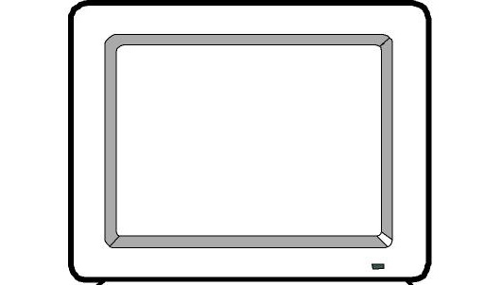
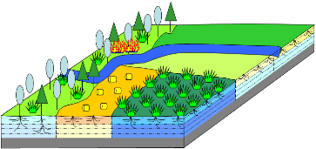


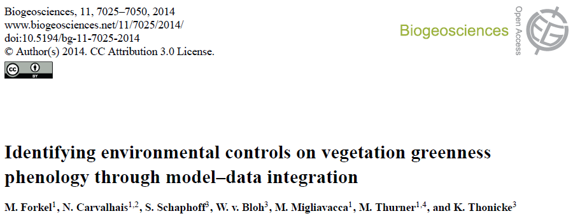
„Obs2Mods“ at TU Wien
Evaluating relationships in FireMIP models
Evaluation and optimization of the LPJmL dynamic global vegetation model
LPJmL: Integration of Fire_cci
Optimization against land cover_cci, biomass, SIF, FAPAR
Reduction in model error

