Slide 1
Use of satellite data for model evaluation
Alejandro Bodas-Salcedo
CMUG Integration Meeting, Exeter, 30 October 2018

Slide 2
Motivation: use of simulators

Slide 3
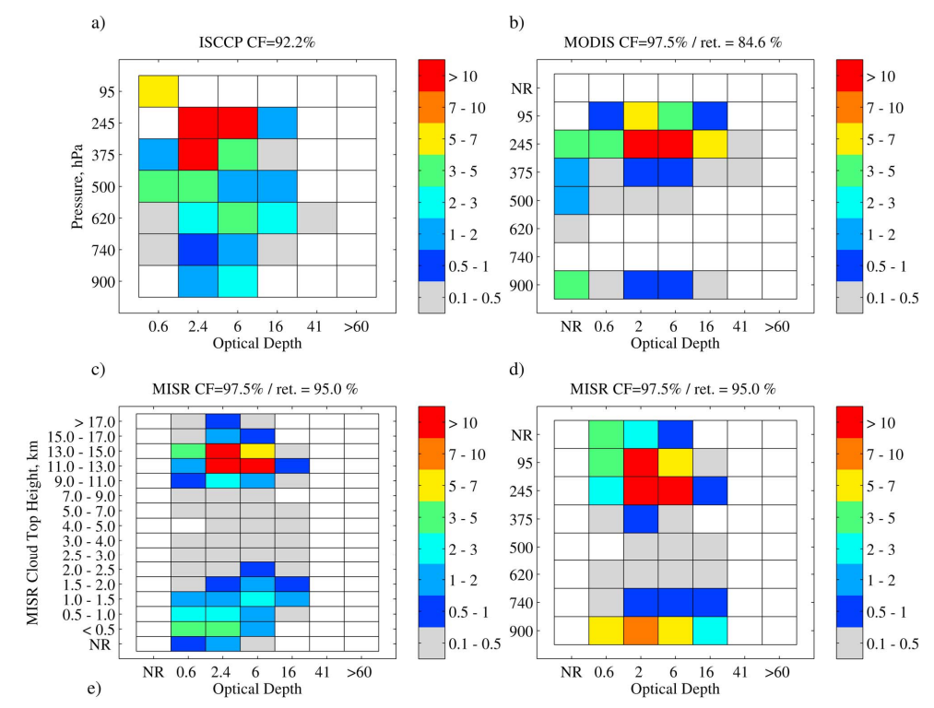
In the eye of the beholder
Multilayer scene [232ºE-237ºE, 9ºN-15ºN]
(Marchand et al., JGR, 2010. DOI: 10.1029/2009JD013422)

Slide 4
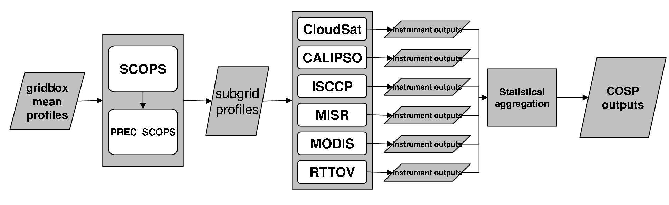
COSP
CFMIP Observation Simulator Package
User group: http://groups.google.com/group/cosp-user
Code: https://github.com/CFMIP/COSPv2.0
STEP 1
STEP 2
STEP 3
(COSP1: Bodas-Salcedo et al., BAMS, 2011)
(COSP2: Swales et al., GMD, 2018)

Slide 5
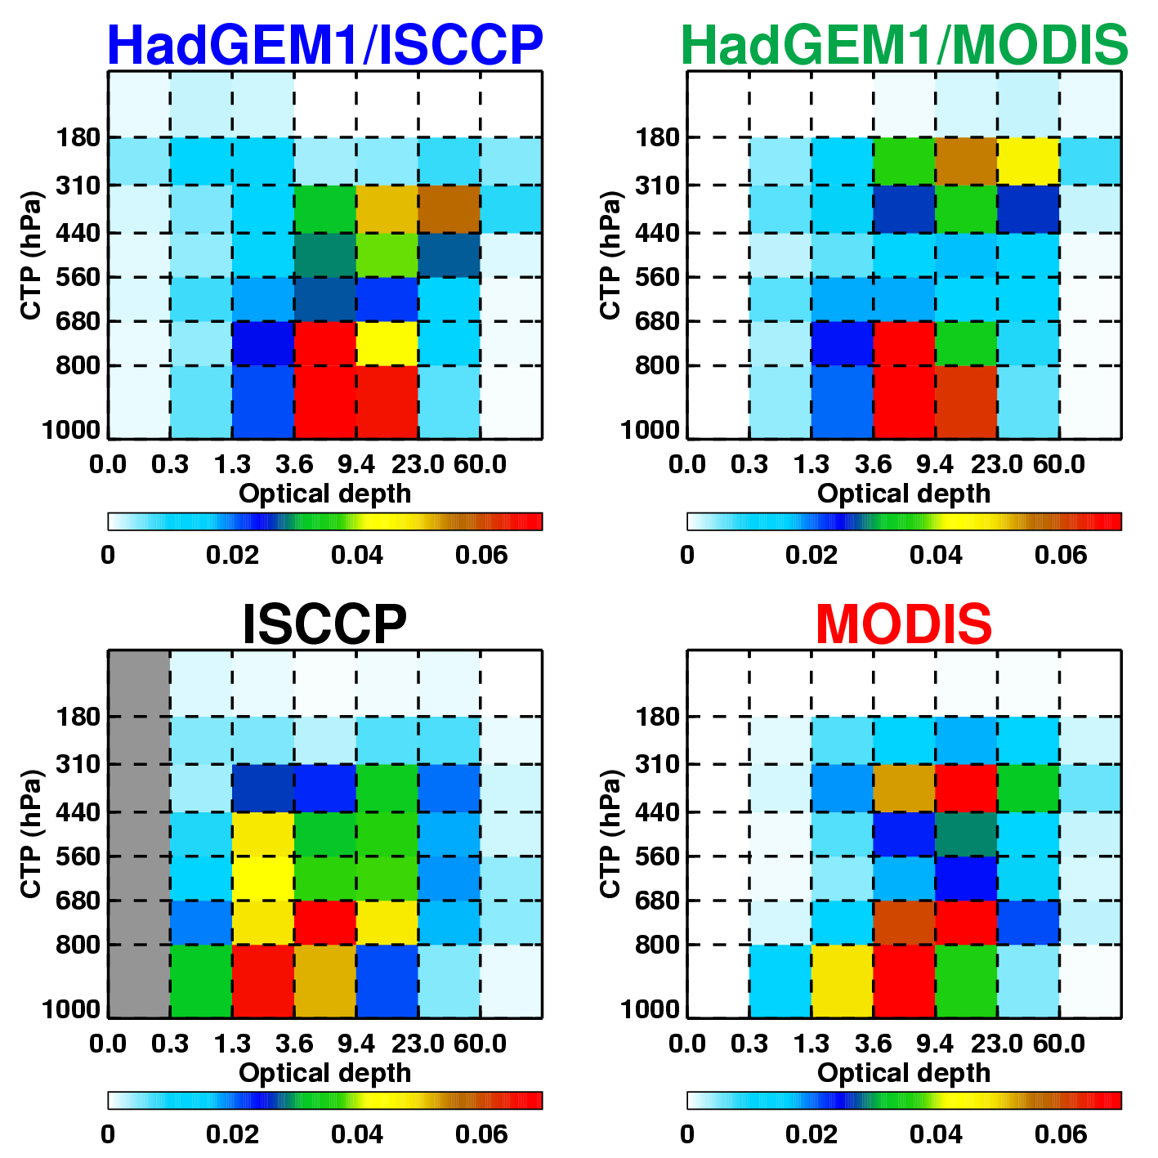
MODIS vs ISCCP
South Pacific [180ºE-255ºE, 60ºS-40ºS]
(Bodas-Salcedo et al., BAMS, 2011)
Notes:
ISCCP and MODIS CTP-τ histograms over a region in the South Pacific [180o E -255o E , 60o S -40o S ], only available for HadGEM1
ISCCP reports a large fraction of mid-level cloud. MODIS places most of this cloud in the high-level category due to the higher sensitivity of the CO2 slicing method. MODIS shows less low-level cloud, especially in the optically thin bins (τ<3.6).
MODIS filters out broken clouds, cloud edges, and heavy aerosol or sunglint situations. The cloud fraction reported by the MODIS cloud mask is very similar to the one reported by ISCCP in this region (0.83). MODIS retrievals reduces the fraction to 0.71. MODIS containing less optically thin cloud, as previously reported by Marchand et al. (2010).
MODIS reports the same amount of cloud as ISCCP with optical depths between 3.6 and 9.4, but the vertical distribution is very different. In addition to reporting more high-level cloud, it also reports more low-level cloud. This suggests that part of the cloud reported as mid-level in ISCCP is reported as low-level by MODIS. Perhaps systematic difference in the CTP estimates between ISCCP and MODIS for clouds with tops in the lower 3-4 km of the troposphere. If there are clouds with tops around 3 km, small differences in CTP retrievals may place clouds above or below the pressure level that separates low-level cloud from mid-level cloud (680 hPa). MISR CTH-τ histograms for the same region agree with MODIS.
The simulators capture some of the specific characteristics of the retrievals, but not all. The ISCCP simulator reports more mid-level cloud, as the cloud top pressure estimates of high-clouds put clouds at lower levels, consistent with the observations. The effect of broken cloud and the additional cloud screening applied by the MODIS retrievals is not represented in the simulators, so the distribution of optical depths from both simulators is nearly identical. This analysis illustrates again the synergy between different observations and how different simulators may reveal different aspects of the model simulations.

Slide 6
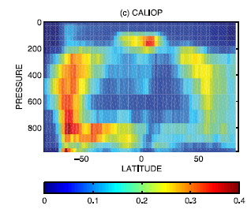
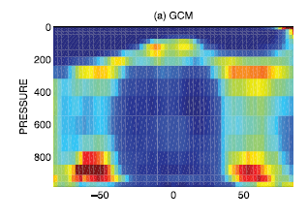
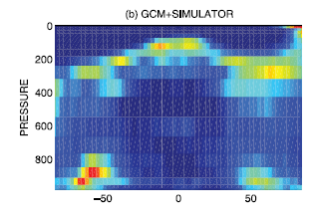
LMDZ4 v CALIOP/CALIPSO
(Chepfer et al., GRL, 35, 2008. DOI:10.1029/2008GL034207)
Notes:
Vertical distribution of the zonally averaged cloud fraction for JFM: (a) cloud fraction predicted by the GCM, (b) GCM cloud fraction diagnosed from the lidar simulator, and © cloud fraction derived from CALIOP/CALIPSO data.

Slide 7
Examples

Slide 8
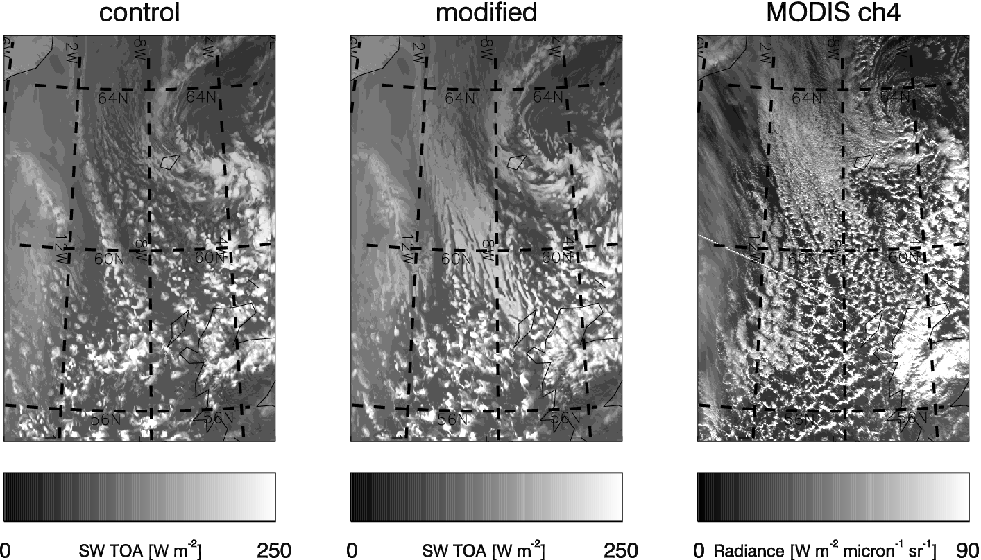
S. Ocean SW bias
UKV case study (31st Jan 2010)
(Bodas-Salcedo et al., J. Climate, 2012)

Slide 9
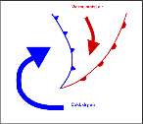
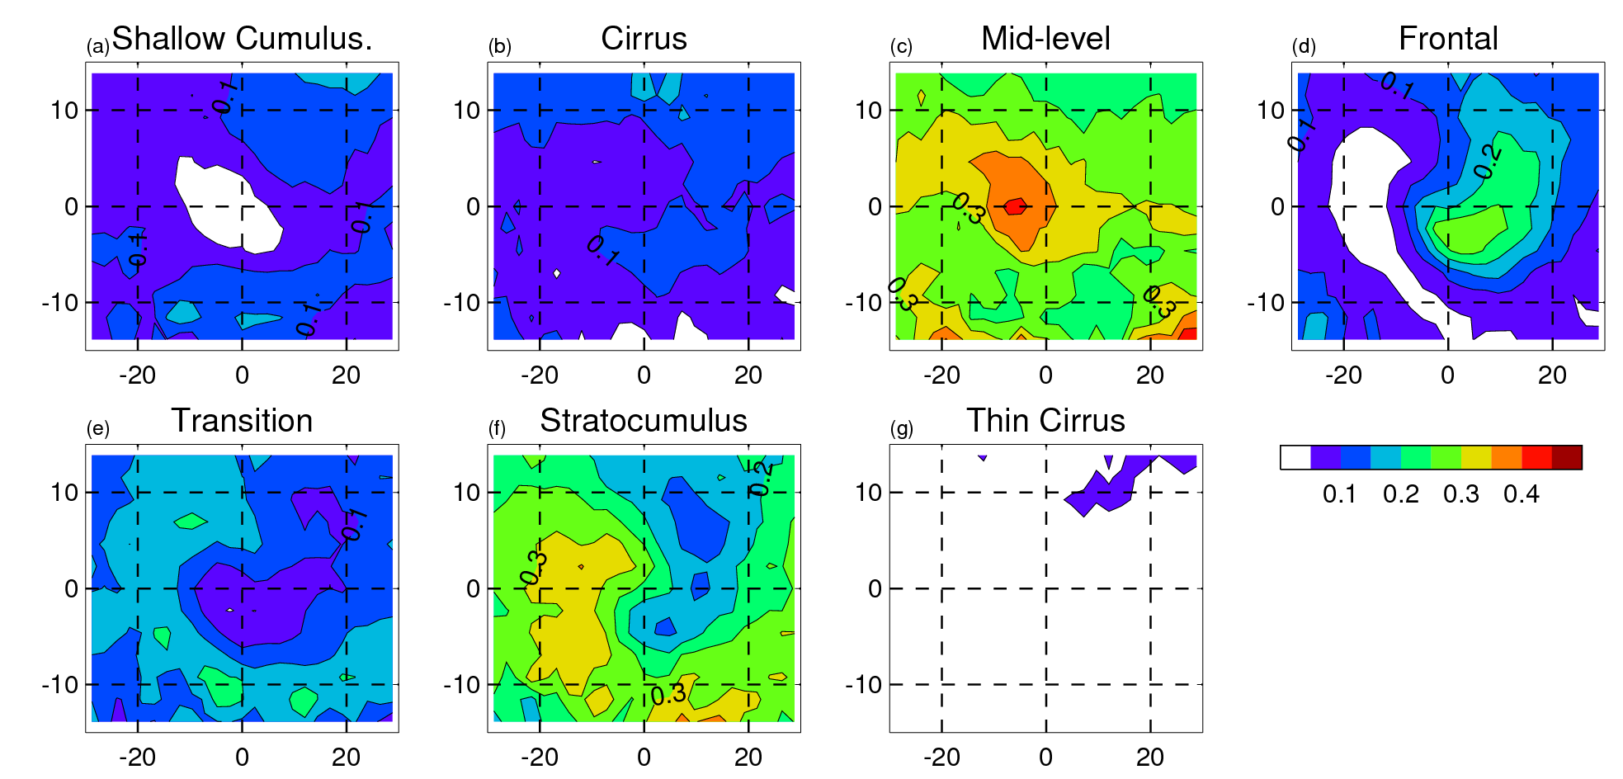
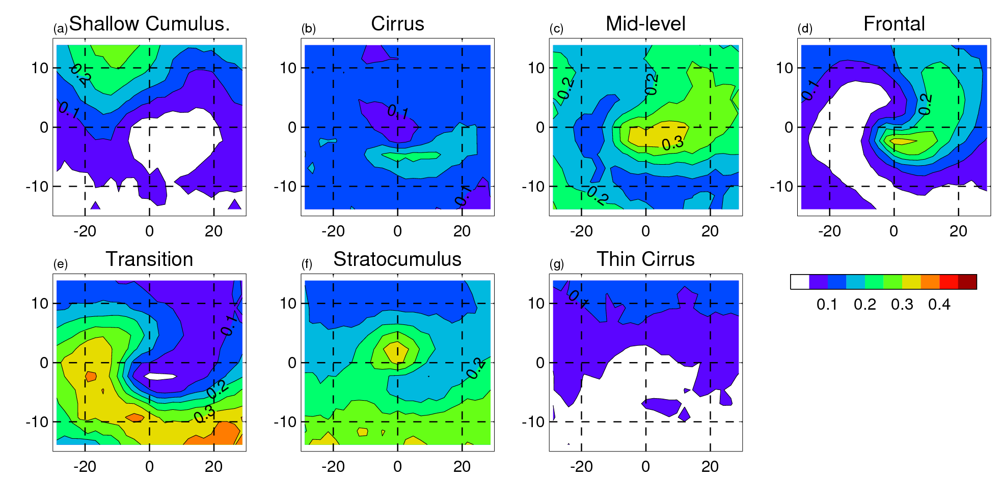
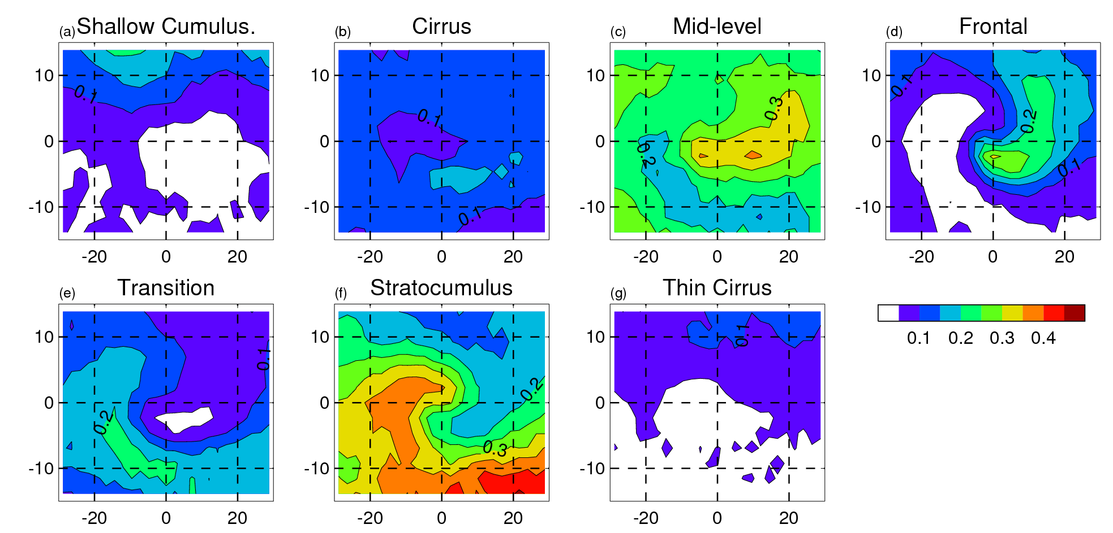
S. Ocean SW bias
ISCCP
GA3.0
BL changes
(Bodas-Salcedo et al., J. Climate, 2012)

Slide 10
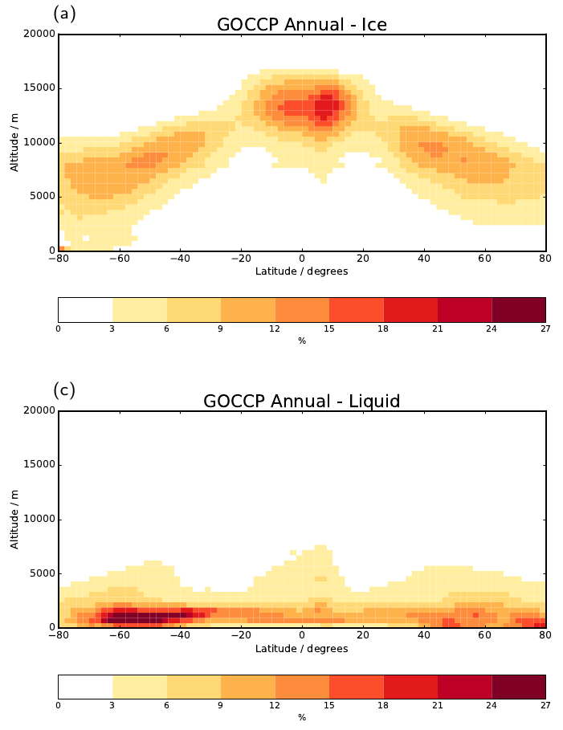
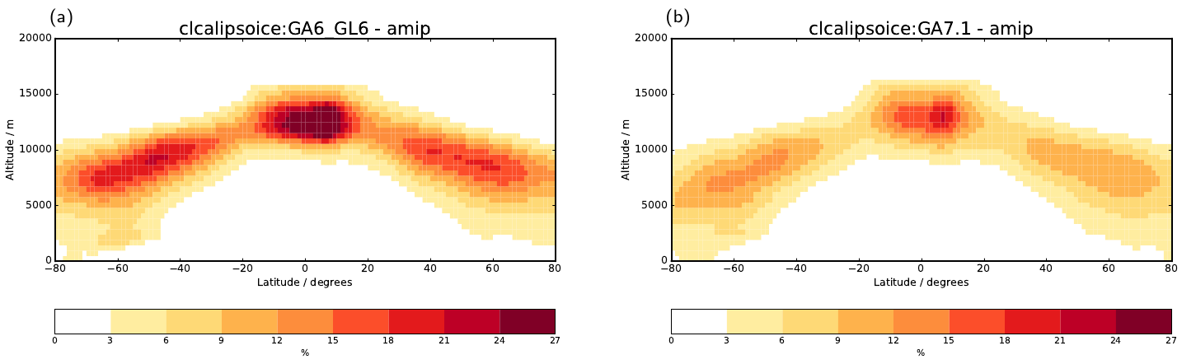
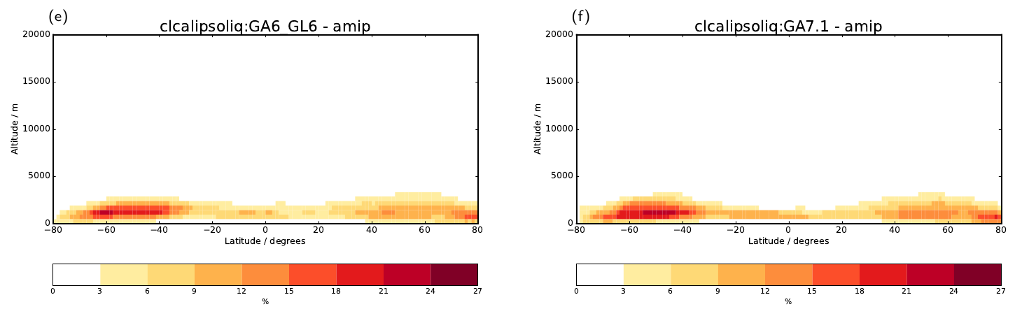
Cloud 3D structure and phase from CALIOP

Slide 11
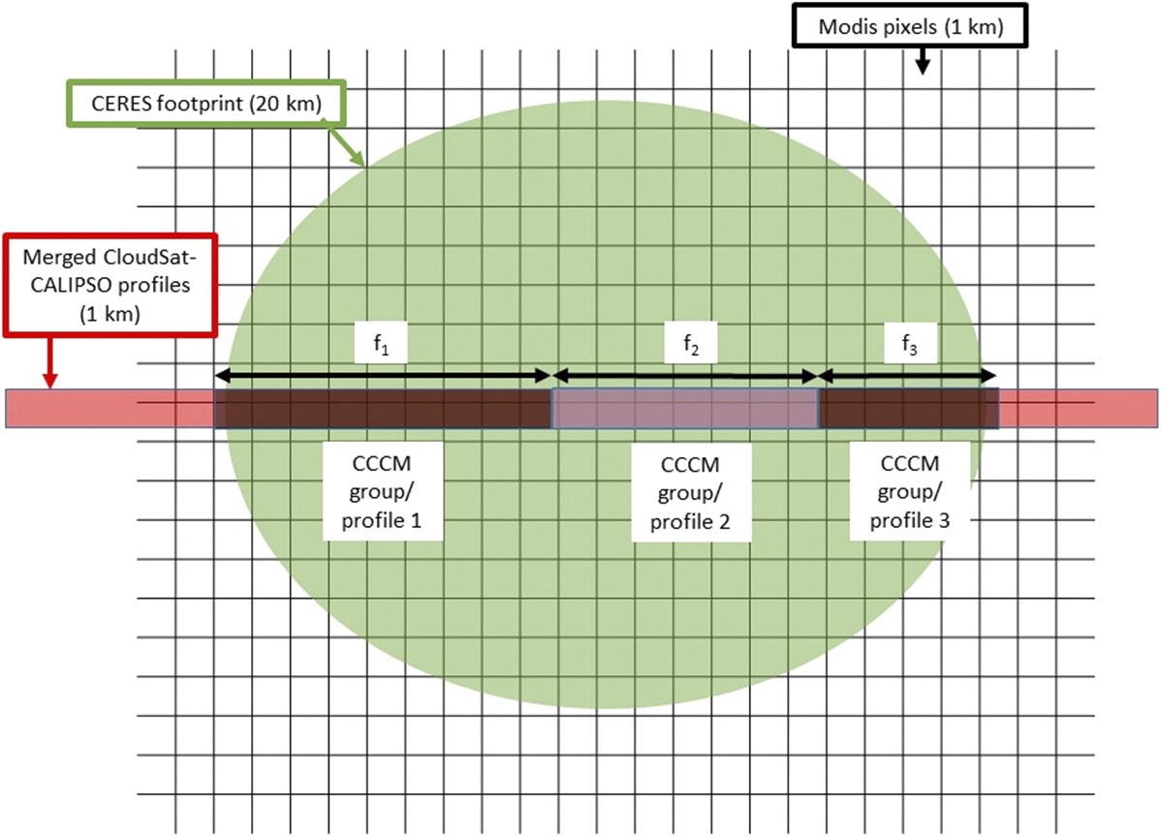
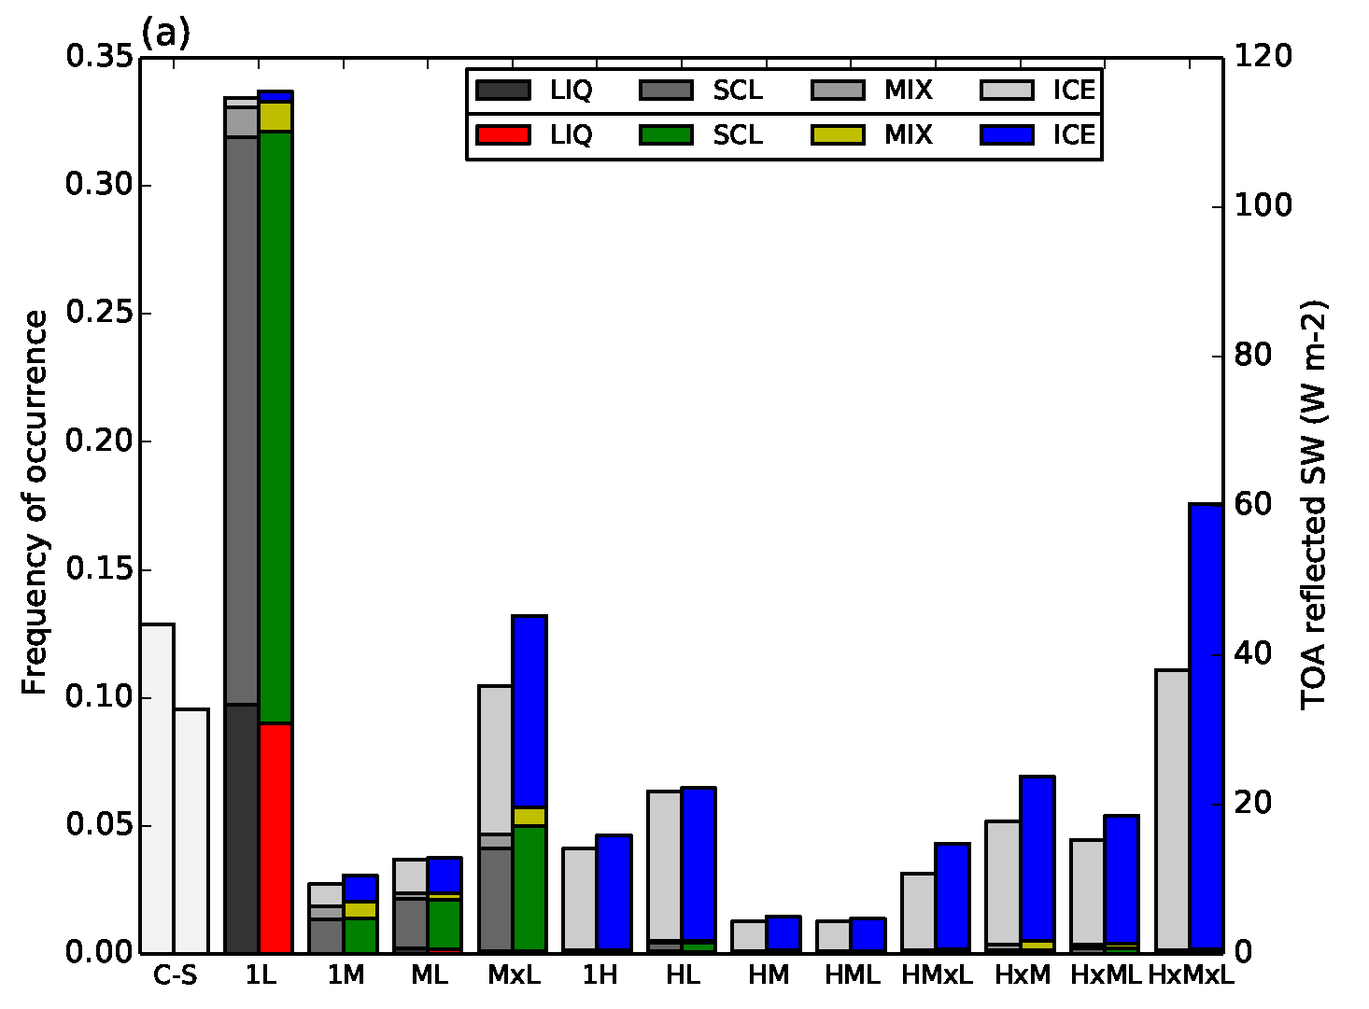
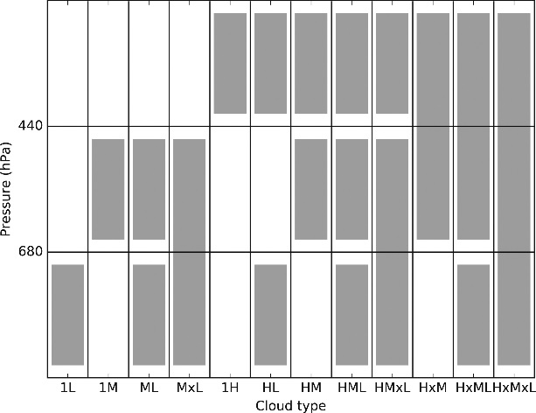
Multi-instrument products
(Bodas-Salcedo et al., J. Climate, 2016)
(Kato et al., J. Climate, 2011; Hill et al., J. Climate, 2018)

Slide 12
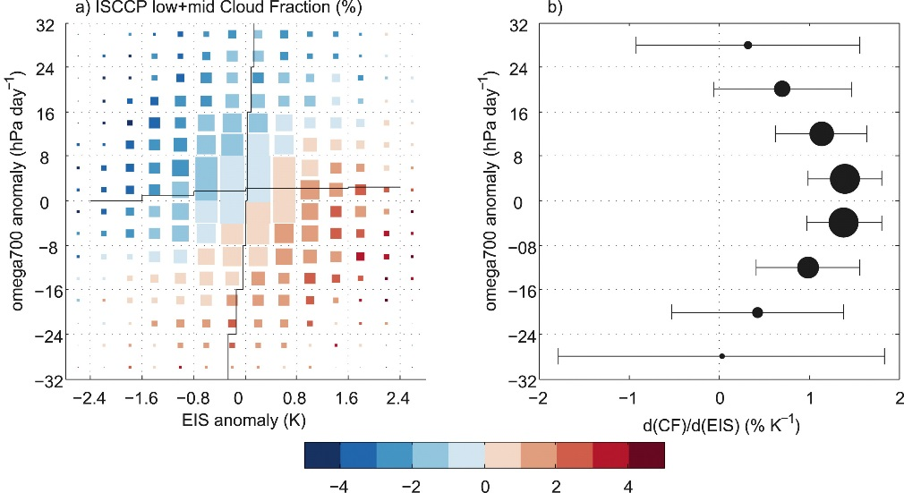
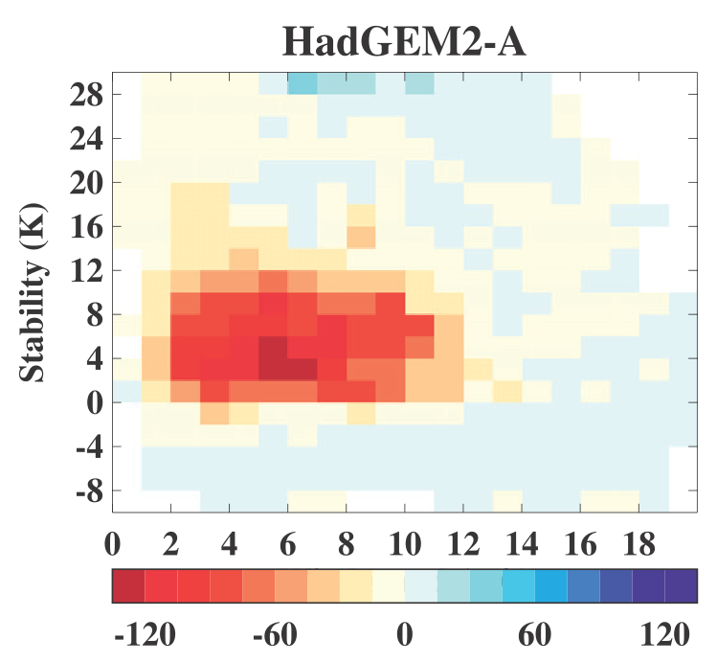
Cloud-controlling factors
(Myers and Norris, J. Climate, 2013)
(Williams et al., J. Climate, 2013)

Slide 13
Summary
Simulators are useful tools that help overcome inconsistencies when comparing models with observations.
Focus not only on univariate climatologies, but on multivariate relationships to constrain processes.
Need for co-located, consistent (resolution) measurements of radiation, clouds and environmental properties with enough time resolution.
Advances can be made through better combination of existing technologies and coordination of efforts.

